Slide 1

HTA in the Region
Reflections on the way forward
Dr. Ansgar Hebborn
F. Hoffmann-La Roche AG, Basel, Switzerland
Dubai, 17 September 2018

Slide 2
Moving from the «what» to the «how»
What I heard so far
Health care systems differ, the impact of health technology may differ BUT key principles about the successful implementation of HTA are certainly transferable between countries and regions.
HTA does inform decision makers, it cannot and should not take decisions by itself.
«HTA» is not just another word for cost-effectiveness assessments eg. «equity» considerations seem to matter a lot when establishing UHC.
HTA is about improving the value of the health care system, not just lowering costs.
HTA can only be sustainably implemented if its value is recognized by policy and decision makers.
Implementing HTA is not about selecting methodology, it is about process, governance, «planning and monitoring for relevance» and resourcing.
HTA activity has to be carefully prioritized given inevitably limited capacity.

Slide 3




Incentives to use HTA and «relevance»
Key to successful implementation
Mobilized self-interest to search for efficient and effective health technologies
Developing «relevant» HTA output/service
deep understanding of target audience and information needs
timely and «decision-relevant» outputs
stakeholder engagement and training
communication channels
incentives and disincentives
training
regulation and guidelines
DECISION-MAKER
HTA

Slide 4
“Relevant” HTA is necessarily context-specific
But there are transferable ingredients
LOCAL CONTEXT
Local clinical
practice
“Fair Access”
considerations
Local clinical
practice
“Fair Access”
considerations
Legal
constraints
HTA
Local health
care priorities
Affordability
Decision
Making
Other cultural
values and
preferences
Local burden
of disease and
unmet need
Local burden
of disease and
unmet need
Comparative
clinical efficacy/
effectiveness

Slide 5

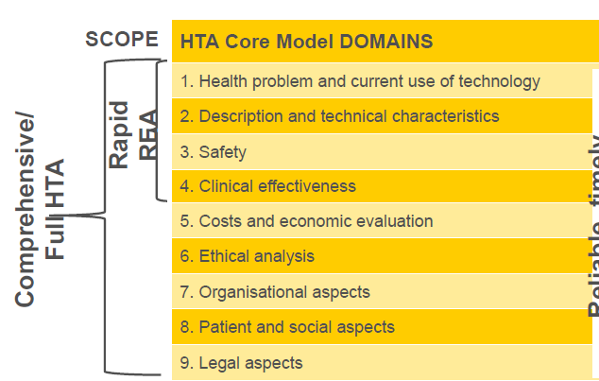
HTA collaboration in the EU
Joint clinical assessments (EUnetHTA)
transferable
https://www.eunethta.eu/15599-2/

Slide 6
Stakeholder involvement in HTA
Involving industry
Developing HTA policy and methodology
  Assurance of efficiency and quality of HTA
  Mobilizing substantial HTA experience in companies gathered over time in many jurisdictions
Providing expertise and experience on specific technologies
  Manufacturers inevitably produce the vast majority of evidence for a technology
  Manufacturers maintain an in-depth understanding of their products and available and emerging new evidence
  Plan and managing the entry of new technolgies and the reduction of related uncertainty
based on a balanced «conflict of interest» approach

Slide 7
HTA is a health technology in itself
Effective and efficient production are key
Given limited health care resources, resources devoted to HTA need to be constantly justified.
HTA needs to be «relevant» («effective»)
  a decision maker asks for the information that only HTA can deliver
  HTA is conducted based on a deep understanding of the decision context, provides information on «relevant» questions, objectives and decision criteria («perspective is key»)
  HTA methods are selected based on the question of the decision maker
  HTA is delivered in a timely manner
HTA needs to be conducted «efficiently»
  Focus on what enables the «critically appraisal» of health technology
  Transfer data/evidence from one setting to another where «relevant»
  Collaborative and planful HTA production
  Optimal involvement of stakeholders

Slide 8
HTA in the region
Towards a more concrete policy-level debate
Strategic direction is needed, not just more debate about HTA methodology.
HTA experts and experience may inform the policy debate, but strategic direction and sustainable resourcing can only come from policy makers.
There is considerable value of international and regional collaboration for the resource-efficient development of national HTA strategies.
And so it is good to see that with the MENA HPF
  regional policy-level debate exists prior to the finalization of national HTA strategies
  There is willingness to advance to concrete proposals for HTA implementation
→MENA HPF

Slide 9
Doing now what patients need next

