Slide 1
Evaluation and impact of HTA on private health insurance
Dr Ehab Abul-Magd
*President of the Afro-Asian congress for Medical Insurance & Managed Care
*Chairman of the Egyptian Health Care Management Society

Slide 2
Universal/Private Health Coverage support of health system objectives
Response to public needs
Response to limited resources
Health gain
Equity in health
Equity in finance
Responsiveness
Sustainability of health care financing
Efficiency of health care delivery
Financial protection of households
2

Slide 3
Definitions of different private insurance schemes
Duplicate PHI: PHI that offers coverage for health services already included under government health insurance, while also offering access to different providers (e.g. private hospitals) or levels of service (e.g. faster access to care). It does not exempt individuals from contributing to government health coverage programs.
Substitutive PHI: An alternative to statutory insurance and is available to sections of the population who may be excluded from public cover or who are free to opt out of the public system

Slide 4
Definitions of different private insurance schemes (cont.)
Supplementary insurance: Offers faster access to service, greater choice of health care provider or enhanced amenities
Complementary services: covers services excluded from the publicly financed benefit package
Complementary user charges: covers user charges for goods or services in the publicly financed benefits package

Slide 5
Private health insurance in UHC systems
Many Low and Middle Income Countries (LMICs) move toward the extension of Universal Health Coverage (UHC).
Due to the lack of resources it is difficult to sufficiently finance a comprehensive health care coverage.
The role of private health insurance has to be adjusted to the benefit package in the public health care system
Private health insurance (PHI) can have a new role, in the form of providing complementary (CompHI) and supplementary health insurance (SuppHI) in addition to the public health insurance scheme.
Source: Syreon Research Institute
Notes:
Many Low and Middle Income Countries (LMICs) move toward the extension of Universal Health Coverage (UHC).
Due to the lack of resources it is difficult to sufficiently finance a comprehensive health care coverage.
The role of private health insurance has to be adjusted to the benefit package in the public health care system
Private health insurance (PHI) can have a new role, in the form of providing complementary (CompHI) and supplementary health insurance (SuppHI) in addition to the public health insurance scheme.

Slide 6
Different Roles that PHI can play under umbrella of UHC
Private health insurance can support the implementation of universal health coverage through covering the areas which the benefit package of the public insurance is not fully functioning.
If the UHC does not cover 100% of the population, the PHI can extend the number of insured by offering primary private health insurance.
To extend the number and quality of services covered by the public health insurance, private health insurance can offer supplementary and complementary services.
To reduce cost sharing (the co-payment paid to receive a service), private health insurance can cover the co-payments for patients. This is called complementary (user charges)
Source: Syreon Research Institute

Slide 7
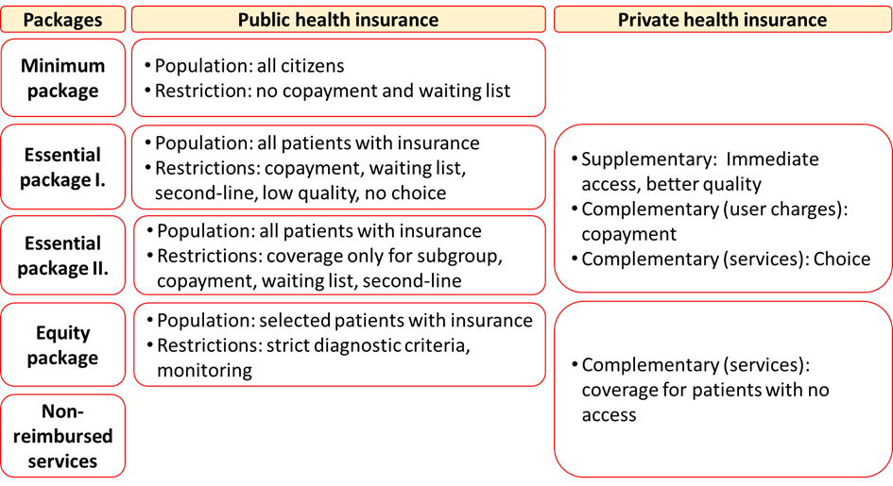
Potential role of supplementary and complementary private health insurance
Ref: Almasi T, Fasseeh AN, Elezbawy B, George M, Abouelmaged E, Arnaiz F, Abaza SA, Nagy B, Kaló Z.Role of supplementary and complementary private health insurance in selected countries. European ISPOR Conference, Barcelone. 2018.

Slide 8
HTA as a tool
HTA can help policy makers to:
  effectively prioritise health interventions and services
  improve their quality
  make consistent decisions
  reduce inappropriate variation
  signal ‘value’ to industry
  inform the selection of indicators to assess performance and incentivise providers, especially in the context of capitation
Notes:
Final point: indicators not always financial incentives alone.

Slide 9
HTA is primarily used to support policy decision in public health insurance
In many countries pricing and reimbursement decisions are based on HTA recommendations
If the basic benefit package is estabslihed, it creates an opportinuty for private health insurance to offer complementary and supplementary services.

Slide 10
HTA can also support decision-making in private health insurance
Increased evidence base and transparency of decisions in private health insurance
Improves sustainability of private health insurance
Tool for price negotiation by private health insurers
Potential for collaboration between private (and public) health insurers to align basic benefit package with complementary and supplementary services

Slide 11
Thank You

