Slide 1

Photo credit: Rui Pires

Slide 2
How to use HTA?
Application of HTA findings
Héctor E. Castro MD, PhD
Senior Technical Director

Slide 3
OUTLINE
The need for priority setting
The role of HTA
HTA in action in a LMIC
Conclusions

Slide 4
ABOUT MSH
Management Sciences for Health (MSH) builds strong health systems that deliver everything it take to prevent disease, treat illness, and empower people to lead healthier lives. For more than 45 years in over 150 countries, MSH has worked shoulder to shoulder with our partners to build stronger health systems for better outcomes and performance. Our work will not be done until all people in need have equitable access to health care.
^{MSH in 2016}
72 Countries, 41 Offices. Total Staff: 1,849. Staff Outside US: 1,477
93% of MSH personnel in countries or regional offices are from the country or region where they work.
Notes:
When adding slides to your presentation, please use our branded fonts if possible: Garamond or Gill Sans. If these fonts are problematic, please use Calibri or Arial.

Slide 5

WHY DO WE NEED TO SET PRIORITIES?
“All health systems face the challenge of managing finite resources to address unlimited demand for services” Glassman et al, 2012
“Things which matter most must never be at the mercy of things which matter least.” Goethe

Slide 6
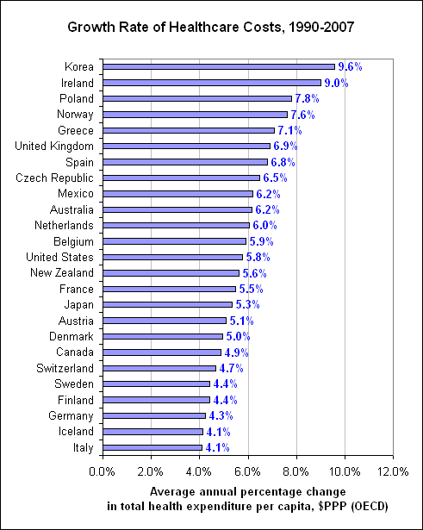
Priority setting in health and health care
“…All health care systems face problems of justice and efficiency related to setting priorities for allocating a limited pool of resources to a population”.
THE COST & CONSTRAINTS ARGUMENT
(Sabik and Lie, 2008)
There are unlimited needs and limited resources, and health and healthcare related costs increase each year

Slide 7

“Clinical care given to patients frequently departs from best practice; the fast adoption of new technologies without certainty about its clinical and cost-effectiveness, but also the slow adoption of those proven to be effective and “good value for money”, leads to inefficiency”
Decision-making in health and health care
QUALITY & EFFICIENCY ARGUMENT
Rawlins (1999)

Slide 8
“The lack of coherence between limitless promise and limited resources leads to implicit and covert rationing through waiting lines, low quality, inequities, and other mechanisms…in many LMICs rationing still occurs as an ad hoc, haphazard series of non-transparent choices that reflect the competing interests of governments, donors and other stakeholders”
Priority setting in health and health care
However…
(Glassman et al, 2012)

Slide 9
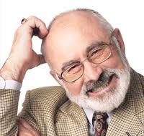
“Decision-making in health care is a complex process taking (should) place along a continuum that moves from evidence generation to deliberation and communication of the decision made” (Goetghebeur et al, 2008)
Decision-making in health and health care

Slide 10
The notion of explicit priority setting as process or a sub- system
STEWARDSHIP OF PRIORITY SETTING POLICY
Marketing authorization
Topic selection Identify and select candidates for evaluation
Technical assessment using robust methods and evidence summary
Budget impact analysis
Appraisal Deliberation process and recommendations
Decision Making
Monitoring and Evaluation
INFORMATION SYSTEM
Source: Adapted from IDB, Colombia priority setting of public expenditure project, 2011 Adapted H, Castro 2013.

Slide 11
Decision-making in health and health care
-different levels-
Macro - Government (MoH, regulatory agencies) or payers (SHI,NHS):
  Comparative analysis of safety, efficacy, effectiveness and cost-effectiveness, value based pricing, infectious diseases modelling, public policies.
Meso - Health insurers, Hospitals and other providers:
  CPGs, protocols, health care pathways, quality standards and outcomes, self- regulation of professionals.
Micro - Health care professionals, carers and patients:
  Safety, efficacy, effectiveness, CPGs, self- care.

Slide 12
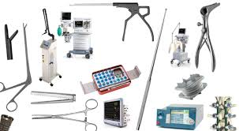


What is Health Technology Assessment– HTA ?
Health technology assessment is the systematic evaluation of properties, effects, and/or impacts of health care technology.
It may address the direct and indirect consequences of health care technologies.
Its main purpose is to inform technology-related policy making in health care.
HTA contributes to answering questions from decision makers in areas and organizations related to health policy and/or practice.
INAHTA definition

Slide 13
The role of some HTA agencies
  Country-specific HTA organizations and processes vary according to setting,
  Key procedural principles (transparency, robust methods for combining costs and benefits, characterization of uncertainty and active engagement with stakeholders)
  (Drummond et al, 2008 and Chalkidou et al, 2009)
Advisory HTA agencies
AT AU BE CH DE NL NO Eng, Sco, IRL, Col
CA
FR
Regulatory HTA agencies
FI NZ
SE
Physicians
Health economists
Pharmacists, clinical pharmacologists
Epidemiologists
Government/insurance fund representatives
Consumers and public (AU, SE, Eng)
Industry (Eng)

Slide 14
Common motivators for the establishment of HTA
3 main motives:
  Support decision-making
  Promote allocation efficiency
  Strengthen credibility/legitimacy/ accountability
HTA initiation:
  Top-down: political interest
  Bottom-up: academic/ research interest
  Converging
Rajan et al. 2011

Slide 15
“Drivers” for HTA establishment
The concept of “drivers” for the future development and use of HTA in Colombia
Source Castro HE, 2013. Assessing the feasibility to conduct and use HTA in Colombia- WiP .

Slide 16
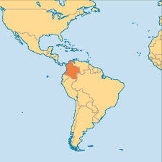


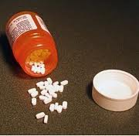
HTA in action in a LMIC
1993 HSR (Law 100), statutory health insurance (SHI)
At first very explicit, inequitable and outdated list of benefits for C & S regimes
THE 6.5- 7.4% GDP
BP challenged by patients with exceptional requests and judiciary claims (tutelas).
Every 5 minutes there is a tutela request (>120 K per annum)
BP forced to cover (prescribed) services not initially budgeted for
HTA agency (IETS) was created in 2012
HS covers nearly 98% of the country´s population and BPs (POS) is being more systematically updated
Health system´s financial crisis (2009 2 COL$ 2B, 2015 COL $5B… 2017 COL$7B…2018 COL$10?)
50 Million inhabitants. UMIC- GDP pc (PPP) USD $15,055 (IMF, 2018)

Slide 17
Priority setting as process or a sub- system
Marketing authorization
Topic selection Identify and select candidates for evaluation
Technical assessment using robust methods and evidence summary
Budget impact analysis
Appraisal Deliberation process and recommendations
Decision Making
Monitoring and Evaluation
INVIMA
MoHSP
IETS
MoHSP
Colombia
DMB
MHRA EMA
NICE
England
BfArM EMA
IQWiG
G-BA
Germany

Slide 18
HTA to inform 2 D or 3 D coverage?
Height: what proportion of costs are covered?
Include services
Copayments
Extend base
Public spending
Depth: what benefits are covered?
Breadth: who is covered?
Source: The World Health Report (OMS, 2008), modified by HE, Castro 2014

Slide 19




HTA requires close involvement of all stakeholders
IETS became an insider within the decision-making process led by the MoHSP
IETS liaises with different stakeholders
Pilot to set up a priority setting committee
Meeting with representatives form professional bodies
PPP
PPP
Meeting with patients, people´s advocates, and civil society
Talks and meetings with the pharmaceutical and devices producers
PPP
PPP

Slide 20
Final considerations
Whenever there is need to allocate and prioritize the use of limited resources, better to make it explicitly and looking at the best available evidence.
Explicit priority-setting needs to make best use of resources to maximize health benefits, should be ethical as well–fair and transparent.
Priority-setting as a whole is a process that moves from evidence generation to deliberation and communication of the decision made, HTA is only part of this process
Different countries around the world have institutionalized the use of HTA to improve resource-allocation decision-making. LMICs are increasingly looking at HTA as a policy solution.
The case of IETS in Colombia provides an example of the challenges and considerations that should be borne in mind for the successful implementation of HTA in a resource constrained setting.

Slide 21
Thank you!
شكرا

