Slide 1
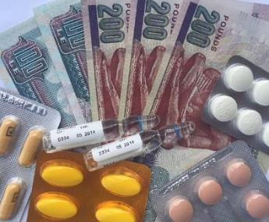
Financial Toxicity
“A Worrisome Challenge”
Second Regional Health Technology Assessment Policy Forum
17 – 18 September 2018, Dubai
Mohsen George, MD
Vice President, Health Insurance Organization
First Undersecretary MOHP - Egypt

Slide 2
Cancer Treatment is Evolving very Rapidly
Molecularly Targeted Treatment
Combination
Chemo-radiation
Combination
Immuno-therapy
Single agent
Chemotherapy
Surgery
1800s
1900s
1940s
1970s
1980s
1990s
2000s
2015
Current
Radiation
Combination
Chemotherapy
Introduction of Oral
Chemotherapy
Immuno-therapy

Slide 3
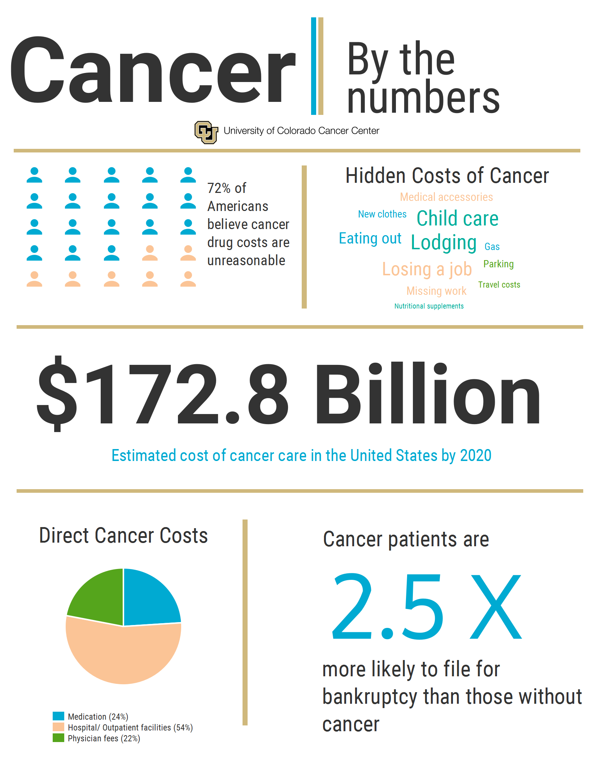

Slide 5
Cancer Expenses are Rising due to:
Aging Population (more people with cancer requiring therapies – growing older is a risk factor)
Improved access to treatment (available – geographical - affordable - acceptable – information)
Innovations (development of higher efficacy less toxic treatment & optimized supportive care – but more expensive)
Overutilization (especially interventions have minimal benefit or used contrary to the evidence base – Marketing efforts by companies - Moral hazards)

Slide 6

Hidden Costs of Cancer
Medical Accessories
Missing work
Losing a job
Nutritional supplements
Child & home care
Eating out
Lodging
Travel costs
Fuel costs
Parking
New clothes (losing weight), etc.……

Slide 7
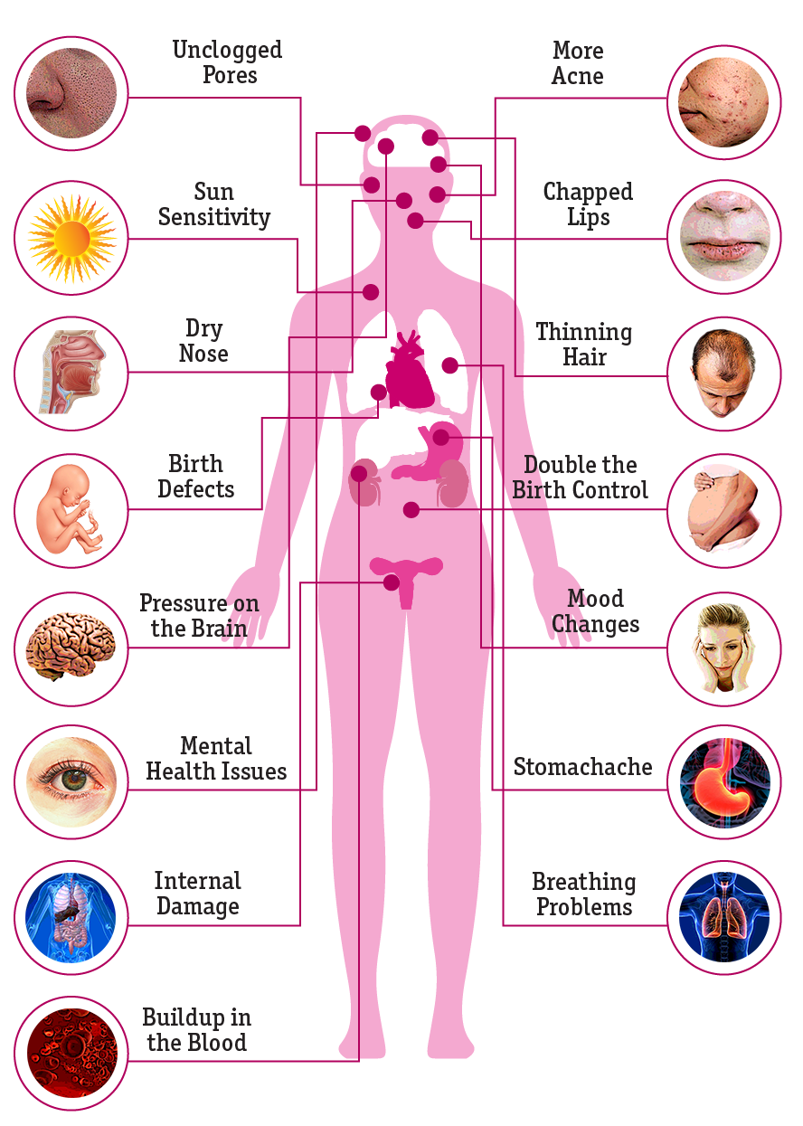
Side Effects of Cancer Treatment
The Side Effects of Cancer Treatment are many & well documented in the medical literature.
As treatment become more complex and expensive, another toxic reaction has to be dealt with: “Financial Toxicity”
“A Worrisome Side Effect”

Slide 8
What is Financial Toxicity
The term ‘financial toxicity’ is broadly used to describe the distress or hardship arising from the financial burden of cancer treatment

Slide 9
What is Financial Toxicity
Financial toxicity is, in the world of cancer, a new term. (a new name for a growing problem)
First hinted at in 2011 by researchers from Fred Hutchinson Cancer Research Center in USA, & coined by Amy Abernethy, MD from the Duke Cancer Institute USA in 2013
What a cancer diagnosis can mean to patients financially.

Slide 10
What is Financial Toxicity
Describes how Out-of-Pocket spending can cause financial problems for a Cancer patient (whole costs or cost sharing payments).
OOPs are what patient directly pays to provider at time of service.
OOPs include the following: copayments – coinsurance – deductibles – ceiling – life time limit.

Slide 11
What is Financial Toxicity
Cancer diagnosis could be considered a risk factor for personal bankruptcy.
Cancer survivors may have financial problems many years after they are diagnosed.
A new adverse event in cancer treatment.

Slide 12
Cancer Diagnosis & Bankruptcy Rate
Bankruptcy rates were almost twice as high among cancer patients one year after their diagnosis compared to the general population.
The median time to bankruptcy was just two and a half years after diagnosis.
Bankruptcy rates increased 4-fold within 5 years of diagnosis.
Facing significant financial stress, owing to out-of-pocket costs & income loss associated with their treatment

Slide 13
The Impact of Financial Toxicity
OOPs can be catastrophic to patients, both with regard to their outcomes as well as their financial situations. (catastrophic health expenditure – impoverishment health spending)
Overwhelmed by cancer treatment costs, patients resort to many strategies that have a negative impact on their well being
Patient must make many difficult decisions that can have a negative effect on their treatment and outcome

Slide 14
The Impact of Financial Toxicity
Non-adherence with medications & opting out expensive treatment.
Skipping appointments.
Need to cut back on basics like food, clothes and shelter, which can impact their diet and negatively impact their health
Using up retirement saving

Slide 15
Factors Affecting the Level of Financial Toxicity
Type of Cancer, stage, comorbidities & treatment options (costs related to cancer).
Whether patients make the most money for their household.
How much money other people in their household make.
Their assets (valuable things owned, such as money, investments, real estate, and vehicles).

Slide 16
Factors Affecting the Level of Financial Toxicity
How much debt patients had before they were diagnosed with cancer.
How the cancer and its treatment affect ability to work.
Whether patients have health and disability insurance and what they cover.

Slide 17
How to measure the Level of Financial Toxicity?
Comprehensive Score of Financial Toxicity (COST) (0 – 44)
Incharge Financial Distress / Financial Well-being (IFDFW) Scale (1 – 10)

Slide 18
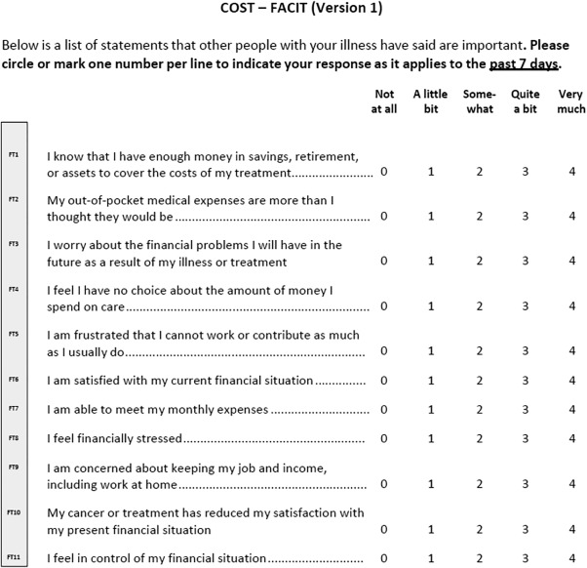
How to measure the Level of Financial Toxicity?
Comprehensive Score of Financial Toxicity (COST)
(0 - 44)

Slide 19
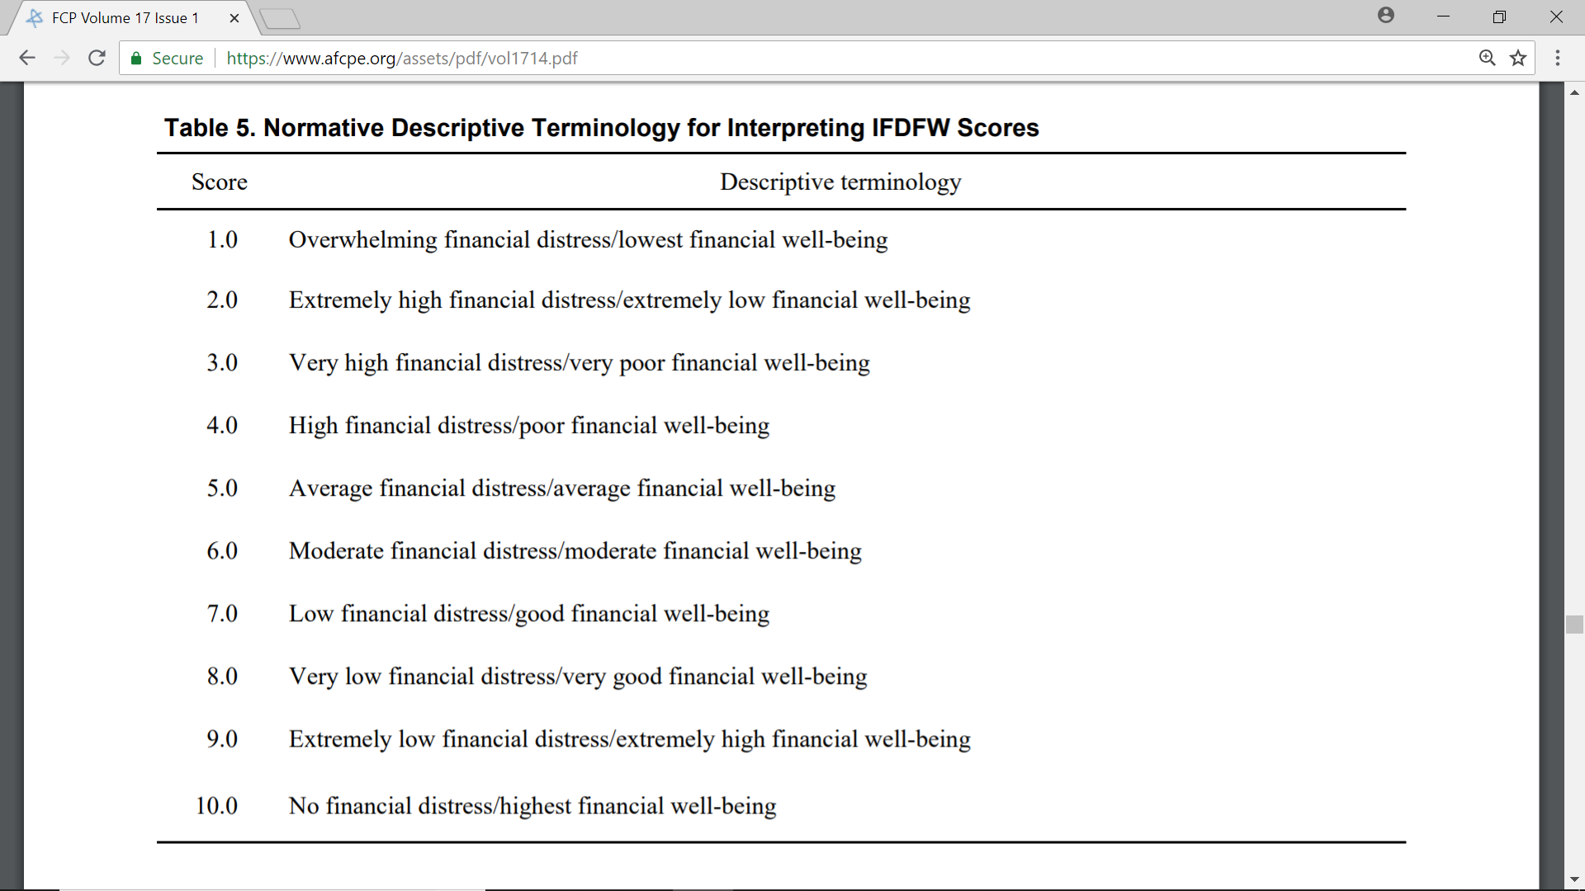
How to measure the Level of Financial Toxicity?
Incharge Financial Distress / Financial Well-being Scale
(IFDFW scale)
(1 - 10)

Slide 20

Being diagnosed with Cancer!
Emotional Stress
Financial Stress
(Financial Toxicity)
Mental Stress
Physical Stress
Notes:
Mental health refers to your ability to process information. Emotional health, on the other hand, refers to your ability to express feelings which are based upon the information you have processed
While being diagnosed with cancer alone can put a person under tremendous amounts of mental & emotional stress, the additional burden of the outrageously expensive medical care only adds to the strain.
The dramatic rise in the cost of cancer treatments has now given rise to what is being called Financial Toxicity.

Slide 21

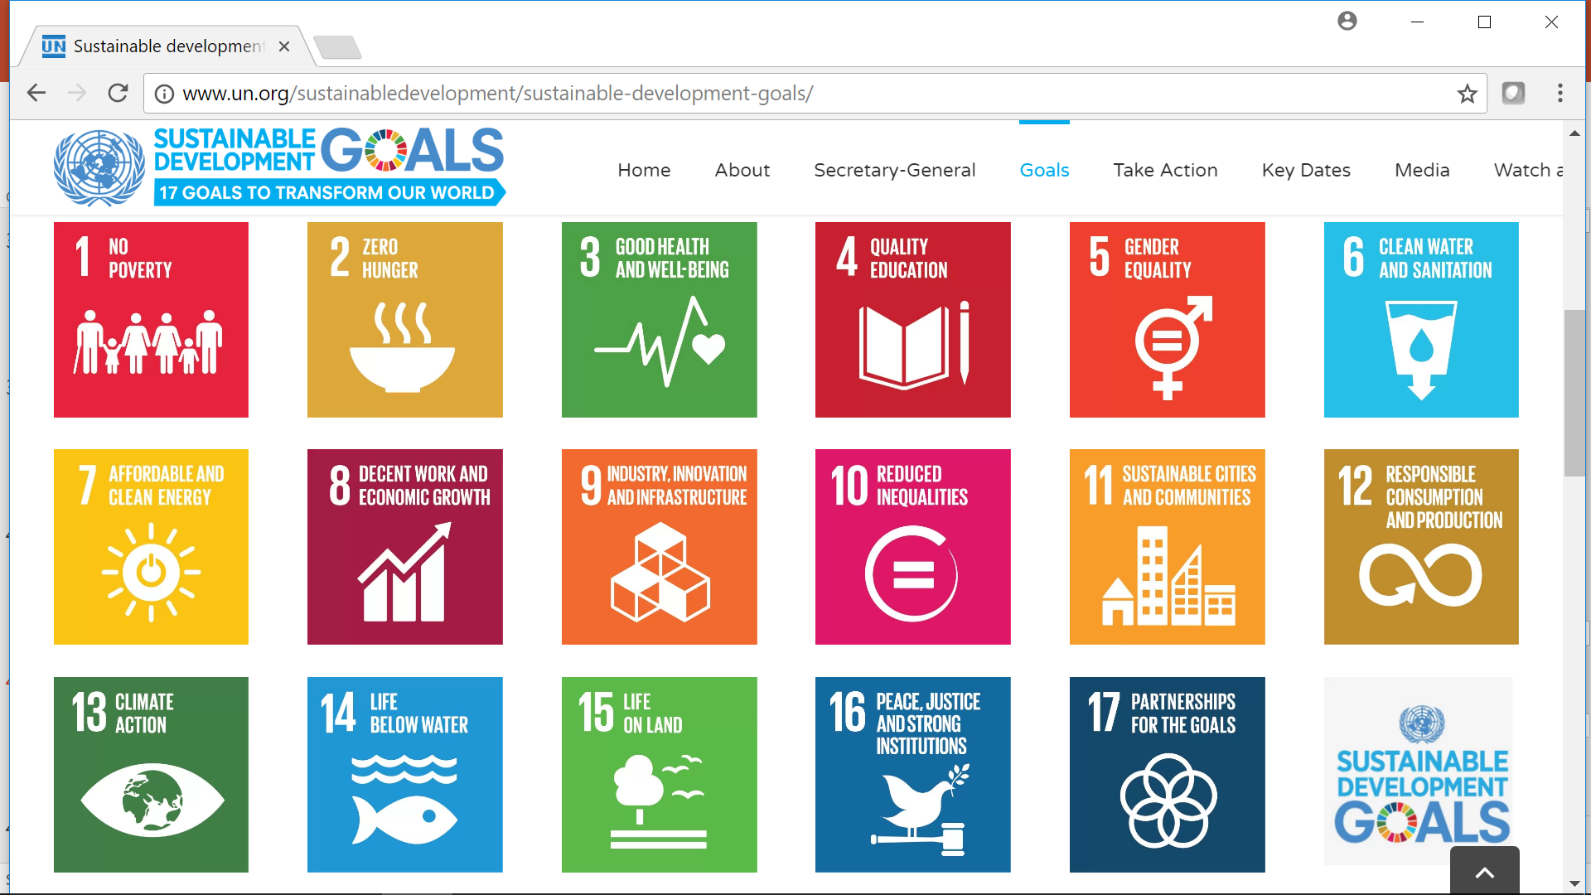
Goal 3: Ensure healthy lives and promote well-being for all at all ages
Target 3.8: Achieve UHC
Think of UHC as a Direction & not a Destination

Slide 22
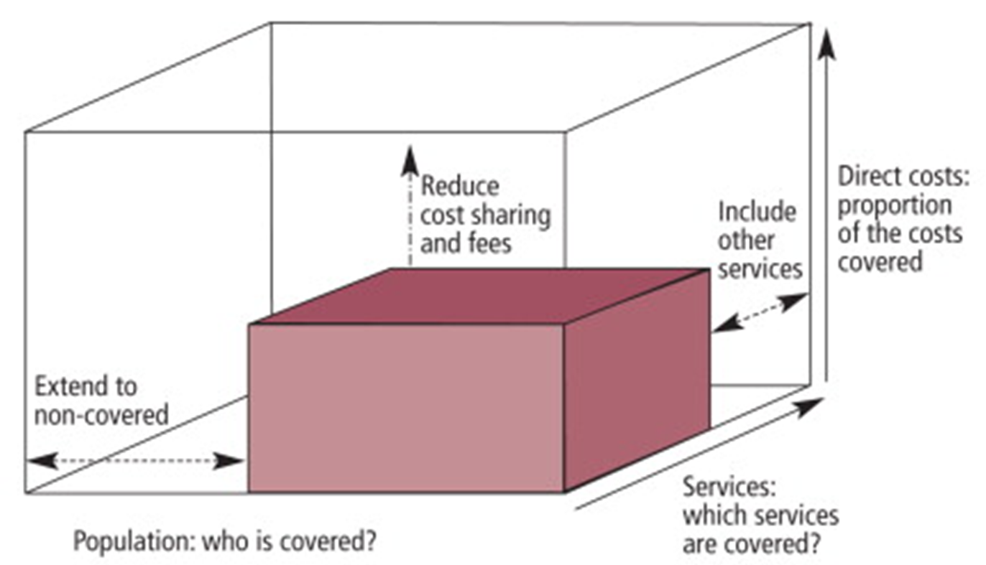
Dimensions of UHC
(UHC Cube)
Three dimensions to consider when moving towards UHC
Source: WHO

Slide 23
UHC Goals
Health Financing Within the Overall Health System
Intermediate UHC Objectives
Final UHC Goals
CREATING RESOURCES
Revenue Raising
Equity in Resource Distribution
Utilization Relative to Need
Pooling
Financial Protection & Equity in Finance
STEWRDSHIP / GOVERNANCE / OVERSIGHT
Efficiency
Benefits
Purchasing
Transparency & Accountability
Quality
SERVICE DELIVERY
Source: WHO

Slide 24
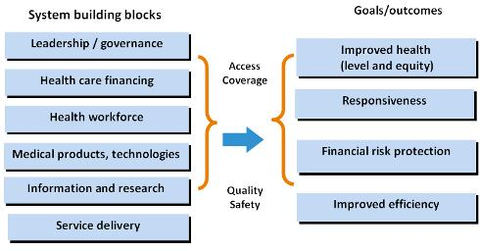
Health System Framework
Source: WHO

Slide 25
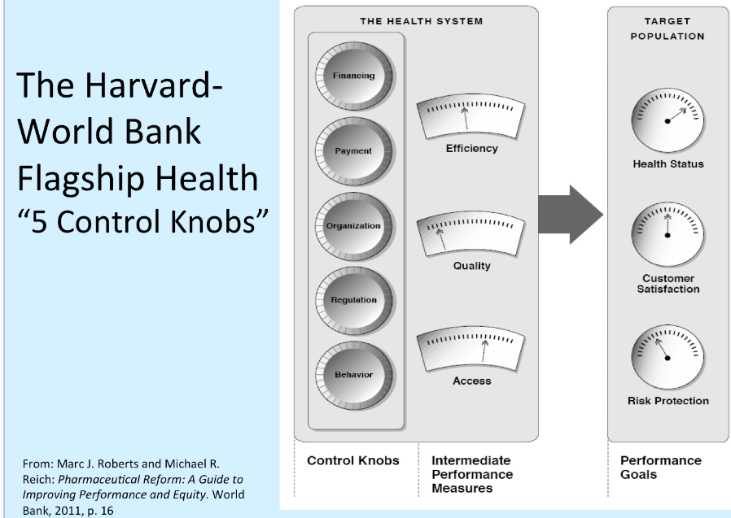
Health System Framework

Slide 26


Financial Risk Protection
SHI – GGR – PHI – CBHI - MSA
Catastrophic Health Expenditure
Impoverishing Health Spending

Slide 27
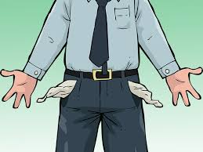
Without Financial Risk Protection!!

Slide 28
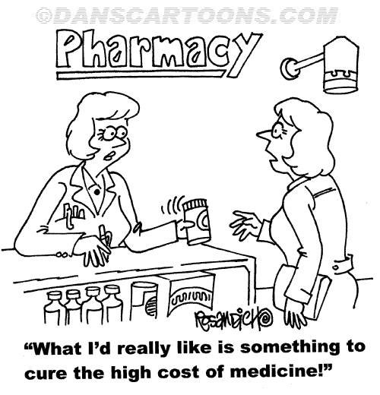

Slide 29
To Prevent Financial Toxicity
Two questions look for answers:
1- Is it the right decision to add the drug to the Formulary (reimburse) or not?
HTA (ICER – Budget impact) & at what price? (risk sharing schemes - managed entry agreement?)
2- Who will pay for the drug?
Financial Protection (SHI – GGE – PHI – CBHI – MSA – ?OOP)

Slide 30
Measures to Prevent Financial Toxicity in Egypt
Whether to add the technology (reimburse) or not?
Scientific committees (MOHP – HIO)
PEU at MOHP
Who will pay?
HIO
PTES
PTP
Free access (public cancer institutions)
New SHI law 2018

Slide 31
Financial Toxicity
Key Points
Financial toxicity describes problems a cancer patient has, related to the cost of treatment.
A number of studies show that cancer patients and survivors are more likely to have bankruptcy than are people without cancer.
The level of financial toxicity will depend on a number of household factors besides cancer-related costs.
Cancer treatment can affect both; paying the bills and ability to work.
It is essential to have HTA & financial risk protection (SHI ..)

Slide 32
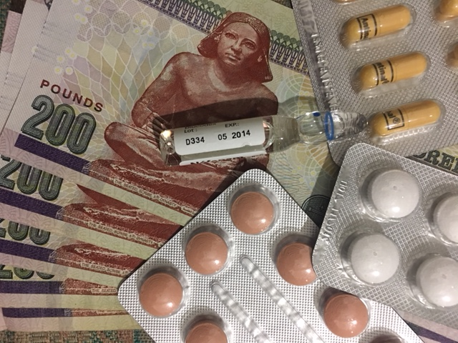
Thank You

