Slide 1



Session I : What does it take to have an HTA?
National Authority for Assessment and Accreditation in Healthcare (INEAS)
Dr. Mouna Jameleddine, PharmD, MSc
Director, HTA department, INEAS
Director, INAHTA board
Dubai, September 17th, 2018

Slide 2
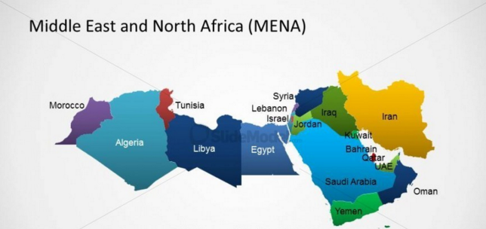

Population: 11,647,057
Life expectancy:(2016) :
m/74 ; f/78
Child Mortality/1000: 14
GDP/2015 : 48.61 billion US $
GDP on health(2014) : 7,1%
Evaluation
Accréditation
www.ineas.tn

Slide 3
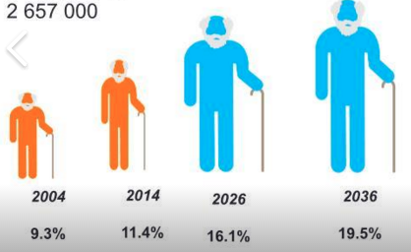
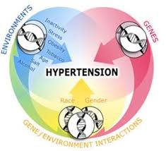


Health system facing the combined effects of :
Demographic Transition
Population of 60 + is predicted to double from 1 389 000 (2016) to 2 657 000 (2036)
Epidemiological transition
(Decline in CD., progression of the NCD.)
Evolution of the needs of the population
19 %
35,4%
Adaptation
Of the health system??
Technological progress
Institute for public health : health survey, 2016

Slide 4
Context
Political choices
REFORMS
Aim to coordinate resources
For an equitable access to quality healthcare services

Slide 5
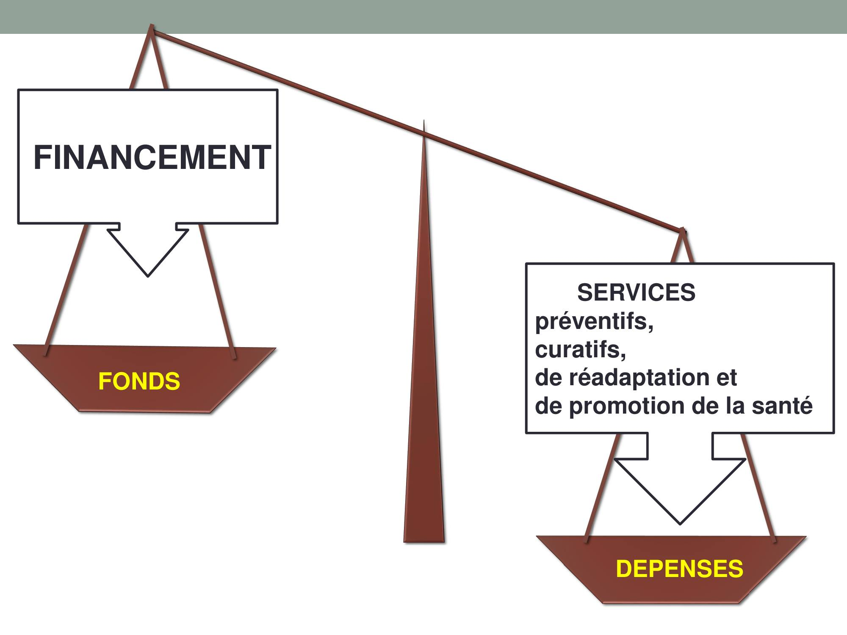
Funding
Health services
Preventives, curatives, rehabilitation…
Evaluation
Accréditation
www.ineas.tn

Slide 6
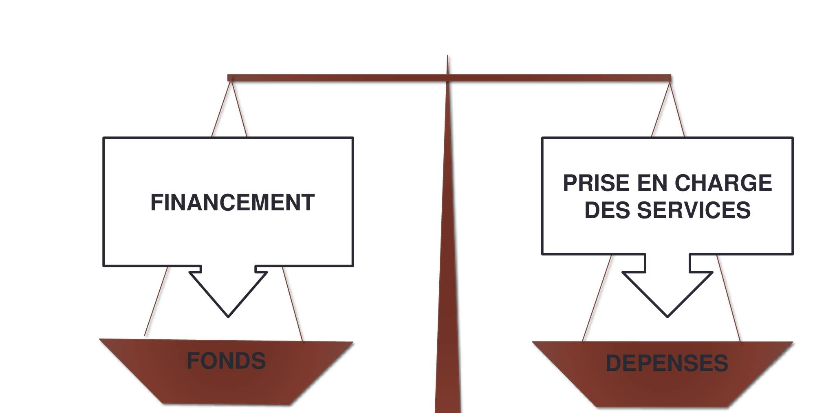
Funding
Health services
Preventives, curatives, rehabilitation…
Evaluation
Accréditation
www.ineas.tn

Slide 7


National Authority for Assessment and Accreditation in Healthcare INEAS
Public & scientific authority
Staff : 40 permanent staff
Publically-funded
Evaluation
Accréditation
www.ineas.tn
Notes:
Aims
to improve quality of Healthcare services & to optimize costs by investing in the most efficient technologies

Slide 8

General Manager
Legal unit
Health Technology Assessment department
Quality and internal audit department
Unity of information system
Unity of control management
Administrative & financial affairs
Quality of care and security of patients
Accreditation department
College of experts
Administrative board
Technical coordination unit
Organization
Evaluation
Accréditation
www.ineas.tn

Slide 9
Technologies
HTA
Technologies
Interventions
Drugs & Devices
Medical Equipment
Medical & Surgical Procedures
Health Strategies & Programs
Evaluation
Accréditation
www.ineas.tn

Slide 10
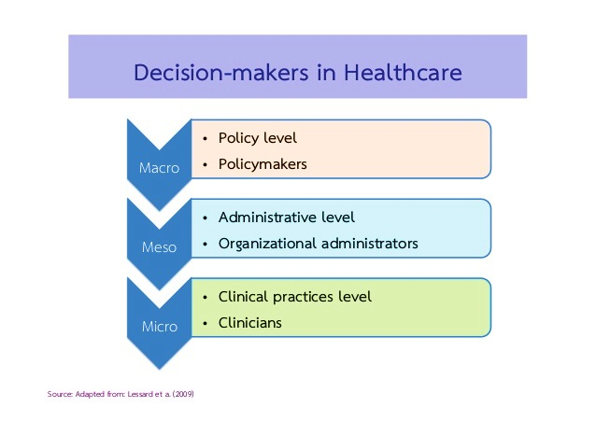
For whom?
Policy Makers (Investment)
P&R process
Hospitals (costly equipment)
Evaluation
Accréditation
www.ineas.tn

Slide 11

Focus on pharmaceuticals (P&R)
INEAS informs :
  MOH (Regulator)
  CNAM (National Insurance body)
  Committee for benefit package
Evaluation
Accréditation
www.ineas.tn
Notes:
MA and pricing are combined/ 4 levels for price negotiation/ Pricing/revision of price performed by different actors

Slide 12

What does it take to have an HTA?
Evaluation
Accréditation
www.ineas.tn
Notes:
MA and pricing are combined/ 4 levels for price negotiation/ Pricing/revision of price performed by different actors

Slide 13
What does it take to have an HTA?
HTA
Organizational structure & process
National partnerships
International collaboration
Capacities
Legal framework
Evaluation
Accréditation
www.ineas.tn

Slide 14
Organizational structure
Creation of INEAS
: 6 september 2012 (Decree)
: 14 may 2013 (Decree)
Appointment of the Director General
: 23 mai 2013 (Decision-MOH)
Constitution of the founding team
(12 persons)
: 11 october 2013
First meeting of the administrative
Think tank 1 & 2
: 2013-2014
Stakeholders analysis & consensus conference
: 2015
Structure development
: 2015-2018

Slide 15
Think Tank 1&2
Consensus with stakeholders
(resource persons : national consultants & international experts)
Collegiality
Multidisciplinarity
Since the Implementation Step
  Technical & Scientific organization (TT1)
  Administrative & legal organization (TT2)
  Recommendations
  Roadmap

Slide 16

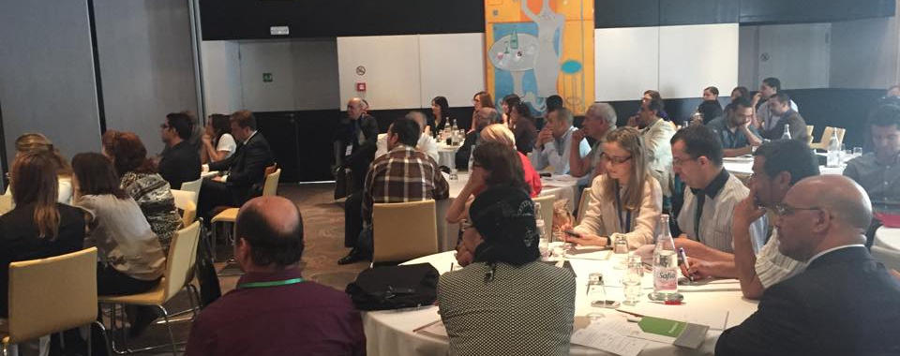
Stakeholders analysis (1)
Engaging stakeholders since the institutionalization :
Better understanding of the complexity of the decision making process, its challenges and need for HTA
Shaping in “a consensus atmosphere” the policy levels that need to be informed by HTA
Integrate the multidisciplinarity “spirit” of HTA
Evaluation
Accréditation
www.ineas.tn
Notes:
A consensus conference was organized in may 2015 to explain participants of the HTA initiative .
Obtaining a stakeholders commitment is a key element also in order to Insure understanding of the barriers and enablers of setting up a national HTA system, acceptance and participation of key stakeholders and to predict its potential impact on the health system
different workshops raised awareness on different issues and forwarded solutions on HTA intervention, and all stakeholders highlited the importance of the scientific independence of INASanté in order to be a reliable institution and on it’s main role in the tunisian health system, with two main roles:
Role of HTA in pharmaceuticals’ pathways,
In the pricing and reimbursement process of pharmaceuticals

Slide 17
Stakeholders analysis (2)
Workshop | Recommendations
1-HTA & UHC | A new step towards UHC in Tunisia
2-HTA processes & stakeholders involvement | Involvement of academics, healthcare professionals in multidisciplinary teams for HTA production
3-Challenges & solutions | Scientific independence Management of conflicts of interests Participatory approach Regulatory embedding Good linkage with policy makers and key STK
4-HTA and pharmaceuticals | Predicted crucial role in the P&R process
Evaluation
Accréditation
www.ineas.tn

Slide 18

Structure, scope & support program…
  Staff reinforcement…
  + 40 (Administrative & technical staff )
  - more staff is needed
  Budget allocation
  + Allocated budget for research projects & capacity building
  - Procedure for paying experts should be well defined
  - More funds to finance research

Slide 19
Structure, scope & support program…
  IT system development
  + Data center, documentary portal, new website …
  - More visibility & better communication
  Legal text
    + From INASanté to INEAS to highlight HTA
  - Accreditation and HTA are not mandatory yet

Slide 20

Capacity building support programs
HTA, Accreditation, CPGs & care pathway
WHO 2014-2018
EU
    PAZD (2015-2016) : Accreditation; 10 experts /1Y
    PACS (2015-2019): 3 departments ; 35 experts /2 Y
Visits HAS, OSTEBA, INESSS
Conferences HTAi, INAHTA, ISPOR
GIN, ISQUA, Integrated care
Evaluation
Accréditation
www.ineas.tn
Notes:
Deficit of trained HTA doers

Slide 21
Capacity building in HTA
HTA databases
Systematic reviews, Meta-anaysis
Critical appraisal of literature in HTA
Clinical effectiveness
Modeling (CEA)
Budget impact analysis
Post graduate training, master programs abroad
Projects based training with international experts
Conferences
visits to HTA organizations
Evaluation
Accréditation
www.ineas.tn
Notes:
Deficit of HTA doers

Slide 22

Processes
Request form (available on website)
Prioritization of topics process : 2 meetings/ year with a permanent committeee ( key Stakeholders) using Pritec tool
Timelines defined
Structure & sections
Evaluation
Accréditation
www.ineas.tn
Notes:
Mise en place et développement d’un processus d’adaptation

Slide 23

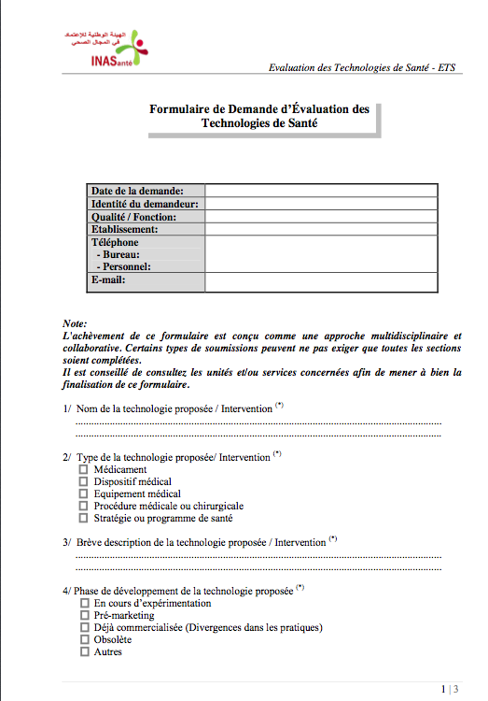

Guidance for introduction of new and emerging technologies (Application of MCDA)
First Tunisian HTA report published
Evaluation
Accréditation
www.ineas.tn
Notes:
Mise en place et développement d’un processus d’adaptation

Slide 24

Deliverables
Pharmaceuticals (templates for submissions)
Methodological guidance
2 ongoing projects (pharmaceuticals)
Evaluation
Accréditation
www.ineas.tn
Notes:
Mise en place et développement d’un processus d’adaptation

Slide 25

National collaboration
HTA
Faculty of pharmacy
Payers
National Insurance company
Scientifc societies
Faculty of medicine
High school for statistics & information analysis
Regulator
Evaluation
Accréditation
www.ineas.tn

Slide 26







International collaboration
Evaluation
Accréditation
www.ineas.tn
Notes:
Capacity building
Partnerships for support
Technical expertise

Slide 27


The way forward
Building larger capacities for HTA
  Collaborating with universities for permanent educational programs to overcome limited capacities
Extending the scope of activities
  Devices, procedures
Developing & using local evidence for HTA reports
  public/private partnerships
  Academic teams
More integration of results in decision-making
  Good communication plan & raising awareness around HTA
  Prioritization of HTA topics according to the healthcare system priorities
  Evolving to a mandatory use of Results of HTA
Notes:
Even if INEAS has been cre

Slide 28
Platform for citizen & health professionals
CITIZEN
Patients ; Associations
PROFESSIONNALS
Public sector
Private sector
international
PROVIDERS
Health organizations
Private companies
Universities
Scientific societies
Experts

Slide 29

Thank you for your attention

