Slide 1

Application of HTA findings
Sophie Werkö
SBU – The Swedish Agency for Health Technology Assessment and Assessment of Social Services
Chair, International Network of Agencies for Health Technology Assessment (INAHTA), www.inahta.org
September 17-18, 2018, Dubai

Slide 2
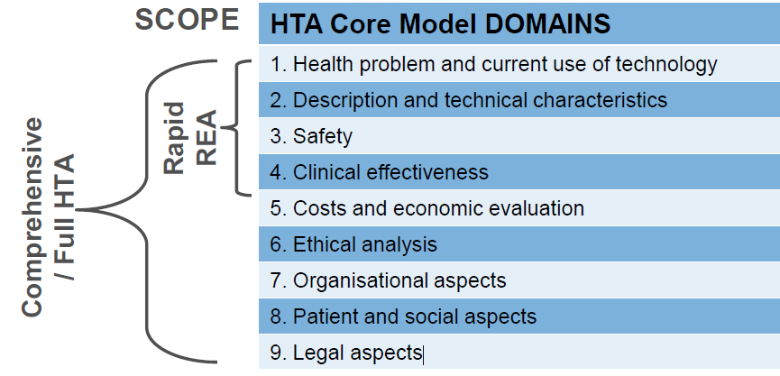
The Domains of the EUnetHTA HTA Core Model

Slide 3
Why an SBU Report?
To help:
a well-ordered introduction, abandonment or use of interventions in routine health care
ensure health care is as effective as possible
provide a better basis for decision-making when prioritising
Notes:
September last year in Cairo
SBU conducts assessments of interventions to diagnos, treat or prevent an illness or condition.

Slide 4
To summarise…
The role of HTA in the health care system is to provide knowledge used for decision-making
HTA not used by decision-makers is therefore meaningless
HTA’s overall role is contributing to better informed decisions
Key principles concern both the structure, methods, processes and use of HTA

Slide 5

So, what does HTA result in?
Many different kinds of decisions or other types of impact, for example:
Policy decision-making
Guidelines
Pricing & Reimbursement decisions
The aim being to ultimately improve health

Slide 6
The International Network of Agencies for Health Technology Assessment, INAHTA
50 members in 31 countries. http://www.inahta.org/
The David Hailey Award for Best Impact Story
The INAHTA Impact Story Sharing program was started in 2015. Read more:
http://www.inahta.org/hta-tools-resources/hta-impact-influence/#Story
A series of articles based on INAHTA member impact stories was published in the IJTAHC in December 2017.
Ref: Schuller T & Söderholm Werkö S, Insights from the front lines: A Collection of stories of HTA Impact from INAHTA Member agencies, International Journal of Technology Assessment in Health Care, https://doi.org/10.1017/S0266462317001076, 15 December 2017, pp. 409-410
Notes:
The INAHTA Impact Story Sharing Program has been very successful in sharing knowledge and building relationships among INAHTA members. These stories are told in-person at the annual INAHTA Congress in a brief format (~10 minutes) in small groups. INAHTA members come to the Congress prepared to share a story about HTA impact that their agency has experienced – what has worked well (or not so well) in achieving HTA impact with decision making or more broadly in the health system or society.

Slide 7
The David Hailey INAHTA Award for Best Impact Story
2016
Winner: INESSS, Quebec, Canada, storyteller: Michèle de Guise
Honourable mention to semi-finalists:
IQWiG, Germany, storyteller: Naomi Fujita-Rohwerder
ASERNIP-S, Australia, storyteller: David Tivey
IETS, Colombia, storyteller: Aurelio Mejía
2015
Winner: HAD-Uruguay, storyteller: Alicia Alemán
Honourable mention to semi-finalists:
SBU, Sweden, storyteller: Sophie Werkö
IETS, Colombia, storyteller: Aurelio Mejía
HIQA, Ireland, storyteller: Mairin Ryan

Slide 8
Tools and Resources
Conceptual paper on the influence of HTA
Systematic review on the influence of HTA
Impact framework
HTA Agencies and Decision Makers
Notes:
This document has been prepared to provide guidance on the interaction of health technology assessment agencies with the decision makers whom they inform through their assessments. The perspective taken generally reflects that of the member organizations of INAHTA, which are primarily concerned with informing decision makers in the public sector.

Slide 9

Do SBU assessments have an impact on health care?

Slide 10

Does HTA affect decisions and clinical practice in Sweden?

Slide 11
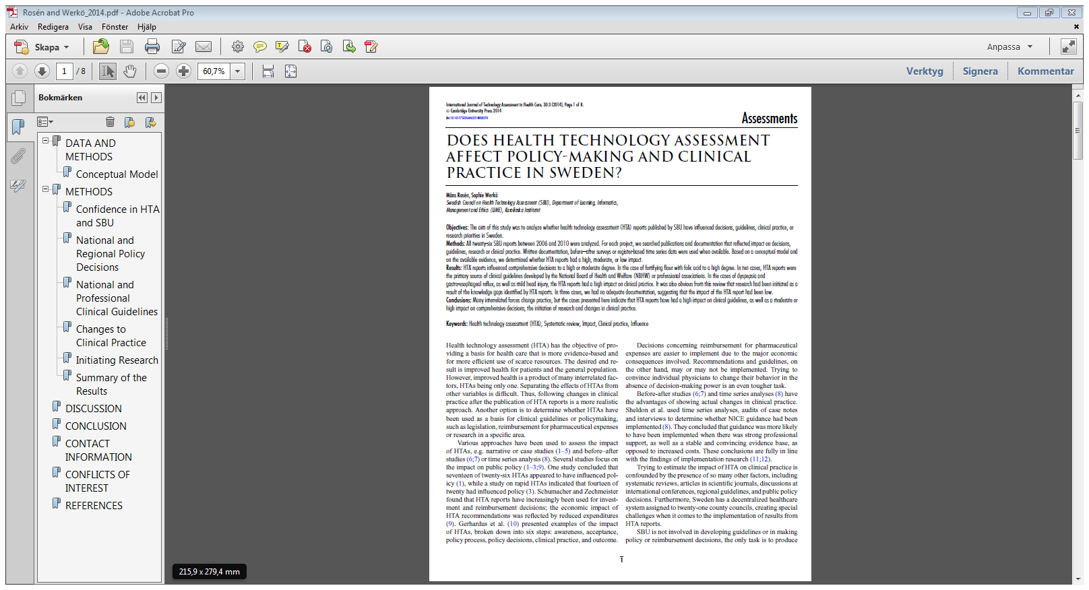
We did a study…
Rosén M & Werkö S. “Does Health Technology Assessment affect policy-making and clinical practice in Sweden?”, International Journal of Technology Assessment in Health Care, 30:3 (2014), pp.1-8.

Slide 12
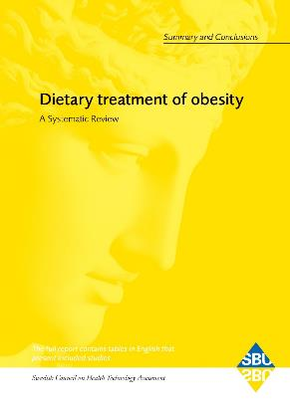
Assessing the impact of all published SBU reports (“yellow”) between 2006 and 2010
26 reports published
Self assessment
Data collected from: registers,
surveys and official documentation from independent sources

Slide 13
Model for measuring impact of HTA
National or regional policy decisions
Other actions from stakeholders
National or professional guidelines
National or professional guidelines
Change in clinical practice
HTA
Confidence/trust among health professionals
Research
Patients
Research priorities
Research /
knowledge gaps

Slide 14
Confidence for SBU in the Swedish health care system
89 % had heard of SBU before they received the questionnaire
91 % rated the quality of SBU’s work as good or very good
The majority reported having had practical use for results published by SBU in their work
According to an SCB poll of 932 decision makers in the Swedish health care system (2015)
Notes:
Statistics Sweden conducted a survey in 2015 to a random sample of health professionals.

Slide 15
Well, confidence is one thing, but does SBU really make a difference?
How do we measure impact?
Decisions taken
Measuring change in practice after publication of
SBU reports
N.B.
Conflict of interest: The audience should be aware that the speaker has some interest in HTA, but the figures are usually from official sources.
Trends are often the product of many interrelated forces.

Slide 16
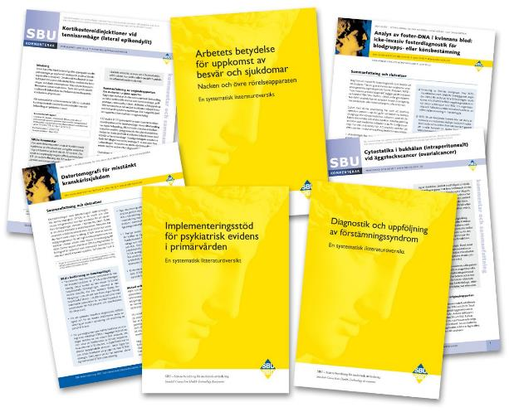
Impact on policy decisions
4 out of 26 SBU reports were used in policy decisions.

Slide 17
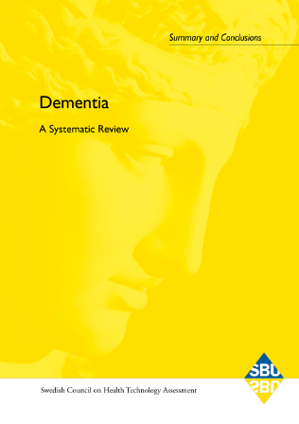
Dementia disorders
The Swedish Association of Local Authorities and Regions (SALAR) used the report in training of municipal caregivers (downloaded 180 000 times).

Slide 18
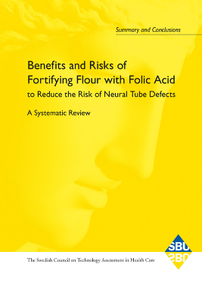
Mandatory fortification of flour with folic acid
Risk could not be ruled out,
Decision not to implement.

Slide 19
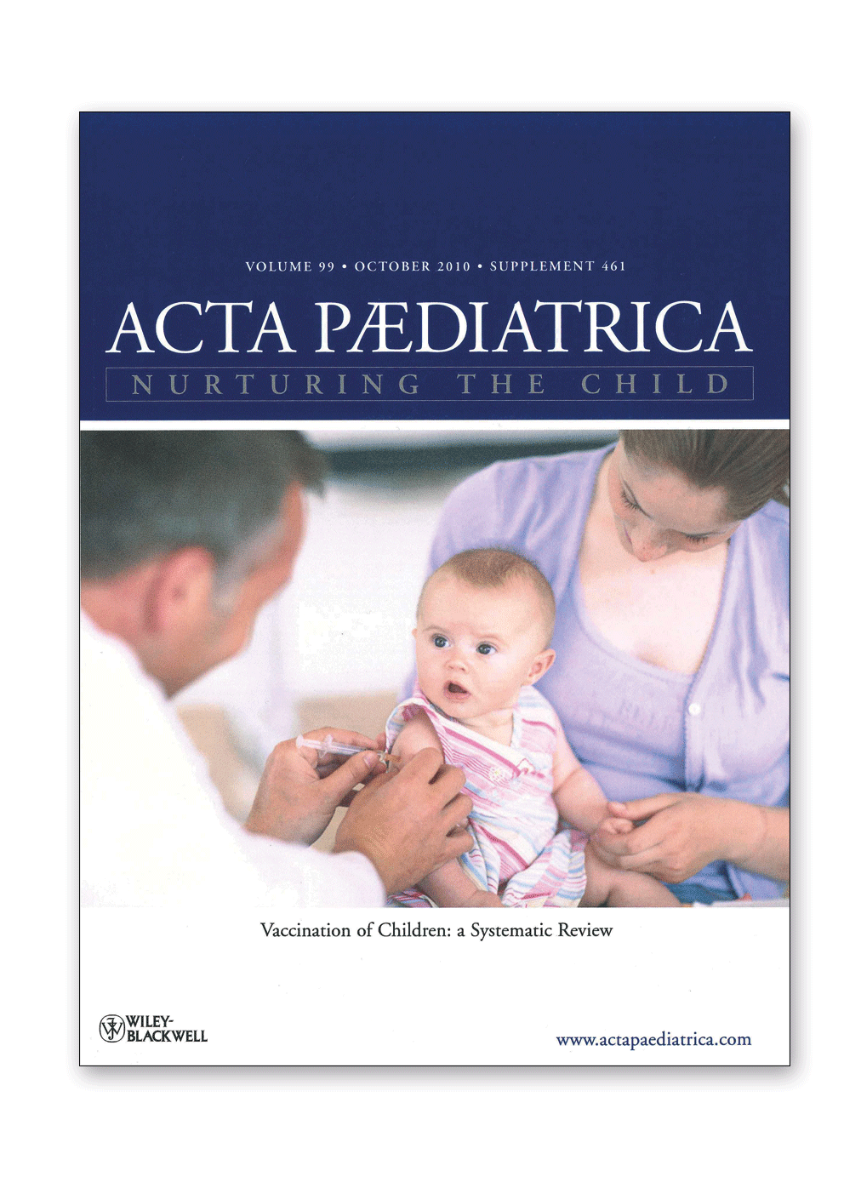
Vaccinations for children
Used by the National Board of Health and Welfare in information booklets.
Immunisation with: Haemophilus Influenza type b Vaccine, Pertussis Vaccine, Measles-Mumps-Rubella Vaccine and Hepatitis B Vaccine.
Immunisation against Tuberculosis and Adverse Events following combination vaccines.

Slide 20
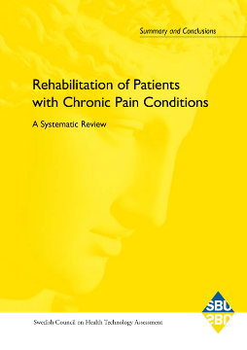
Rehabilitation of patients with chronic pain
A basis for the Government to launch the rehabilitation guarantee.

Slide 21
Impact on clinical guidelines
10 out of 26 SBU-reports were used in national guidelines.
7 implemented by the NBHW and 3 by professional organisations.
All guidelines extensively referred to the SBU reports.
SBU reports:
Patient education in managing diabetes
Dietary treatment of diabetes
Self-monitoring of blood glucose in non-insulin treated diabetes
Intensive glucose-lowering therapy in diabetes
Caries
Endodontics
Partially dentate or edentulous patients
Peripheral arterial disease
Open angle glaucoma
Tympostomy tube insertion for otitis media in children
Diabetes
NBHW published guidelines in 2010.
Oral diseases

Slide 22

Effects of identifying knowledge gaps
SBU has built up a database for scientific uncertainties / knowledge gaps, similar to DUET in UK.
A knowledge gap means that:
Systematic literature reviews reveal uncertain effects
Systematic literature reviews are not available
As a basis for research it has been a success
  The Swedish Research Council has called for applications on clinical research in areas of knowledge gaps.
  Several Swedish research councils have called for applications on research directed towards children’s mental ill-health, after the identification of many knowledge gaps.
  Knowledge gaps in dental care in SBU projects have mobilized collaborative research at Swedish universities.

Slide 23


Change in clinical practice
…was followed in 8 out of 26 reports
High impact from two of the reports
  Mild head injury
  Dyspepsia and gastro-oesophageal reflux
Moderate impact from six of the reports
  Triage methods at emergency departments
  Obstructive sleep apnoea syndrome
  Methods of early prenatal diagnosis
  Methods for promoting physical activity
  Treatment of insomnia
  Antibiotic prophylaxis for surgical procedures

Slide 24
Mild head injury: an example of high impact
Alternative 1: Admission for observation
Alternative 2: Immediate computed tomography
In 2000: An SBU-report: Lack of studies on the most effective administration.
SBU initiated a randomised multicentre trial.
In 2006: SBU-report/BMJ articles: No difference in effects and risks between the two alternatives, but immediate computed tomography is more cost-effective.
The number of admissions for mild head injury decreased by 4000 days spent in hospital between 2006 and 2007.

Slide 25
Number of surgical procedures for gastro-oesophageal reflux per 100,000 inhabitants in Sweden between 2005 and 2011.
Men and women, all ages.
N = 982.
Source: Patient Register, Swedish NBHW
SBU report
published

Slide 26
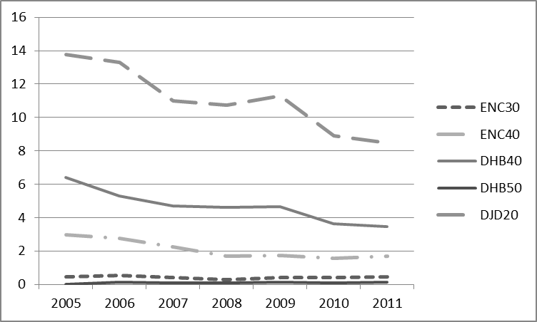
Number of surgical procedures for snoring and sleep-apnéa per 100,000 inhabitants in Sweden between 2005 and 2011.
Men and women, all ages. N = 12,062.
Source: Swedish Patient Register, Swedish NBHW

Slide 27

Antibiotic prophylaxis for surgical procedures
A SBU report from 2010 for all surgical procedures.
Single doses did not increase the number of infections compared to multiple doses.
Between 2008 and 2012 the dentists increased prescription of single doses from 49 % in 2008 to 65 % of all doses in 2012.
No data was available for
antibiotic prophylaxis
for other surgical procedures.

Slide 28

Summary of findings
General confidence in the reliability and
usefulness of SBU reports.
4 out of 26 reports were used in policy decisions.
10 out of 26 reports were used in national guidelines.
Research initiatives have been taken due to reports in head injury, dental care and mental ill-health in children.
Change in clinical practice was demonstrated from 8 out of 26 reports.
In 2 reports documentation were lacking /low impact.

Slide 29

Challenges: how could we find effective measures for disinvestments?
Change incentives
A SBU report showed that home blood pressure monitoring was at least as effective as monitoring in a clinical setting and could save costs.
The report received high mass-media attention and the sales of home BP devices more than doubled during the first 3 months.
Then the sales declined to the starting point.
Hypothesis: There was no incentive for primary health care to change. They were getting paid for BP measuring.

Slide 30

Involve the health care professionals
in all parts of the PROJECT work
IN ALL PARTS OF SBU

Slide 31
The results of the work done by SBU
More research into the prevention sexual abuse of children
  SBU’s report on methods for the prevention of sexual abuse of children has led to more research in that field.
Improved quality of life of the elderly and the fragile elderly
  SBU’s report on the treatment of urinary incontinence identified several effective treatments which are now taught to care providers
Supplied evidence that hearing loss screening could improve language development in children
  hörselscreening ökade från 25 % till 75 % i landet,
  SBU’s report on … revealed that hearing loss
  Hearing loss screening has increased from 25% to 75 % in Sweden
  This has led to better language development opportunities for children with hearing loss
Social Insurance Agency uses SBU’s reports on the workplace environment

Slide 32
Further examples
Earlier detection of symptomatic cancer
  Name the report and the result (recc define image referral somehow)
  An image referral has been established in multiple regions in Sweden
  Reduced? Preventative antibiotic treatment before surgery
  SBU’s report Name the report recommended…
  The results were subsequently published in a scientific journal
  Antibiotic use has decreased in all measured aspects in accordance with the conclusions presented in SBU’s report
  Light treatments are offered less often to treat depression
    SBU’s report Name the report concluded that there was insufficient evidence to support light treatments in the treatment of depression. This must be checked! The sentence you wrote could be interpreted different ways. Was there a lack of evidence? Or was there evidence it did not work? This is not the same thing.
  Fewer Swedish counties offer light therapy for the treatment of depression (7 of 21)

Slide 33
Answers provided by the Enquiry Service impact decisions
Reduced number of routinely late prenatal ultrasound scans in Region Skåne.
Answers which have influenced county council decisions:
  manual lymphoedema therapy
  physiotherapy exercise in a heated pool
  for non-rheumatic patients
  knee cartilage cell transplantation
  acupuncture treatment for sleep disorders
  in cases of depression.
Restrictions on the use in care programmes
of ECMO in cases of acute heart failure.

Slide 34
Today SBU influence research by…
Identifying evidence gaps within health care and social service
Conducting priority settings, including users and profession
Collaborating with research councils
Analysing collection of evidence gaps to point out strategic areas with many evidence gaps that are in need of structural support

Slide 35

Thank you for your attention.
شكرا جزيلا لك
sophie.werko@sbu.se
I Swedish Council on Health Technology Assessment

