Slide 1
Health Technology Industry and Profitability:
A WHO Perspective
Adham R Ismail, MSc, MBA, PhD
Coordinator a.i.. Essential Medicines and Health Technologies (EMT)
Regional Adviser, Health Technology and Biomedical Devices (HMD)
Department of Health Systems Development (HSD)
Eastern Mediterranean Regional office (EMRO)
World Health Organization (WHO)
2017

Slide 2
Introduction
“He who has health, has hope; and he who has hope, has everything”
Thomas Carlyle (1795-1881)
MS
This simply means that authorities have the responsibility to promote and protect population health.
UHC
This can be materialized through UHC, the leitmotif for the coming decade.
HT
Polices, Regulation, HTA, and HTM are government functions that provide the rules of the game.
Private
Private sector may be competing with the public health sector but rules should be applied to both sectors.

Slide 3
What is a Health Technology (HT)?
WHO experts define HT as;
“ The application of organized knowledge and skills in the form of devices, medicines, vaccines, procedures and systems developed to solve a health problem and improve quality of lives”.
This definition also encompasses traditional medicine, health promotion & prevention activities and information systems.
3

Slide 4
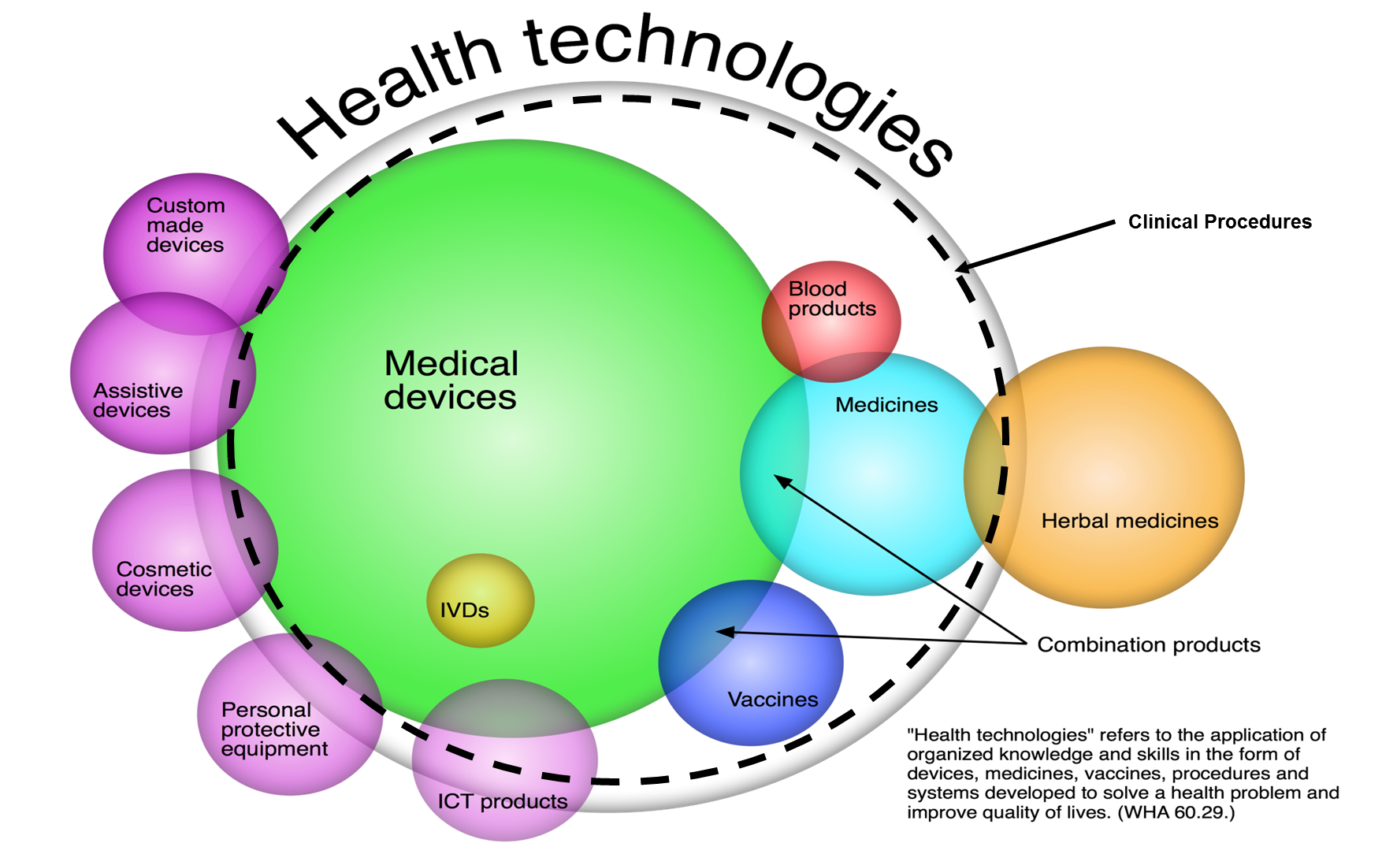
4

Slide 5
HT in WHO Health System Framework
5

Slide 6
HT in Contemporary Health Systems
They form the foundation for prevention, diagnosis and treatment of illness and disease.
Thousands of new technologies are introduced into practice each year.
Technologies and Health Systems are interdependent: Sustainable supply of technologies require functional health systems and vice-versa.
6

Slide 7

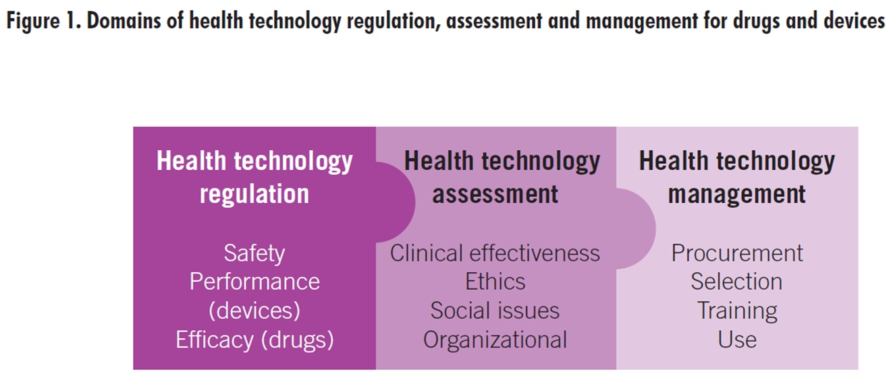
HT Policies
Health technology
Innovation
Medical Processes (R&D)
Business Processes (Marketing, Financing, IT &/or Operating)
Valley of Death
7

Slide 8
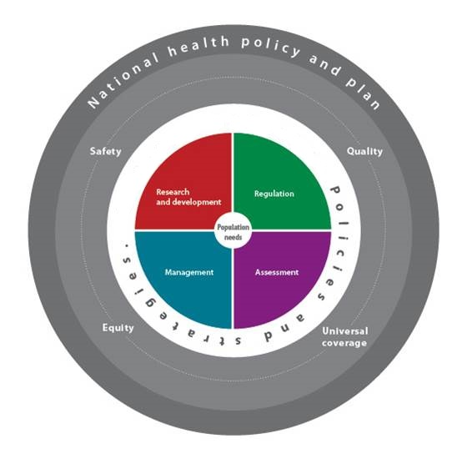
Achieve safety, quality, equity and universal coverage
8

Slide 9
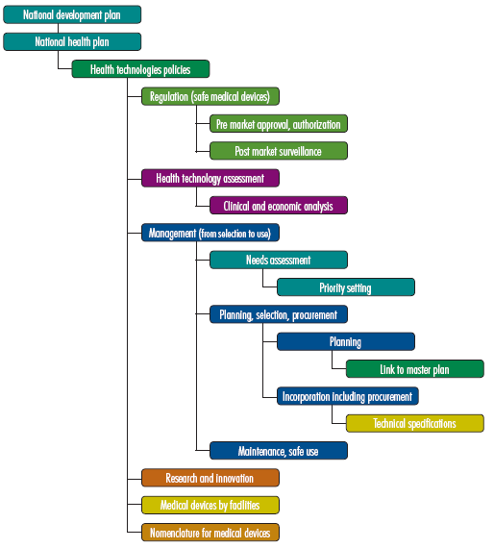
From Plan to the strategies and actions
9

Slide 10
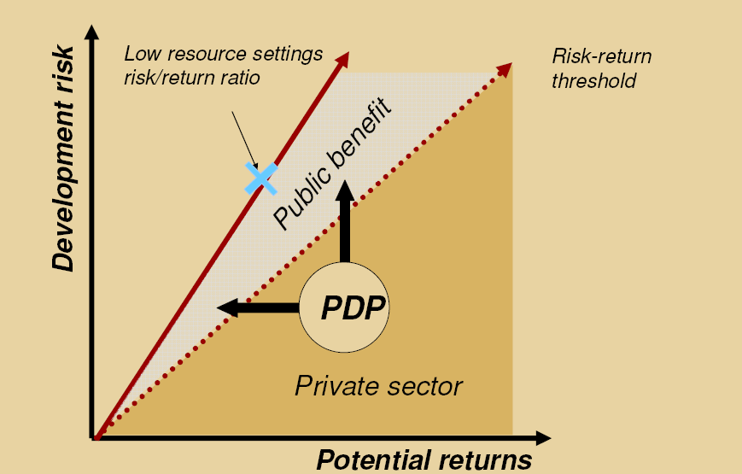
Partnerships for Public Benefit
PDP = Product Development Partnerships
10

Slide 11
Private Sector and Innovations:
Partnership for Local Innovation
Local innovation is possible in settings where they are needed, provided that infrastructure is available locally to:
  Attract competent personnel;
  Link invention and design to health-related needs;
  Use local materials and expertise; and
  Launch the product into appropriate networks for distribution to populations.
Through partnerships, developing countries can strengthen capacities to design and locally produce medical products.
Transparency, rule of law, business conduct and IP to be addressed.
Successful partnerships should stimulate new ideas from concept to manufacture, marketing, and uptake.
To avoid rejection, these new ideas should take into account local values and culture.
11

Slide 12
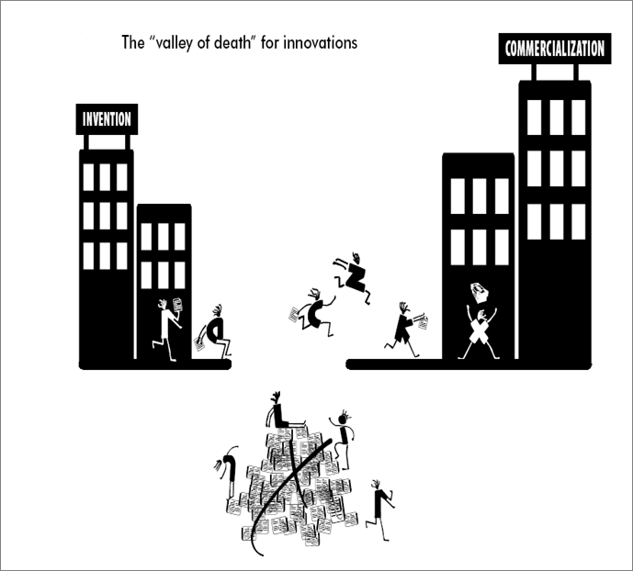
Private sector and Innovation:
The Valley of death
Lack of funding can kill good ideas before hitting the market.
At this stage, risk for innovators is high & profit is uncertain.
Private sector stay away and prefer to fund more mature projects.
12

Slide 13
Private sector and Innovations:
Out-of-Context Situation
Health professionals, especially in low-resource settings, often develop ideas for improving medical products.
Difficulties faced in moving innovations forward can be due to:
  Lack of local research infrastructure
  Little encouragement for local innovations
  Lack of marketing mechanisms
This leads to an out-of context situation where:
“Medical Products for low-resource settings are developed in high-resource settings”.
13

Slide 14
Private sector and Regulations:
Is it a hurdle?
Regulations ensure safety but can also be a financial burden on designers and manufacturers, especially in low-resource settings.
For example:
  Immunodiagnostic tests incur low development costs; however, costs are doubled or tripled when they are submitted to regulatory process for licensing.
High regulatory costs can prompt companies to elude regulatory oversight and market their products in unregulated markets, thereby compromising patient safety.
14

Slide 15
Private Sector and Regulations:
The need for NRAs
International standards vary from one local conditions to the other.
Manufacturers are usually asking perplexing questions :
  Should the same standards be applied everywhere?
  Could standards be adapted to local conditions?
  Could lowering standards lead to lowering overall HC standards?
  What body could authorize such exceptions?
  Would compliant manufacturers suffer a comparative disadvantage with respect to those who bend the rules?
  Could compliant manufacturers be permitted to market their products at lower safety, quality, and/or performance than those necessary for other devices?
National Regulatory Authorities (NRAs) at national, regional and global levels are required.
15

Slide 16
Private sector and Product Design:
A balance is needed
Sometimes it is difficult to strike a balance between solving problems & creating new needs.
  Disposable batteries may solve electricity shortage, but may require a supply chain and waste management.
An example of inappropriate design is the failure of affordable wooden-seat wheelchairs to achieve widespread use among users in Nicaragua.
  Though appropriate to local conditions (narrow doorways, high pavements and lack of access to buildings for wheelchair users), it required a cushion to prevent ulcers in people with spinal cord injuries.
  Although cushions were provided during the first year of use, most people in Nicaragua could not afford a replacement once the cushions wore out.
16

Slide 17
Private sector and Pricing:
Diffusion and uptake
Though their main purpose is to improve health, in many times medical products lead to escalation in HC expenditures.
Efforts to reduce costs mean that some products will diffuse, while others will not.
Conversely, inappropriate uptake can lead to overuse of products that may not meet urgent clinical needs.
17

Slide 18
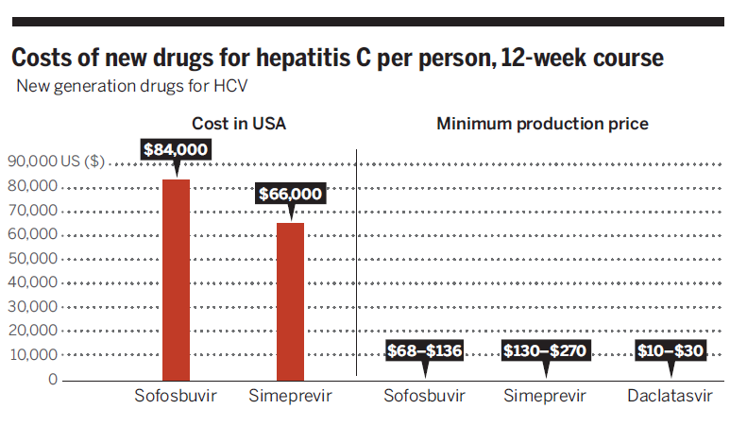

Slide 19
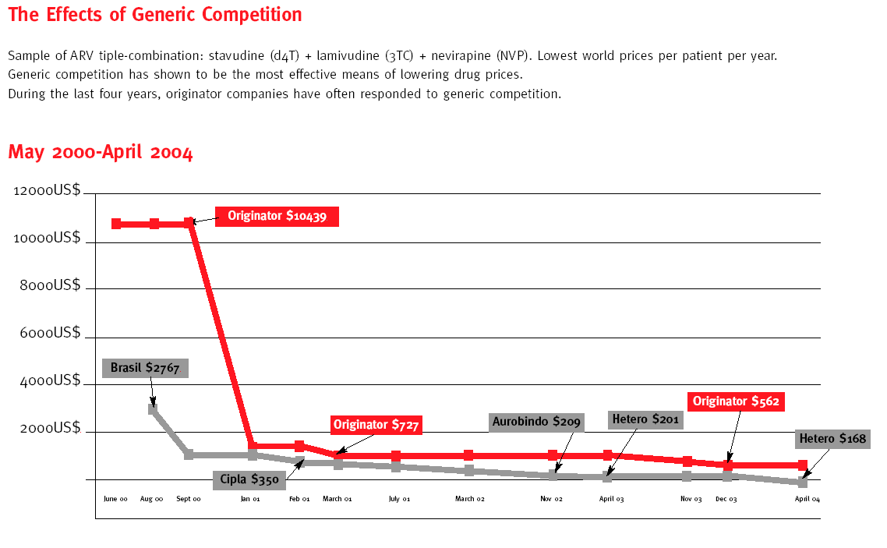

Slide 20
Private sector and HTA:
The Thai Experience
In Thailand:
HTA uses <0.01% of health budget, and results in >$100 million/year savings from price negotiations alone.
Threshold price that makes Oxaliplatin cost-effective in the Thai health care setting
Medicine | Original price (THB) | Reduced price (THB) | Potential saving (THB per year)
Oxaliplatin (injection 50 mg/25 ml) | 8,000 | 2,500 | 152 million
20

Slide 21
Private sector and HTA:
Investment Decisions
Support in production of evidence to support decision making regarding investments made by the public sector.
Examples of situations where HTA had to take decisions on cost-benefit of some drugs:
  Exemestane for treating breast cancer
  Pregabalin for neuropathic pain management
  Combination therapy vs. intensification of stain monotherapy
  Trastuzumab Adjuvant Treatment for Breast Cancer HER2+
  Positron Emission Tomography (PET) Scanners
  3-Tesla Magnetic Resonance Imaging (MRI)
  CT Scan 64 slice ( single and dual )
  Femto-second laser
21

Slide 22
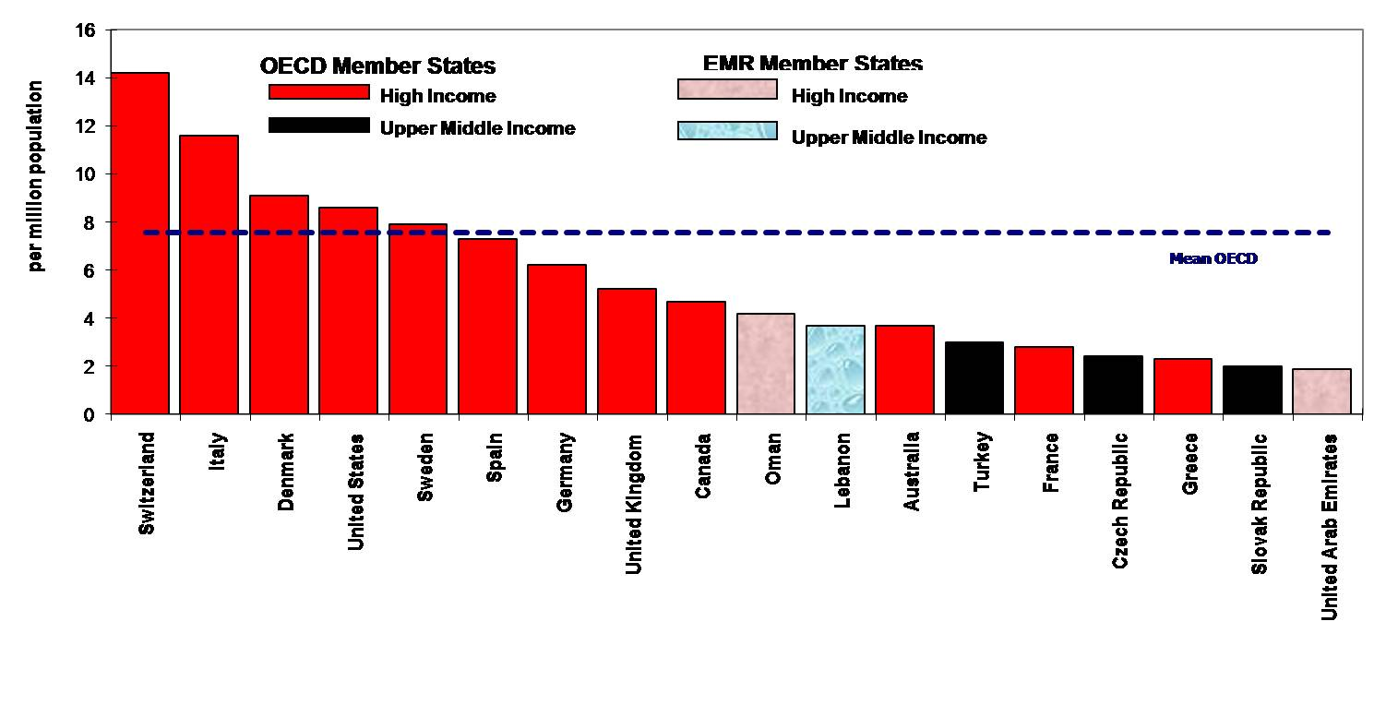
Will HTA decisions affect the private sector?
Procurement of MRI in EMR
22

Slide 23
Will HTA decisions affect Private Sector?
Pricing of Cancer Drugs
Favorable
Unfavorable
23

Slide 24
Private sector and HTM:
Is there a role to play?
Focus will be on activities related to supply chain management; namely:
    Needs Assessment, Selection of priority and essential products, Procurement, Nomenclature, Donations, Safe Use, HR requirements, User Training , Inventory, Maintenance, CMMS and Waste Management
  HT management, or clinical engineering can be located at the national, regional, or local (hospital) level.
  In some countries the national HT management team is part of a center of national excellence.
  It is of interest to the private sector to ensure that their products are adequately used for many reasons (user-related errors, vigilance, downfall times, proper storage, etc.)
24

Slide 25
Private Sector and HTM:
Options for Financing and Distributing Medicines
Financing Strategies | Types | Distribution |  | Characteristics
 |  | Wholesale | Retail
Public | Fully | Public | Public | State is owner, funder, and manager of the supply system Used by many MS
 | Private Supply to Government Facilities | Private |  | Through direct delivery or prime distribution contracts Most common in North America
 | SHI Schemes | Private | Private | Premiums used to reimburse pharmacies or patients Used in Australia, Western Europe, and North America
Private | Private Financing and Public Supply | Public | Public | State dispense medicines but paid (full or partial) by patients Was used in China. Latin America still uses it.
 | State Wholesale Monopoly | Public | Private | State supplies public and private pharmacies Rarely used now.
 | Fully Private | Private | Private | Patients pay for entire cost in private drug stores Exist in nearly every state.
25

Slide 26
Conclusions
Expensive, cutting-edge technologies are often perceived as an indicator of high quality services; however, they may lead to a disproportionate escalation in health care delivery costs.
Creating appropriate products for different resource settings requires in-depth understanding of the particular needs and resource capacities of each country.
The following private sector roles are essential in reconciling private and public interests to enhance efficiency:
  Managing innovations
  Complying with NRA regulations, and
  Lowering costs to fit into HTA requirements
  Adhering to national HT (supply chain) management requirements.
  Discussing PPP options that will provide Win-Win situation for both parties.
26

Slide 27


27

