Slide 1
Using Strategic Purchasing to Leverage the Role of Private Sector in UHC
Lessons for the MENA Region
MENA HPF CONFERENCE ON
PUBLIC - PRIVATE PARTNERSHIP FOR UNIVERSAL HEALTH COVERAGE
12-13 NOVEMBER 2017, Cairo-Egypt

Slide 2
Presentation Outline
Purchasing: Interface between Financing and Provision
Strategic versus Passive Purchasing
Strategic Purchasing: a Tool to Engage the Private Sector in Health
Provider Payment Methods: Instruments to Regulate, Incentivize and Integrate the Private Sector in Health
Key Messages

Slide 3
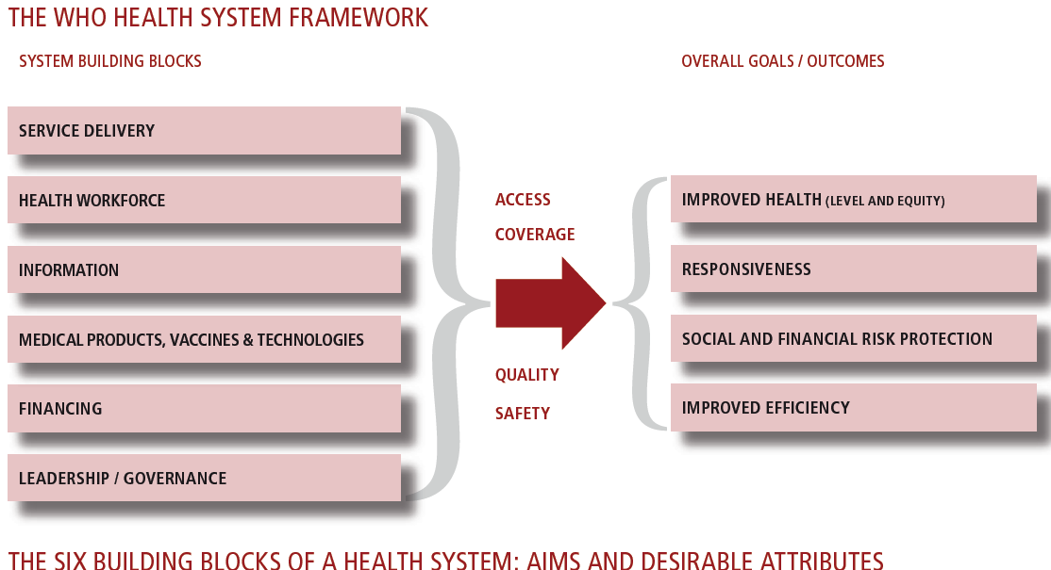

Slide 4
What is Purchasing?
Revenue collection is the process by which the health system receives money – households, organizations, donors;
Pooling ensures that the risk of having to pay for health care is borne by all members of the pool and not individually;
Purchasing is the process by which pooled funds are paid to providers in order to deliver a set of health interventions.
Source: World Health Report 2000

Slide 5
Purchasing – Passive vs. Strategic
Passive purchasing - providers are reimbursed for services and national governments allocate budgets to various levels of administration based on previous year’s funding
Strategic purchasing – is extent to which purchasing is based on evidence informed decisions and promotes quality and efficiency by asking explicit questions:
  What interventions and services to purchase?
  For whom to purchase?
  From whom to purchase?
  How to pay the providers?
Source: World Health Report 2010

Slide 6
Strategic Purchasing, Purchaser-Provider Split, and Private Sector
 |  | Provision
 |  | Public | Private
Financing | Public | Public hospitals and network of PHC facilities [All countries] | Outsourcing, contracting, grants to non-state providers [most countries]
 | Private | Building trust hospitals [UK] BOT, BOOT, Etc. | Private providers paid directly by users [most countries]

Slide 7
Provider Payment Methods
The way in which money is distributed
From a source of funds [fund holders]:
  government
  insurance company
  other payer
To:
  health care facility (including laboratory, pharmacy) [Public or Private]
  individual provider (physician, nurse, physiotherapist) [Public or Private]
Each PPM carries a set of incentives that encourage providers to behave in specific ways in terms of the types, amounts, and quality of services they offer

Slide 8
Major Payment Methods: Advantages and Disadvantages
Payment mechanism | Unit of Payment | Advantages | Disadvantages | Financial risk
Line item budget [e.g. salaries] | Functional budget categories | Simple to administer, well understood in most systems | Little flexibility in resource use, tendency to spend even if unnecessary, rationing occurs | Provider = LOW Payer = LOW
Global budget | Health facility: hospital, clinic, health center | Cost containment, simple to administrate | Low investment in technologies, patient selection, patient shifting | Provider = HIGH Payer = LOW
Capitation | Per person per year | Cost containment, provision of preventive care | Under provision, increase in referral to hospitals and specialists, low quality of care | Provider = HIGH Payer = LOW
Case based payment (DRGs - Diagnosis Related Groups) | Per case or episode | Cost containment, cost-effective treatment, reduction in unnecessary care | Selection of patients, increase in admission, premature discharge, monitoring cost, under-treatment | Provider = MODERATE Payer = MODERATE
Per diem | Per day for different hospital departments | Simple administration, more attention given to patients | Increase in number of admission and length of stays, provision of less cost effective treatment | Provider = LOW Payer = HIGH
Fee for service | Per unit of service | High accessibility, high quality, competition | Overprovision who can pay, under service poor | Provider = LOW Payer = HIGH
There is no perfect payment method.
They all have strengths and weaknesses.
They all can create undesirable incentives and adverse consequences.
They all can be useful at different times depending on the objectives.
However, it is always preferable to move from input-based to output-based payment

Slide 9
Financial risk trade off between Payers and Providers
High
Payer
Provider
Financial risk
Low
FFS
Per day
Per case
Capitation
Payment mechanism
Source: Cid C, 2012

Slide 10
Provider Payment Methods General Trends
For Primary Care: Use of Capitation with Fee-for-Service
For Hospital Care: Use of Case-Based Payment (e.g., DRG) with Global Budget

Slide 11
Key Messages
Strategic purchasing is an effective mechanism for engaging the private sector for quality and efficiency
Different Provider Payment Methods can be a lever for regulating, incentivizing and integrating the Private Sector in Health
Good governance is key for ensuring effective engagement of the Private Sector in Health

Slide 12
Thank You!

