Slide 1
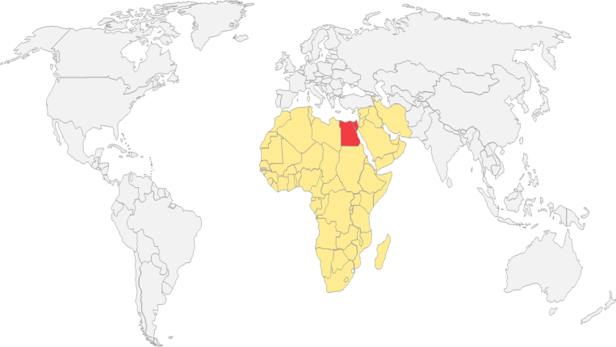

Role of Private Insurers in providing Complementary & Supplementary services to HIO
Dr. Ehab Abul-Magd
Chairman of Egyptian Health Care Management Society

Slide 2
Background
Egypt is seeking universal health coverage for the population.
Due to the lack of resources it is difficult to sufficiently finance a comprehensive health care coverage.
Private health insurance (PHI) can have a new role, in the form of providing complementary (CompHI) and supplementary health insurance (SuppHI) in addition to the public health insurance scheme

Slide 3
Different types of current Private Health Insurance
Substitutive PI: An alternative to statutory insurance and is available to sections of the population who may be excluded from public cover or who are free to opt out of the public system
Duplicate PI: PHI that offers coverage for health services already included under government health insurance, while also offering access to different providers (e.g. private hospitals) or levels of service (e.g. faster access to care). It does not exempt individuals from contributing to government health coverage programs.

Slide 4
way to reach universal health coverage
Supplementary and complementary private health insurance can play a significant role in the Egyptian healthcare system based on:
  large proportion of out of pocket payments
  small proportion of private health insurance expenditures
  incomprehensive basic benefit package

Slide 5
Definitions of supplementary and complementary
WHO definitions:
Supplementary: Offers faster access to service, greater choice of health care provider or enhanced amenities
Complementary services: covers services excluded from the publicly financed benefit package

Slide 6
way to reach universal health coverage
  Private health insurance should be aligned with the development of universal health coverage (UHC)
  Objectives of PHI development should be determined by the government
  Political: satisfaction of different subgroups of Egyptian citizens (and expatriates)
  Direct financial: provide promising business model for private health insurance companies
  Indirect financial: reduce the financial pressure on the implementation of UHC
  Special pilot areas (e.g. disease area, special technologies or services, geographical region) may be selected to facilitate alignment on the short run

Slide 7
Role of private health insurance (PHI)
Packages
Public health insurance
Private health insurance
Minimum package
Population: all citizens
Restriction: no copayment and waiting list
Essential package I.
Population: all patients with insurance
Restrictions: copayment, waiting list , low quality, no choice
Supplementary: Immediate access, better quality
Complementary (user charges): copayment
Complementary (services): Choice
Essential package II.
Population: all patients with insurance
Restrictions: coverage only for subgroup, copayment, waiting list, second-line
Equity package
Population: selected patients with insurance
Restrictions: strict diagnostic criteria, monitoring
Complementary (services): coverage for patients with no access
Non-reimbursed services

Slide 8
Egypt

Slide 9
Structure of the public health care system – Egypt
Governmental sector
  MOHP (Ministry of Health & Population) facilities
    Highly subsidized care
    20% of services require OOP
  Revenues
    Taxes
    Funding from donors
    OOP
Parastatal sector
    Main actors
      Health Insurance Organization (HIO)
      The Curative Care Organization (CCO)
      Teaching Hospitals and Institutes Organization (THIO)

Slide 10
Health Insurance Organization coverage – Egypt
Beneficiaries
  Mandatory to all employees working in the government sector, certain public and private sector employees, pensioners, students and new-borns (children under yr. 1)
  63% of the population (2017) is covered through HIO
Benefit package
  Officially comprehensive
  In reality: Inaccessible medical services, only 6% of the population utilizes HIO coverage

Slide 11
Health Insurance Organization funding – Egypt
Beneficiaries usually have to pay only a marginal contribution to utilize the HIO services:
Beneficaires | Extent of contribution
Students | 4 EGP/year & co-payment(1/3 of the medication costs*)
Newborns | 5 EGP/ year
Pensioners | 1% of the monthly pension
Widows | 2% of the monthly pension
Public sector employees | 1% of the monthly salary
Private sector employees | 3% of the monthly salary collected from the employer
*Except for chronic medications

Slide 12
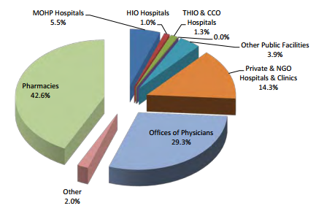
OOP household spending's by providers – Egypt

Slide 13
Role of private sector – Egypt
Public sector services are usually not satisfactory
Egyptians who can afford, prefer to pay for care out of pocket instead of using public services
Over 70% of THE is borne by individuals (i.e. OOP)
Private purchasing of public services is available in some cases
  e.g. economic departments where public providers are permitted to generate their own income by charging user fees for better accommodation (e.g. private room instead of community room)

Slide 14
Market of PHI – Egypt
Duplicate system
  Employees in private companies often have mandatory duplicate coverage
  Both social security contribution and private insurance premiums are deducted from employee salaries
Coverage
  5% of the population
Types of contracts
  Group and company insurances are frequent and affordable
  Individual insurances are rare and more expensive

Slide 15
Summary – Egypt
The public health insurance coverage is not satisfactory for the beneficiaries
The current role of private health insurance is marginal
There is a duplicate system for certain employer schemes
Complementary and supplementary health insurances have a potential role to support the „real” coverage of the basic benefit package
Pharmaceutical, outpatient and inpatient care, the main drivers of OOP expenses, have to be targeted by the PHI schemes

Slide 16
Country | Type of coverage available | Number of covered lives or number of policyholders | Voluntary or mandatory insurance | Individual or group policies (% of market if both policy types exist) | Life insurance products including health elements | Long- term care insurance (LTC)
Australia | Duplicate and supplementary. | Covered lives | Voluntary | Individual | Yes. Lump sums for medical conditions, serious illness, injury or permanent disability. Monthly benefits if unable to work due to illness or injury. | No
Austria | Complementary | Covered lives | Voluntary | - | - | -
Belgium | Complementary (primary small- risks coverage for self-employed) | Covered lives | Voluntary (private companies and mutuelles) Mandatory (long-term care in Flanders) | - 100% individual (mutuelles) - 25% individual and 75% group (private companies) | N.a. (private companies). No (mutuelles) | Yes (for Zorgverze kering in Flanders)
Private insurers | - | - | Voluntary |  | - | -
Mutuelles | - | - | Voluntary | Individual | No | Only if LTC treatment in hospitals, in framework of in- patient treatment
Hospitalisation |  |  |  |  |  | Only if LTC treatment in hospitals, in

Slide 17
Country | Type of coverage available | Number of covered lives or number of policyholders | Voluntary or mandatory insurance | Individual or group policies (% of market if both policy types exist) | Life insurance products including health elements | Long- term care insurance (LTC)
 |  |  |  |  |  | framework of in- patient treatment
Zorgverzekering (Flanders only) | - | All population in Flanders | Mandatory | Individual | No | LTC only
Canada | Supplementary | Covered lives | Voluntary | 10% individual and 90% group | Yes (e.g, critical illness insurance, disability insurance) | Yes
Chile | Primary PHI | 3.196.477 (number of covered lives) in 2013 | Mandatory or Mandatory plus a part voluntary to upgrade services | 18.2% in 2013 (both groups) | - | -
 | Complementary PHI | 3.781.135 (number of covered lives) in 2013 | Voluntary | 21,7% in 2013 (both groups) | - | -

Slide 18
Country | Type of coverage available | Number of covered lives or number of policyholders | Voluntary or mandatory insurance | Individual or group policies (% of market if both policy types exist) | Life insurance products including health elements | Long- term care insurance (LTC)
Czech Republic | Supplementary. Primary: for foreigners who are not eligible for public health insurance coverage. | - | Voluntary | Individual | Life insurance products do not generally comprise coverage for health care services. Disease specific and critical illness products, Income replacement and cash products, Temporary or permanent disability. | No
Denmark | Complementary, supplementary | Policyholders (number of policies taken out. Information on covered lives is n.a.). | Voluntary | Group and individual (% is n.a.) | No. Life insurance products generally do not include health elements. | No
Estonia | - | - | - | - | - | -
Finland | Supplementary | - | Voluntary | - | - | -
France | Complementary | Covered lives | Voluntary | Individual and group | - | -

Slide 19
Country | Type of coverage available | Number of covered lives or number of policyholders | Voluntary or mandatory insurance | Individual or group policies (% of market if both policy types exist) | Life insurance products including health elements | Long- term care insurance (LTC)
Germany | Primary, complementary and supplementary | Covered lives | Voluntary and mandatory | Individual and group (% of n.a) | Yes (e.g. permanent disability insurance) | Yes
Greece | Duplicate | - | Voluntary | - | Yes | -
Hungary | Supplementary | - | Voluntary | - | Yes | No
Iceland | Primary | Covered lives | Voluntary | Individual | Yes | Yes, but just recently offered
Ireland | Duplicate | 2 million covered lives (including children) | Voluntary | Individual and group policies combined | Yes. Life companies offer products (critical illness, hospital cash, income replacement etc). | Yes. Life companie s may offer long term care insurance.
Israel* | Complementary, Duplicate and Supplementary | Covered lives | Voluntary | Both | - | Yes, in addition to the health insurance.
Italy | - | - | - | - | - | -

Slide 20
Country | Type of coverage available | Number of covered lives or number of policyholders | Voluntary or mandatory insurance | Individual or group policies (% of market if both policy types exist) | Life insurance products including health elements | Long- term care insurance (LTC)
Japan Source: Financial Services Agency | Complementary and supplementary | - | Voluntary (except the compulsory automobile liability insurance) | Individual and group | Yes (e.g. cancer insurance, specified disease insurance, etc.) | Yes
Korea | Complementary and supplementary | - | Voluntary | Individual | Yes | Yes
Luxembourg | - | - | - | - | - | -
Mexico | Duplicate | - | Voluntary | - | - | No
Netherlands
Up to 2005 | Primary and supplementary | 5.834 million, of which: - Policies entirely pertaining to private law (4.130 million) | Voluntary | 48% individual, 52% group | No | No

Slide 21
Country | Type of coverage available | Number of covered lives or number of policyholders | Voluntary or mandatory insurance | Individual or group policies (% of market if both policy types exist) | Life insurance products including health elements | Long- term care insurance (LTC)
 |  | Standardised policies regulated under the WTZ scheme (0.817 million) Policies for civil servants (0.888 million)
2006 onwards | Supplementary | Covered lives: approximately 15 million. | Voluntary | Individual and group (group max. 44%, but from the total insured population of 16.5 million) | No | No
New Zealand | Complementary and Supplementary | Covered lives | Voluntary | Individual and group | Yes | No
Norway | Duplicate | - | Voluntary | - | - | No
Poland | - | - | - | - | - | -
Portugal | - | - | Voluntary | - | - | -

Slide 22
Country | Type of coverage available | Number of covered lives or number of policyholders | Voluntary or mandatory insurance | Individual or group policies (% of market if both policy types exist) | Life insurance products including health elements | Long- term care insurance (LTC)
Slovak Republic | - | - | - | - | - | -
Slovenia | Complementary | Insured persons and dependents | Voluntary | - | Yes | No
Spain | Primary, duplicate | Covered lives | Voluntary | Individual | - | Yes
Sweden | - | - | - | - | - | -
Switzerland | Supplementary | Covered lives | Voluntary | - | - | -
Turkey | Complementary and supplementary | Policy holders | Voluntary | - | Critical illness | -
United Kingdom | Duplicate | Covered lives | Voluntary | Individual and group (% is n.a.) | Critical illness | -
United States | Primary and complementary | Covered lives | Voluntary | - | No | Yes

Slide 23
Project Milestones
Product features
Generalization
Replication
Traceability
The product should be able to be generalized to large segment of patients
The product should be subjected to replication to further disease areas or interventions
The product and process should be easily traceable and tracked for KPIs efficiency and control

Slide 24
Project Milestones
Methodology
Gap Analysis
Current situational analysis
Desired situation upon applying the Compl. service

Slide 25

Project Milestones
Roadmap
Literature review and case studies
Situational analysis and way forward
Egypt data gathering
Gap analysis and Proposal Drafting
Physical visit to case country

Slide 26
Why Supplementary and complementary private health insurance are important to the Egyptian health care system :
Health gain
Sustainability of health care financing
Efficiency of health care delivery
Financial protection of the system

Slide 27
Recommendations

Slide 28
Perspectives of SHI and CHI in Egypt
Supplementary and complementary private health insurance can play a significant role in the Egyptian healthcare system based on:
  large proportion of out of pocket payments
  small proportion of private health insurance expenditures
  incomprehensive basic benefit package

Slide 29
Questions before the design of the PHI system cont.
CHI and SHI design
What type of services should be offered?
  all in-kind benefits
  co-payment (CHI)
  higher quality care (SHI)
  better access (SHI)
What type of methods should be used?
  to incentivise
  to finance , e.g. collect premiums, MSAs
  to contract
  to prevent adverse selection
What is the level of control the government want to gain?
  Free market competition
  Managed competition
  Strict government control

Slide 30
How to implement the new healthcare system?
Development of supplementary and complementary private health insurance should be aligned with the development of universal health coverage
  Strategic team of multidisciplinary stakeholders should develop mid-term and long-term policy framework to adjust the role of private health insurance to universal health coverage
  Special pilot areas (e.g. disease area, special technologies or services, geographical region) may be selected to facilitate alignment on the short run
Strategic review of countries with similar challenges to Egypt, but more advanced in implementing universal health coverage. E.g. South Africa or Thailand may deserve more attention

Slide 31
THANK YOU

