Slide 1


Evidence and Knowledge for Strengthening Public-Private Partnerships;
Country Experiences
Fadi El-Jardali, MPH, PhD.
Professor / Chairperson
Director – Knowledge to Policy (K2P) Center
Co-Director – Center for Systematic Reviews in Health Policy and Systems Research (SPARK)
Co-Director – WHO Collaborating Center for Evidence-Informed Policy and Practice
American University of Beirut
November 12, 2017

Slide 2


SPARK
Conflict of Interest
I declare I have no actual or potential conflict of interest in relation to this presentation.

Slide 3
Outline
SPARK
SPARK
Introduction
Integrated Knowledge Translation Model to Promote Evidence-Informed Health Policymaking
Role of evidence and application of Knowledge Translation Model:
  Case study 1: Establishing a performance-based contracting model between the Ministry of Public Health (MoPH) and private and public hospitals
  Case study 2: Enhancing access to care for Syrian refugees through better cross-sectoral coordination
  Case study 3: Accelerating Progress to Universal Health Coverage through Implementation of Essential Health Benefits Packages
Reflections and lessons learned

Slide 4
Reality
Policymaking is a highly complex process
The real-life contexts in which policymakers are situated are important
In some cases, there is a general lack of interest evidence or evidence seen as “too complicated” or “too boring” so that, instead, what resonates
with “common sense” and “gut feeling” is most appealing / convincing
Gut feeling, opinions, competing interests, conventional wisdom, preconceived notions, etc. play a role in decisions
Rational policymaking does not exist in the real world
‘Policy based evidence’, where biased policy and decision makers decide first what they want to do, then cherry pick any evidence that backs up their case

Slide 5
So?
How to combine evidence with current context, appeals and tacit knowledge?
How to produce policy solutions / options that are feasible in a given context?
How to raise interest in evidence and ensure greater influence of reliable evidence on policy advice?
What constitutes ‘good evidence for policy’, as well as the ‘good use of evidence’ within policy processes?
How to create ‘evidence-advisory institutions’ that embed key principles of both scientific evidence and real world context?

Slide 6

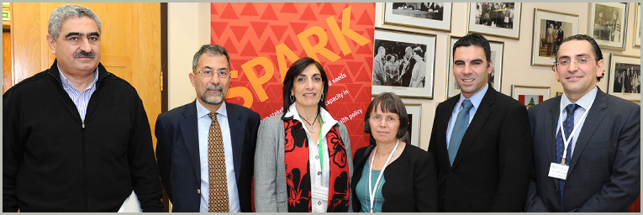
Center for Systematic Reviews of Health Policy and Systems Research (SPARK)
SPARK
The first Center of its kind in Lebanon and the Eastern Mediterranean Region that specializes in the production of systematic reviews and other evidence synthesis products that respond to health policy and systems priorities
Founded in 2013, with funding from the Alliance for Health Policy and Systems Research.
Competitively selected to host the Secretariat of the Global Evidence Synthesis Initiative (GESI).

Slide 7

Knowledge to Policy (K2P) Center
SPARK
SPARK
A forerunner in synthesizing evidence, contextualizing knowledge and engaging stakeholders to impact health policy and action in Lebanon and the Region.
Modeled after McMaster Health Forum
Founded by the Faculty of Health Sciences (FHS) at the American University of Beirut with seed funding from the International Development Research Centre (IDRC)
Designated since 2015 as a WHO Collaborating Center for Evidence-Informed Policy and Practice

Slide 8




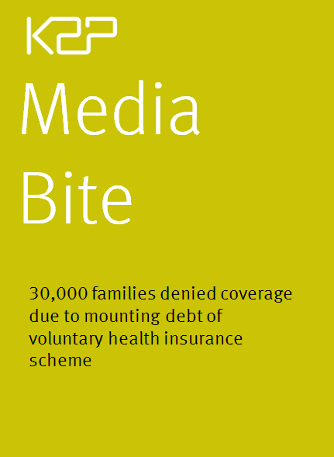

K2P Knowledge Translation Products
SPARK

Slide 9
SPARK
Integrated Knowledge Translation Model to Promote Evidence-Informed Health Policymaking
Priority Setting
Knowledge Production
Systematic reviews
Knowledge Translation
Evidence brief for policy
Knowledge Uptake
Engaging policymakers, stakeholders, civil societies and citizens
Political context
Formal and informal discussions
Rapid reviews
Rapid response products
Guidance documents
Policy dialogue
Citizen engagement
Advocacy strategy
Media engagement
Political engagement
SUPPORT summaries
Evidence summary
Receptive Environment for Use of Evidence in Decision-making
Impact
Capacity Building at Multiple Levels
SPARK
K2P
El-Jardali, F., & Fadlallah, R. (2015). A call for a backward design to knowledge translation. Int J Health Policy Manag, 4, 1-5.
9

Slide 10
Case study 1:
Establishing a performance-based contracting model between Ministry of Public Health & private and public hospitals in Lebanon to improve quality of care, patient outcome, and system performance

Slide 11
Context
SPARK
SPARK
The health care system in Lebanon is pluralistic due to the public–private mix involved in the financing and provision of health services.
The Ministry of Public Health (MOPH) contracts with 105 private hospitals and 26 public hospitals to deliver healthcare services to uninsured citizens, thus providing hospitalization coverage to about 53% of the Lebanese population.
The MOPH is considered the main financier of private hospitals, allocating about 64% of its total annual budget for hospitalization coverage.

Slide 12
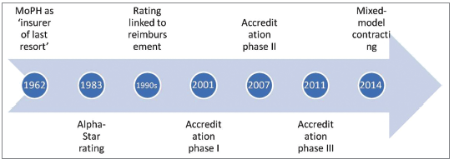
Hospital Contracting Reforms
SPARK
  In 2001, accreditation system was introduced and was linked to reimbursement rate for hospitals. The accreditation- reimbursement link was evaluated and found to be inappropriate.
  In 2014, the MOPH implemented a new reimbursement formula that is based not only on accreditation but also on additional criteria / indicators. However there is a risk that this arrangement may not reflect hospital’s actual performance and not be optimal for improving patient outcomes.

Slide 13
Hospital Contracting Reforms
SPARK
Performance-based Contracting is currently a priority for the MOPH in Lebanon:
Establishment of a reimbursement model fully based on performance indicators to include higher payments for hospitals with higher quality of care and better health outcomes.
Performance-based contracting is a form of pay for performance (P4P).

Slide 14
Pay for Performance (P4P)
SPARK
P4P is defined as the “transfer of money or material goods conditional on taking a measurable action or achieving a predetermined performance target” (Eichler 2006).
While some arrangements allow that providers get paid equally regardless of the quality of care they are providing, pay-for-performance adjusts the fee-for-service model to include higher payments for higher quality care.
P4P is increasingly being used to drive improvements in health care quality and safety.
Pay-for-performance programs are being implemented in a growing number of developed countries, including the United States (US), United Kingdom (UK), Canada, Australia, New Zealand, and in a number of developing countries including now Qatar.

Slide 15
Pay for Performance
(P4P)
SPARK
4 P4P models have been identified in the literature:
Donor to government
Within public sector
Government/Purchaser to non-state provider (private)
Non-state provider and health facility/health workers
Public-private partnership in Lebanon
Source: Eldridg & Palmer, 2009

Slide 16
Which Evidence to Prioritize?
SPARK

Slide 17
Evidence from Systematic Reviews
SPARK
A systematic review (SR) is a high-level overview of primary research that aims to identify, select, synthesize and appraise all research evidence addressing a particular research question in order to answer it.
SRs rely on systematic, explicit and accountable research methods.
SRs provide policymakers, stakeholders and professionals with the most reliable evidence to inform their decisions and practices.

Slide 18
Evidence from Systematic Reviews
SPARK
SRs constitute a more appropriate source of research evidence than individual studies:
Probability of being misled by research evidence is lower with a SR than with an individual study .
Confidence in an intervention’s effectiveness is higher with a SR than with an individual study.
SRs provide a summary of the best quality studies, so drawing on an existing SR constitutes a more efficient use of time.
SRs summarize the findings of studies conducted in different settings so they make it easier for users to assess the applicability of a certain option.

Slide 19
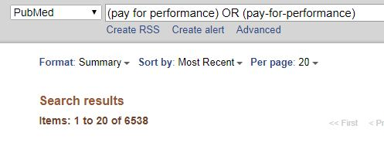
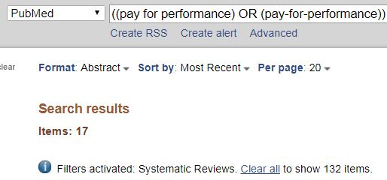
Existing Evidence on P4P
SPARK

Slide 20

SPARK
Which evidence should you prioritize?
Primary studies
Systematic reviews

Slide 21
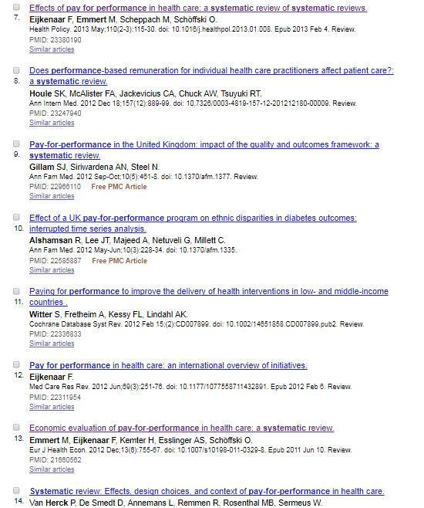
Sample Systematic Reviews on P4P
SPARK

Slide 22
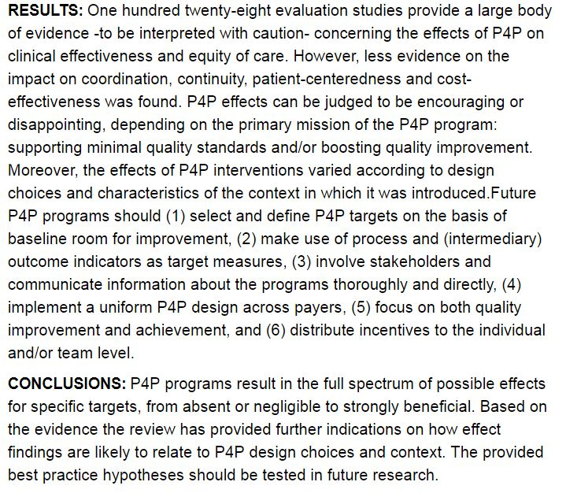

Slide 23
Interpretation of Evidence from Systematic Review
SPARK
How should this evidence be interpreted?
Can it be used to inform decision-making?
  Yes it can and it should.
  Policy decisions will be made regardless of whether or not evidence is present.
  Health systems are complex in nature and health systems strengthening is not an easy or quick task ➔ Sometimes, the existing research evidence is not very robust, but it is the best available research evidence to inform the decision at that time.

Slide 24
SPARK
Effectiveness of P4P | Findings
clinical effectiveness | Effects of P4P ranged from absent to positive (1 to 10%) or very positive (above 10%), depending on the target and program. In general, there was about 5% improvement in quality of care and performance due to use of P4P, with wide variations depending on the measure and program.
Access and equity of care | P4P did not have negative effects on patients of certain age groups, ethnicity, or socio-economic status, or patients with different comorbid conditions.
Cost effectiveness | Cost-effectiveness of P4P use was reported in several studies.
Important role of evidence in answering many different types of questions which policymakers need to inform their decisions.
Summary of findings from systematic review by Herck et al, 2010

Slide 25
Interpretation of Evidence from Systematic Review
SPARK
Is this evidence adequate to inform policy decisions related to P4P?
    Evidence on the effectiveness of interventions should be supplemented by evidence on how contextual factors (e.g. health systems characteristics, target population, culture) can affect the size of such effectiveness.
    Relying on only what can work – as opposed to understanding how, why, when and for whom interventions work – has contributed to the uneven progress towards the achievement of the Millennium Development Goals, and to the weak health systems responses to Ebola and refugee crisis.

Slide 26
Implementation Considerations
SPARK
Level | Barrier | Counterstrategies
Patient | -- | --
Professional | Cherry-picking: selecting healthier cases to achieve better outcomes Dependency on financial incentives: Provider may stop on improving performance when the incentives end Demoralization: occurs if short-term professionals receive more financial incentives than those who have established long-term practices | Use of a combination of process and outcome measures Alignment with norms and values to keep providers’ intrinsic motivation. Involvement of stakeholders, particularly providers, in designing the program Provision of a relatively high incentive Provision of incentives of a purely positive nature Selecting and defining targets based on baseline room for improvement
Organizational | Free-riding: in group settings performance payments may not be effectively distributed to group members, and it may be tempting for members to free ride, especially in large groups. Bureaucratization Limited Resources | Minimizing delay between care delivery and pay- out Use of absolute targets
System | Gaming the system: improving on reporting/documentation rather than improving performance | Use risk adjustment to even playing field across providers with respect to severity of patient mix Supply data via an online tool enabling auditing and checks Impose penalties on hospitals failing to meet data accuracy targets

Slide 27
Summary of the Evidence on P4P
SPARK
P4P can improve quality of care.
Effectiveness of P4P depends on the design of the scheme and the context in which it is implemented.
Findings suggested:
    Selecting and defining P4P targets based on baseline room for improvement.
    Using a combination of process and outcome measures
    Involving stakeholders in designing the program
    Providing a relatively high incentive size
    Implementing a uniform P4P design across different payers at a national level rather than fragmented initiatives

Slide 28
Implications for Countries in the EMR
SPARK
Is P4P a fit for all purpose? Can we develop one P4P program that can be implemented across countries of the EMR?
Magic bullets do not exist.
Each country has to:
  Agree on the payment formula, the mix and size of incentives & list of metrics.
  Define the goals that a health care purchaser wants to accomplish through the incentives
  Develop capacity including enforcement and monitoring strategy
  Knowledge translation becomes critical to contextualize the evidence and promote its uptake in policy decisions.

Slide 29
Missing Link: Knowledge Translation
SPARK
Research
process
Policy-making
process
Research
process
Policy-making
process
►
◄
►
◄
Unlinked processes
Poorly/unintentionally linked processes
Knowledge-
translation
processes
Policy-
making
process
Research
process
►
►
◄
Purposefully linked processes
Source: Lavis, 2006

Slide 30
SPARK
Integrated Knowledge Translation Model to Promote Evidence-Informed Health Policymaking
1-Priority Setting
2- Evidence Production & Synthesis
Systematic reviews
3- Knowledge Translation Products
Evidence brief for policy
4- Knowledge Uptake
Engage policymakers, stakeholders, civil societies and citizens in setting priorities
Political context
Guidance documents
Evidence summaries
Primary studies
Implementation
Media engagement
Advocacy strategy
Citizen dialogues
Policy dialogue
Rapid response products
Briefing notes
Receptive Environment for Use of Evidence in Decision-making
We are here
Impact
Capacity Building at Multiple Levels
SPARK
K2P
El-Jardali, F., & Fadlallah, R. (2015). A call for a backward design to knowledge translation. Int J Health Policy Manag, 4, 1-5.
30

Slide 31
Knowledge Translation Product
SPARK
The creation of new knowledge does not, on its own, lead to widespread uptake, implementation or impact on health.
Knowledge translation (KT) products allow evidence generated from the systematic reviews to be packed in a user-friendly format and written in an understandable language which would increase the likelihood to be used by policymakers.

Slide 32

Knowledge Translation
Product
SPARK
The findings from existing systematic reviews are incorporated into a knowledge translation product known as policy brief.
Policy Briefs bring together:
        Global research evidence (numerous systematic reviews)
        Local evidence (from primary studies, reports, indicators)
        Context-specific knowledge (key informant interviews with targeted policymakers and stakeholders)
To inform deliberations about health policies and programs.
Establishing performance-based contracting for hospitals in Lebanon

Slide 33
Knowledge Translation
Product
SPARK
Outline:
    Problem and underlying causes
    3-4 options to address the problem
    Implementation consideration
Format:
    Key messages (1 page)
    Executive summary (3-5 pages)
    Full brief (25-30 pages)
Establishing performance-based contracting for hospitals in Lebanon

Slide 34
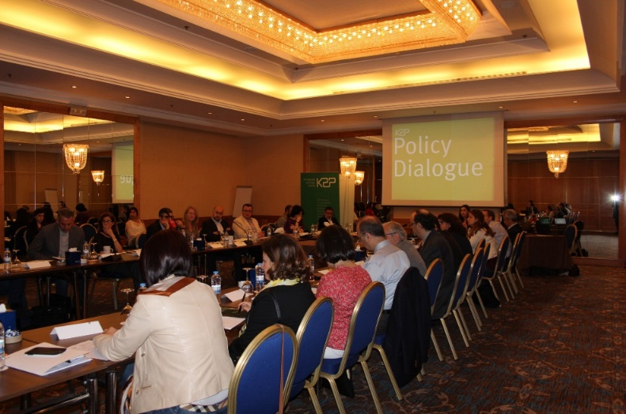
Knowledge Uptake
SPARK
Policy dialogue meeting about “Performance-based contracting for hospitals in Lebanon” being planned
Dialogue to include policy-makers, stakeholders, civil societies and researchers to deliberate about a
policy issue
Dialogue to be informed by Policy Brief
Dialogue brings research evidence together with the views, experiences and tacit knowledge of participants to agree on an ideal P4P model that would fit the context of Lebanon

Slide 35
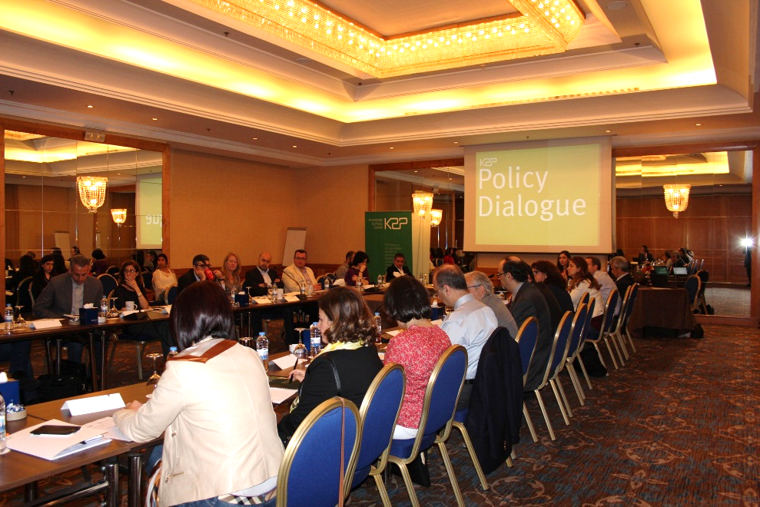
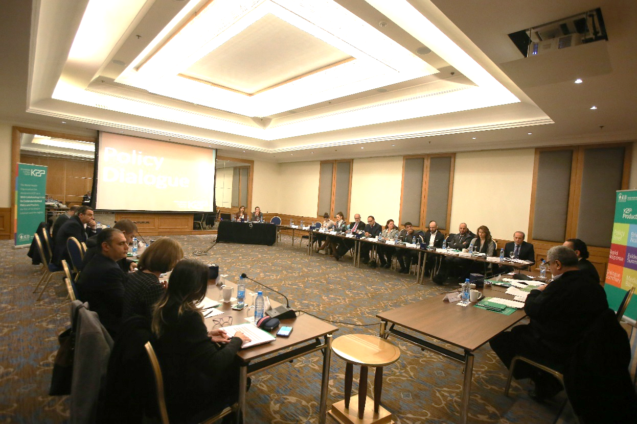
Policy Dialogue
SPARK

Slide 36
Desired Impact
SPARK
      A re-modeled pay for performance model to provide the right incentives to improve patient outcomes and value for money
      Model currently being pilot-tested by the MOPH. The model is based on the following indicators:
        Accreditation
        Patient satisfaction
        Readmission rates
        Case-Mix Index (CMI)
Patient level impact
Establishing performance-based contracting for hospitals in Lebanon
Health system/ hospital level impact
  A new reimbursement rate will be applied based on the performance scores.

Slide 37
Case study 2:
Enhancing access to care for Syrian refugees through better cross-sectoral coordination and Partnerships

Slide 38
SPARK
Refugee Crisis
Syrian conflict erupted in 2011
Large influx of refugee to neighboring countries (mainly Turkey, Lebanon and Jordan), as well as to distant countries

Slide 39
SPARK
Notes:
Turkey hosts the most refugees of any country worldwide with 2.77 million in total, ahead of Pakistan (1.58 million) and Lebanon (1.04 million).
Canada population 36 million; 1/3 is 12 millions

Slide 40
Refugee Crisis
SPARK
Major burden on different levels, including the economy, jobs, education system, and healthcare system in Lebanon
Health policy makers were struggling with how to respond to the needs of refugees in the context of an already strained health system
A number of local and international NGOs, UN agencies and governmental bodies and agencies provide humanitarian, assistance to Syrian refugees.
Poor coordination of efforts & partnerships between the different entities providing or financing health services led to inefficiencies and duplication of efforts and hindered optimal access of refugees to care.

Slide 41
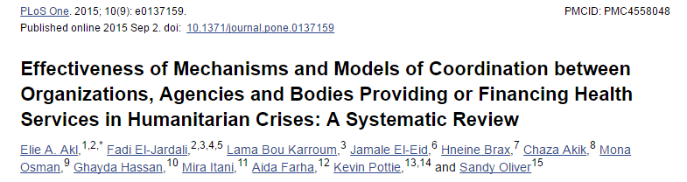
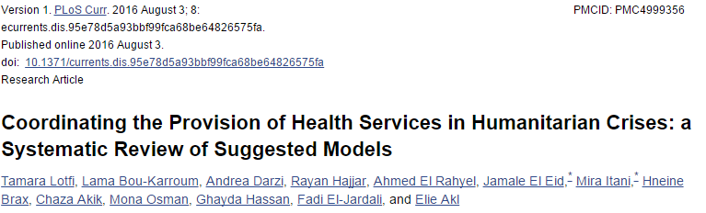
SPARK
Systematic Review Production

Slide 42
SPARK
Knowledge Translation
Preliminary findings from systematic reviews were incorporated into a Briefing Note
*Do not wait till the systematic review is published to disseminate findings!

Slide 43
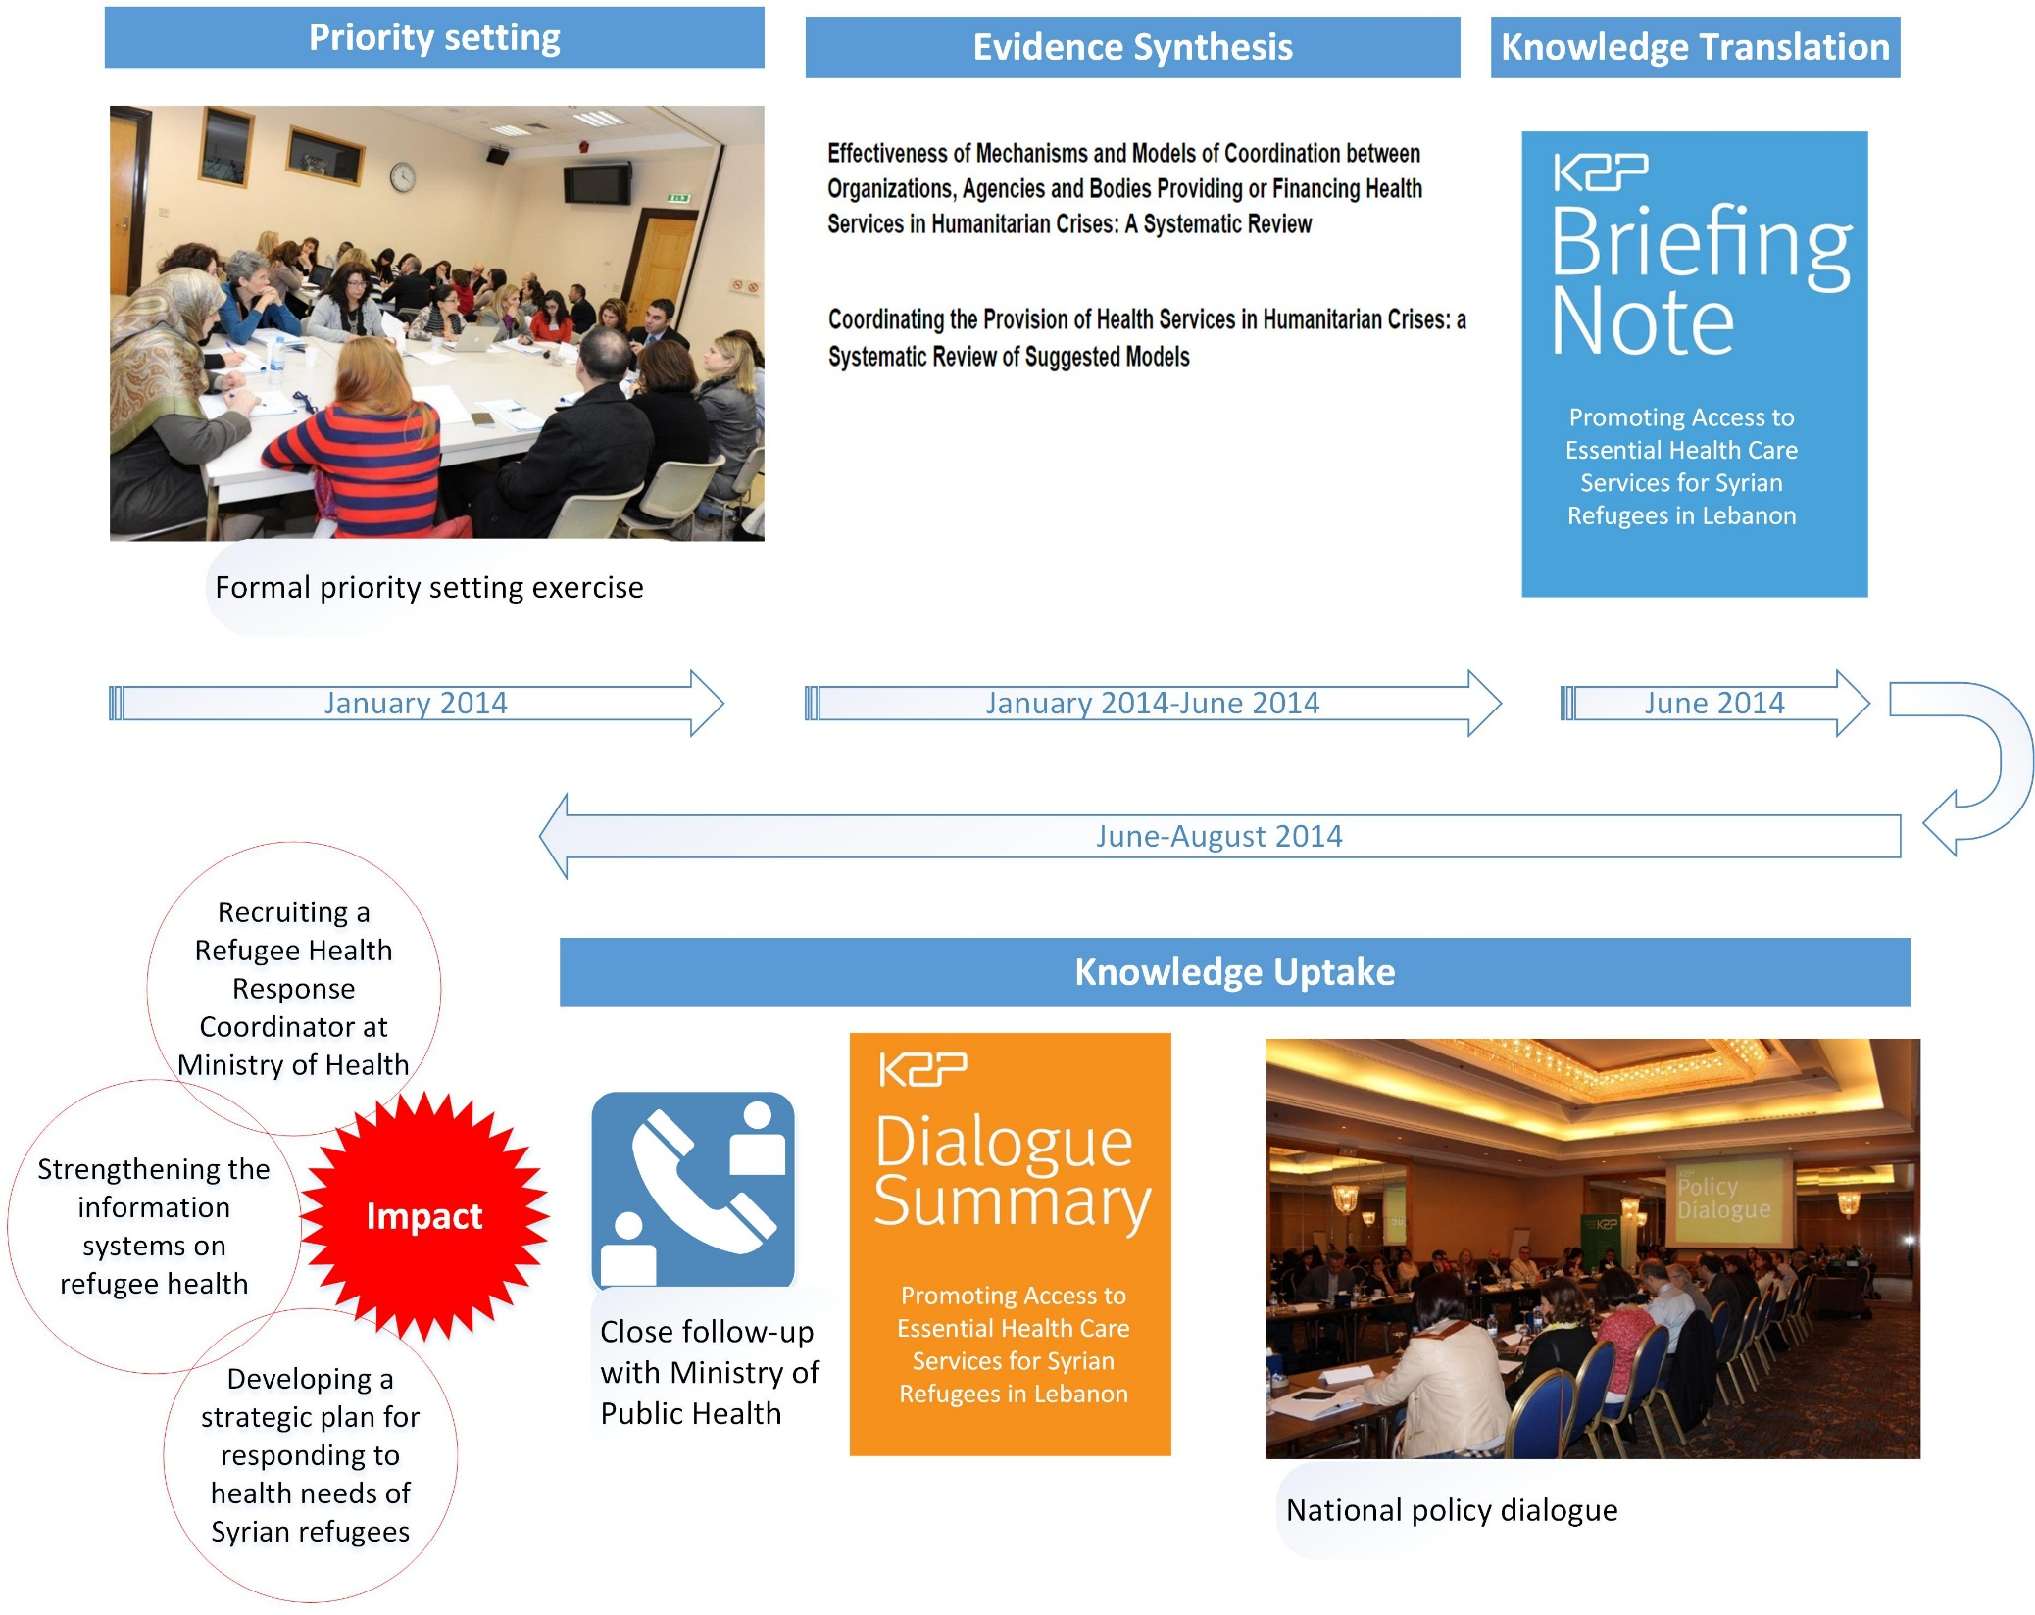
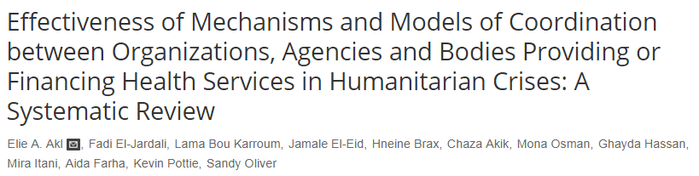
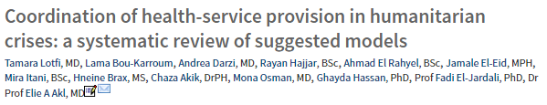

Slide 44
Case study 3:
Accelerating Progress to Universal Health Coverage through Implementation of Essential Health Benefits Packages

Slide 45
Leveraging on the UHC agenda
SPARK
In January, 2016, the Ministry of Public Health in Lebanon launched the “Comprehensive Primary Health Care Project, a Step toward Universal Health Coverage”.
The project is considered a stepping stone to accelerate progress towards universal health coverage in Lebanon.

Slide 46
Determinants of Universal Health Coverage
SPARK
One of the key requirements for successful UHC programs is the design and implementation of Essential Health Benefits Packages (EHPs).
EHP is defined as a set of essential health services that population have access to.
A basket of six EHPs has been designed to be provided for free to 150,000 citizens of limited incomes through 75 primary healthcare centers selected according to the geographical location of the targeted groups
MOPH needs research evidence on the factors that are critical to the successful implementation of EHPs within PHC.

Slide 47
Evidence Synthesis
SPARK
A search of the literature revealed a lack of systematic reviews addressing this priority.
Accordingly, we conducted a systematic review of factors critical to the implementation, uptake and sustainability of health benefits package in low- and middle-income countries
Factors critical to implementation are presented at the governance, financial, and delivery arrangement levels of the health systems

Slide 48
Governance Arrangement level
Political commitment and national ownership of package
Involvement of all key actors including local authorities, PHC health workforce and package beneficiaries
Financial Arrangement level
Delivery Arrangement level
Availability of a sufficient, well-trained, gender-sensitive and motivated health workforce
Establishment of a legal and regulatory framework linking implementation to the overall health system reform
Clarity on authority and autonomy in making decisions related to the package
A simplified pricing lists for the services covered by the package
Linking package implementation to health financing reform (including resource allocation decisions and budgeting)
A supportive work environment
Incorporation of equity as a priority in delivering package
Dedication and discipline of PHC management and frontline staff to adopt and commit to the package
A respected and functioning PHC network with the appropriate level of accessibility and geographical coverage
Institutionalization of monitoring and evaluation as part of the health information system of the government
Awareness campaigns targeted at all key stakeholders
Public-private/NGO partnership to extend access to health services
Strong coordination between the PHC and the community network
Proper dialogue between policymakers and frontline implementers on the role and purpose of the package
Sufficient and timely remuneration to health care providers
Government and donor commitment to financing package and flexibility in exploring new funding mechanisms
Regular joint evaluation and rationalization by the MOPH and PHC managers on resource use to optimize combinations of inputs and minimize resource gap
A simplified list of co-payment categories to simplify cost calculations and achieve better public understanding
Lower co-payment for patients referred from the primary health care level compared to those without referrals
Integration of primary healthcare service delivery
Considerations to include trained traditional birth attendants in the package payment scheme in areas where they are perceived as a critical part of the health system
Effective referral and communication across the primary-secondary care interface
Translation of policies into practical interventions with a focus on priority interventions
Strong leadership & stewardship functions of the government & MOPH
Availability and proper management of equipment, protocols & stationaries, vital drugs & other medical supplies
Standard package definition with clearly defined preventive and curative services to be delivered at the different service level
Routine supervisory visits for key PHC programs and feedback on monthly PHC reports
Timely development of routine health management information
Strong coordination between government & various donors and international partners
El-Jardali, F., Fadlallah, R., Daouk, A., Rizk, R., Hemadi, N., El Kebbi, O., Farha, A., Akl, E. (2016). Barriers and Facilitators to Implementation of Essential Health Benefits Package in Low-income and Middle-income Countries: A Systematic Review. (under review)

Slide 49
Knowledge Translation
SPARK
A Guidance Document has been prepared to provide guidance to policymakers and stakeholders on how to implement essential health benefits package within primary care.
The Guidance Document combined global research evidence and best practices to inform the implementation process as well as provides implications to local contexts at the governance, financial and delivery arrangement level of the health system.
The Guidance Document to help guide the implementation process in Lebanon.
Notes:
For case study 3, it is important to remind them of the public-private partnership involved, i.e. that NGOs and private sectors in Lebanon account for 60% of the PHC centers within the PHC network, and that the MOPH has created a special type of contractual agreement with these PHC Centers tot deliver the essential benefits package

Slide 50
Reflections & Lessons Learned
SPARK
Health policymaking and health system strengthening need to be informed by robust research evidence.
Health systems are highly context-specific, thus necessitating an approach that is evidence-informed, context-specific and responsive to a country’s needs.
Evidence synthesis and knowledge translation centers / platforms have critical roles to bridge the gap between research and policy and promote evidence-informed policymaking.
Engaging policymakers and stakeholders in priority-setting, research(knowledge co-production), and knowledge translation is critical to facilitate uptake of evidence in policy decisions.

Slide 51
Reflections & Lessons Learned
SPARK
Leveraging pre-existing research evidence and systematic reviews can enhance efficiency and minimize research waste.
Utilizing a range of knowledge translation products, strategies and tools is critical to contextualize the evidence and promote their uptake in decision-making.
SDGs cover a wide range of social, environmental and economic issues and cross-sectoral collaborations and PPP are critical
Strengthening the science–policy–society interface and ensuring the continuity of science–policy dialogue in all areas of sustainable development is imperative for all countries and at all levels
Turner, Tari, and Fadi El-Jardali. "Building a bright, evidence-informed future: a conversation starter from the incoming editors." (2017): 88.

Slide 52
Thank you
For more information:
www.aub.edu.lb/spark
www.aub.edu.lb/k2p
Follow us on Twitter:
@SPARK_AUB
@K2PCenter
Email:
fe08@aub.edu.lb
@feljardali

