Slide 1
Public-private partnership for UHC
THE WAY FORWARD
November 13th, 2017

Slide 2

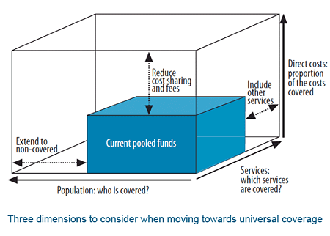
Let’s be clear where PPP Could help uhc?

Slide 3
Planning Horizons for UHC and health system
5 years of
20-30 years?

Slide 4
Potential Areas for ppp (incomplete list)
Expand service coverage
  Use existing capacities within private sector, when public capacities are overstretched
  Reach hard to reach population by engaging NGOs (Sudan, Jordan, Lebanon, etc.)
Include other services or alternative approaches
  Develop new capacities through PPP e.g. screening centers in shopping malls, dialysis centers, etc.
  Hospital investments in UK
  Elderly care – home management e.g. Dubai
  Google surveillance in US
Reduce cost sharing and/or costs and increase value
  Complimentary or basic insurance to pool the risks and reduce OOPs
  Engagements with technology providers for securing better pricing
  Assess the value afforded by new technologies using HTA
  More efficient production through economies of scale (if feasible and realistic????) telemedicine, etc.

Slide 5
What are Gaps in policies and regulations?
A LOT such as (incomplete listing):
  Lack of understanding
    Why do we need PPPs?
    What triggers need for PPP and when?
  Lack of willingness to engage private sector
  Lack/or weak capacity within the public sector entities/organizations
  Lack of information but (solvable) with information technology
  Rule of law and corruption related issues
  Capacity to develop contracts, lack for templates on HOW THINGS ARE BEING DONE?

Slide 6
Added value of global-regional partnerships

Slide 7

Added value of global-regional partnerships

Slide 8


Slide 9
Advancing Health Systems for All in the SDG Era
Symposium 4 sub-themes
The SDGs as a stimulus for renewed multisectoral action
Polemic and pragmatism: engaging the private sector in moving towards universal health coverage
Leaving no one behind: health systems that deliver for all
Community health systems – where community needs are located, but often the invisible level of health systems
http://healthsystemsresearch.org/hsr2018/
http://healthsystemsglobal.org/

