Slide 1

Community Partnerships for Social Justice in the Health Sector
Dr. Laila Iskandar
CID Consulting

Slide 2
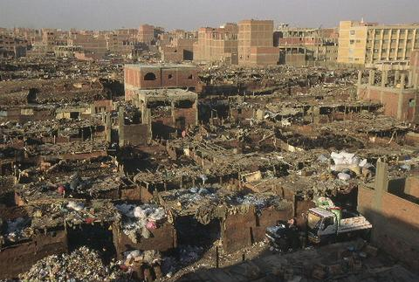
Reaching the Unreached

Slide 3
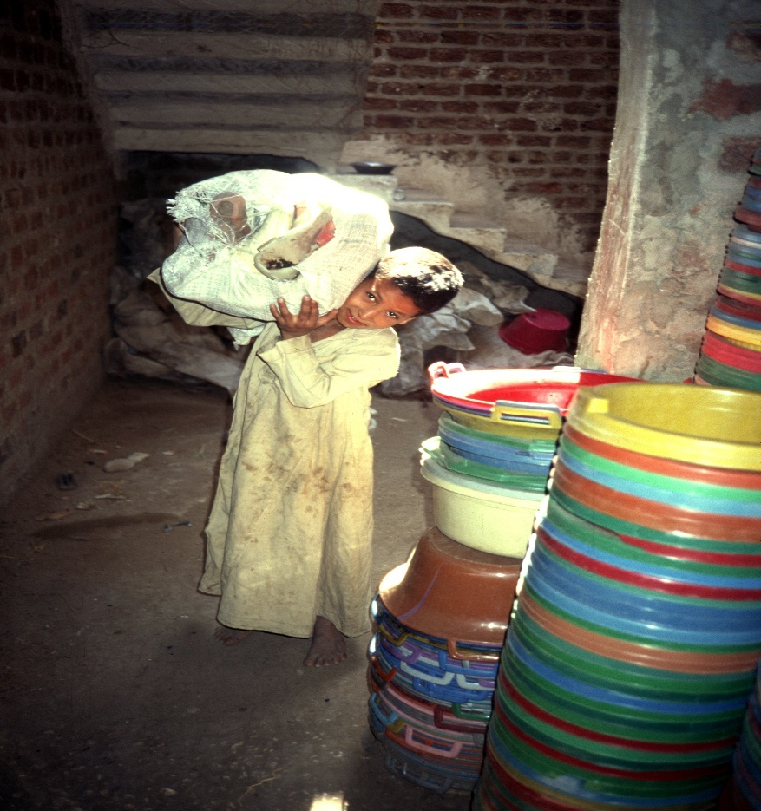
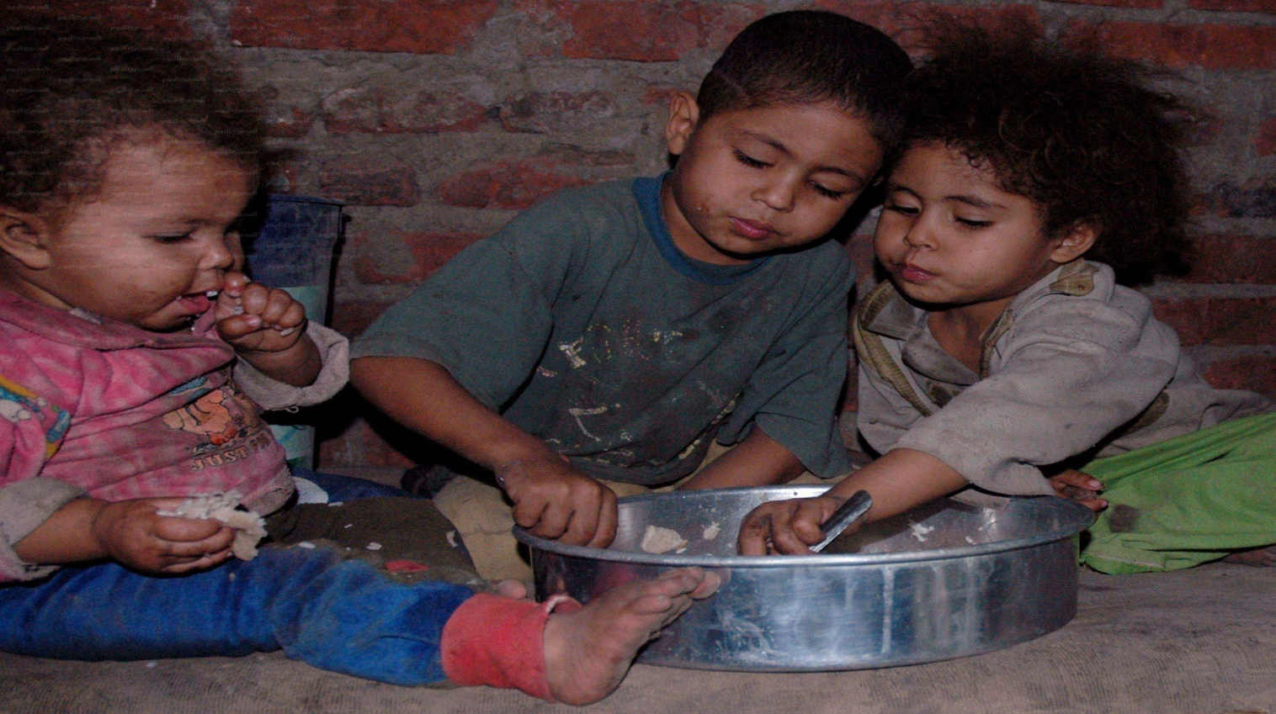
Addressing non medical aspects of Health

Slide 4
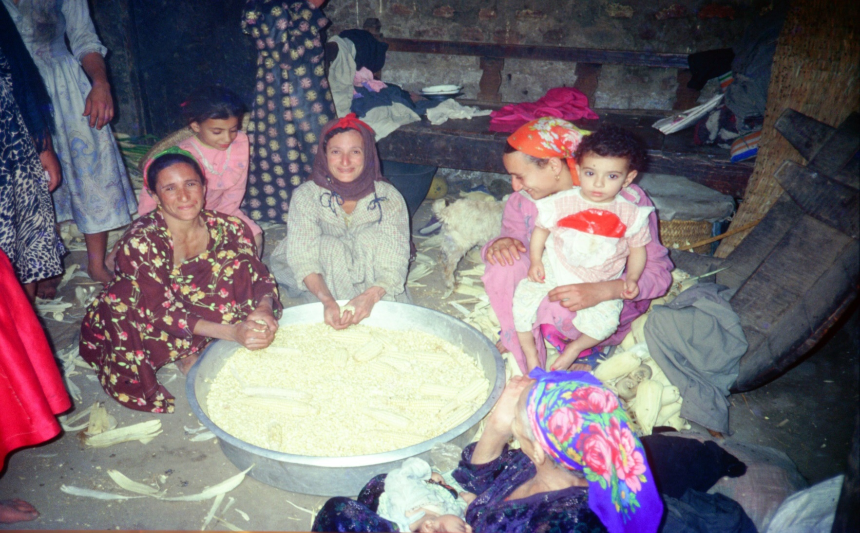
Home Based Family Health – Gender approach to power over resources

Slide 5
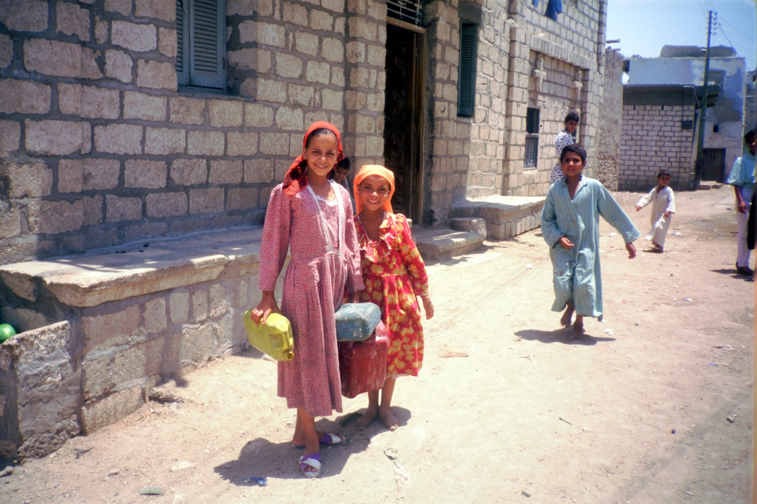
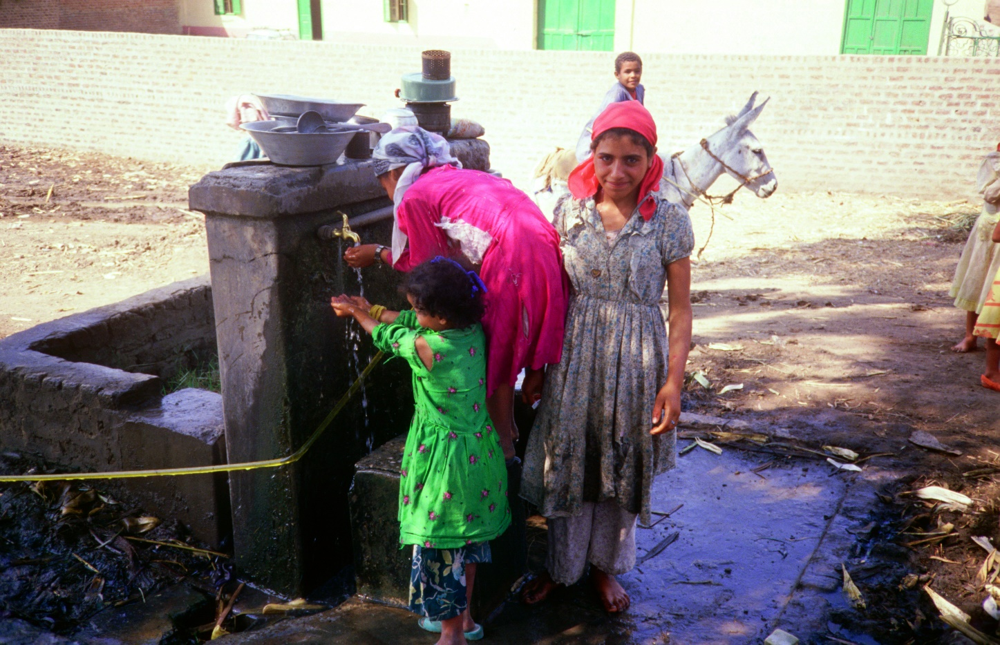
Financing non medical home based health needs

Slide 6
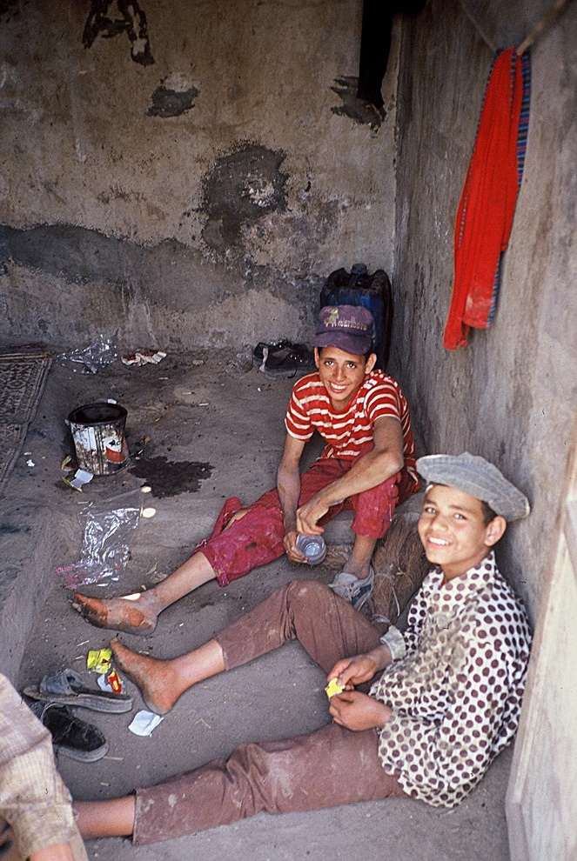
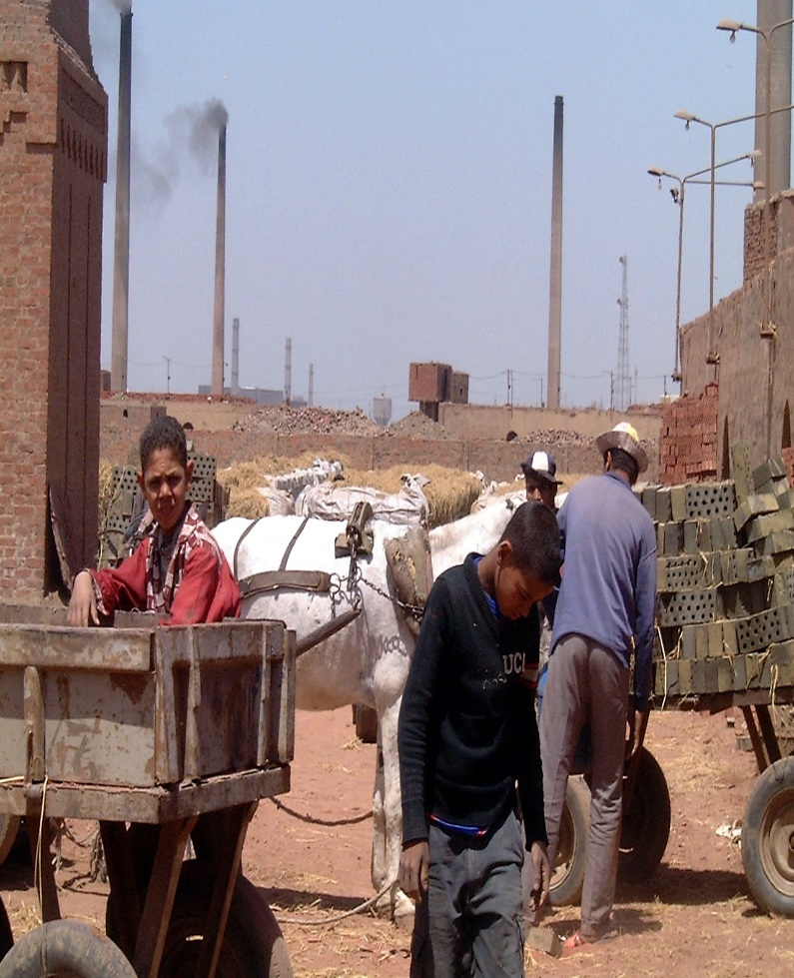
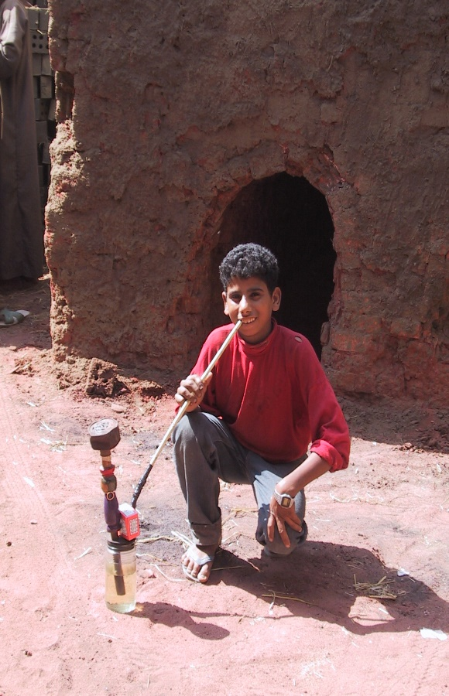

Slide 7

Children in Brick Factories
No. of Children by Task
70
65
No. of Children
60
56
50
40
30
20
13
10
1
3
0
0
0
0
0
Harii
Hamra
Khadra
Khatt
Cleaners
Sikkin
Mechanics
Clay loader
Truck drivers

Slide 8
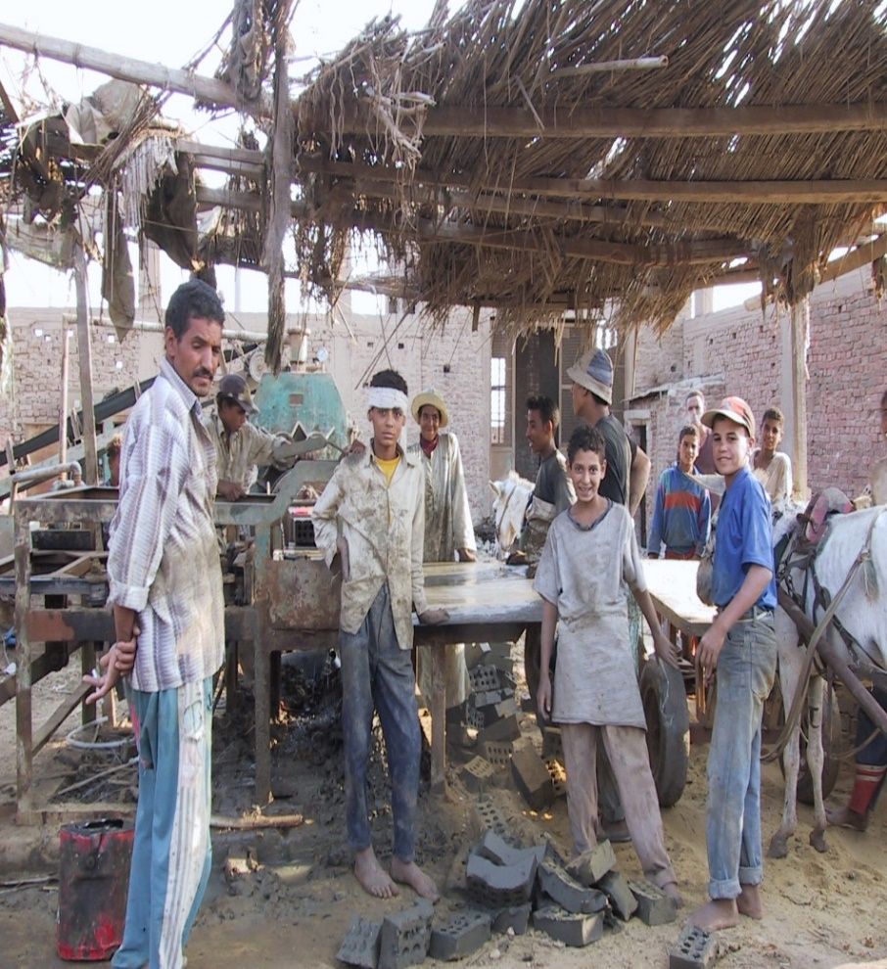
Issues Identified by Brick Factory Workers
Water Supply and Quality
Upgrading the Waste Water System
Improving and Paving Main Roads
Establishing Emergency Health Services
Providing Telephone Lines (Infrastructure)
Toilets
Living Conditions/Accommodations for Workers in Factories
Children's Education (Vocational and Academic)

Slide 9
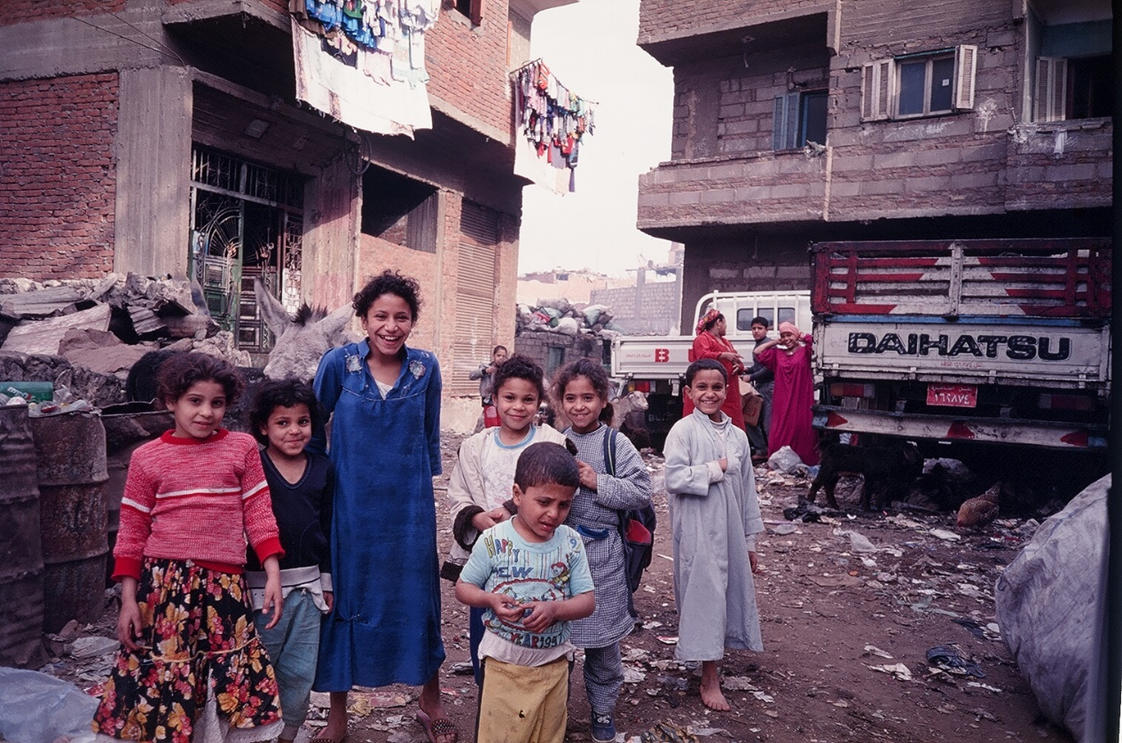
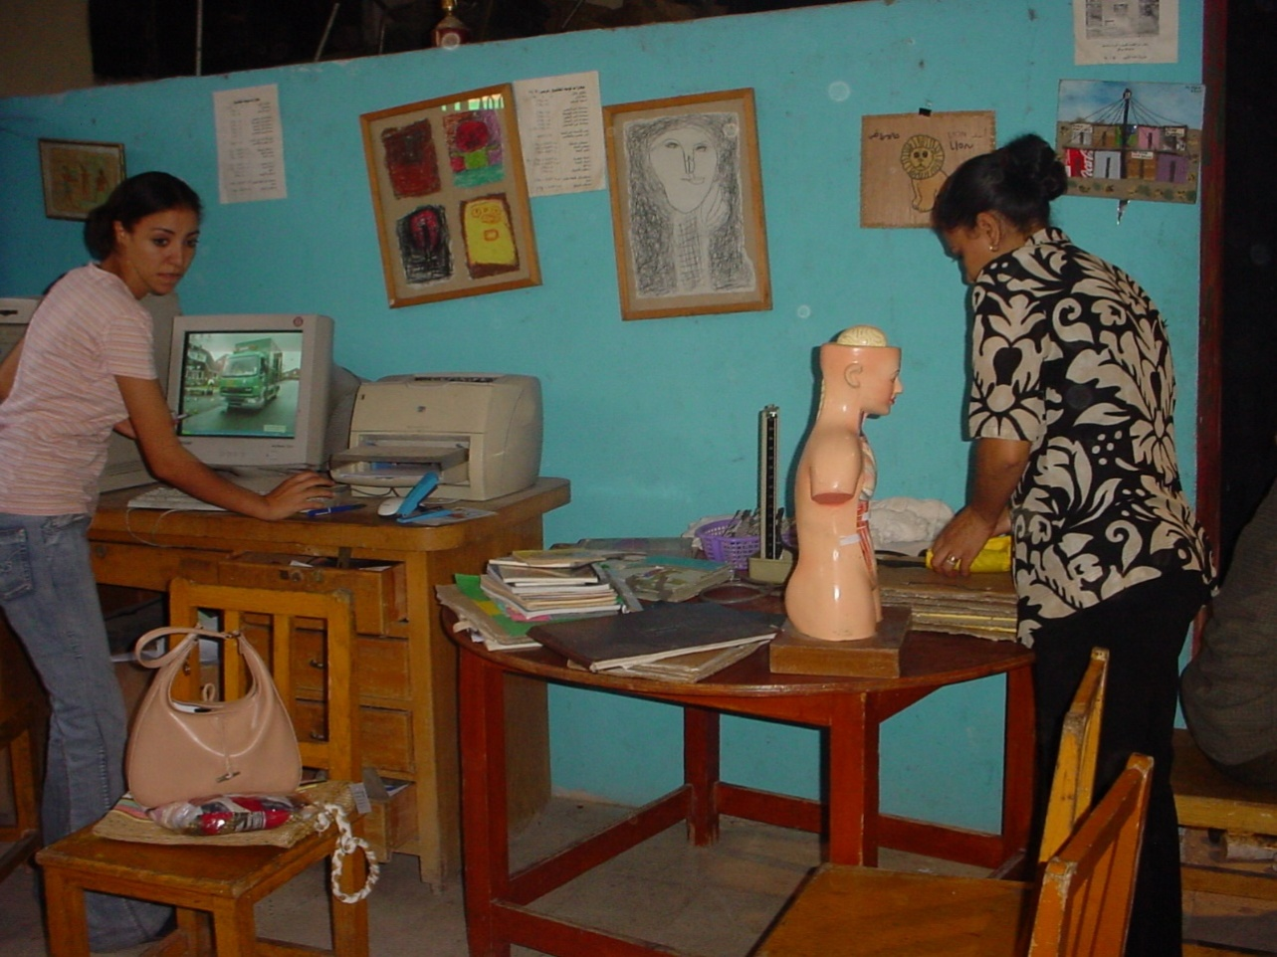
Non Formal Education on Health Issues - Urban and Rural

Slide 10
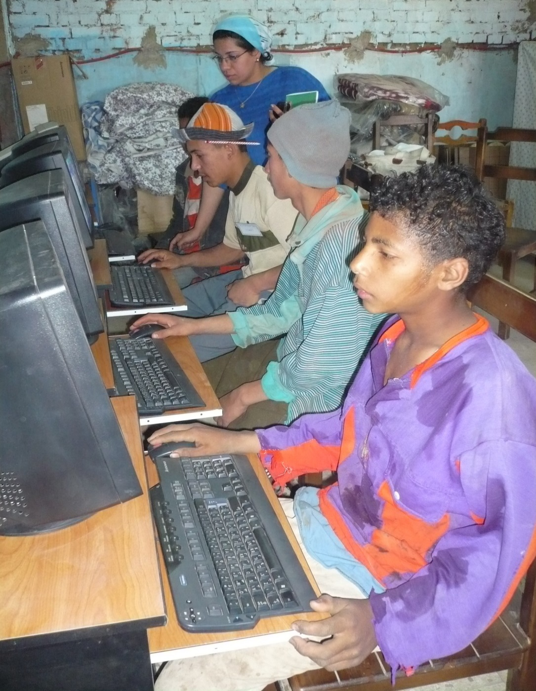
This requires mobilizing, training, and managing people and resources

Slide 11
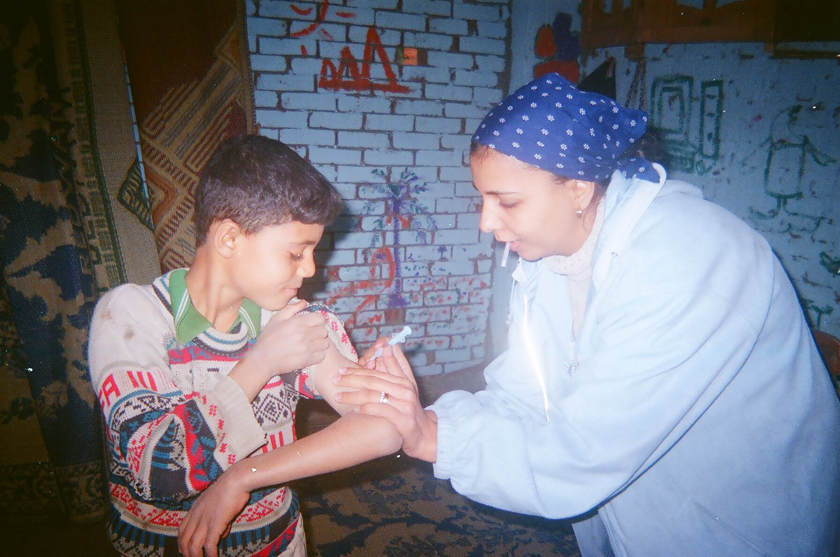
Linking to Government Services

Slide 12
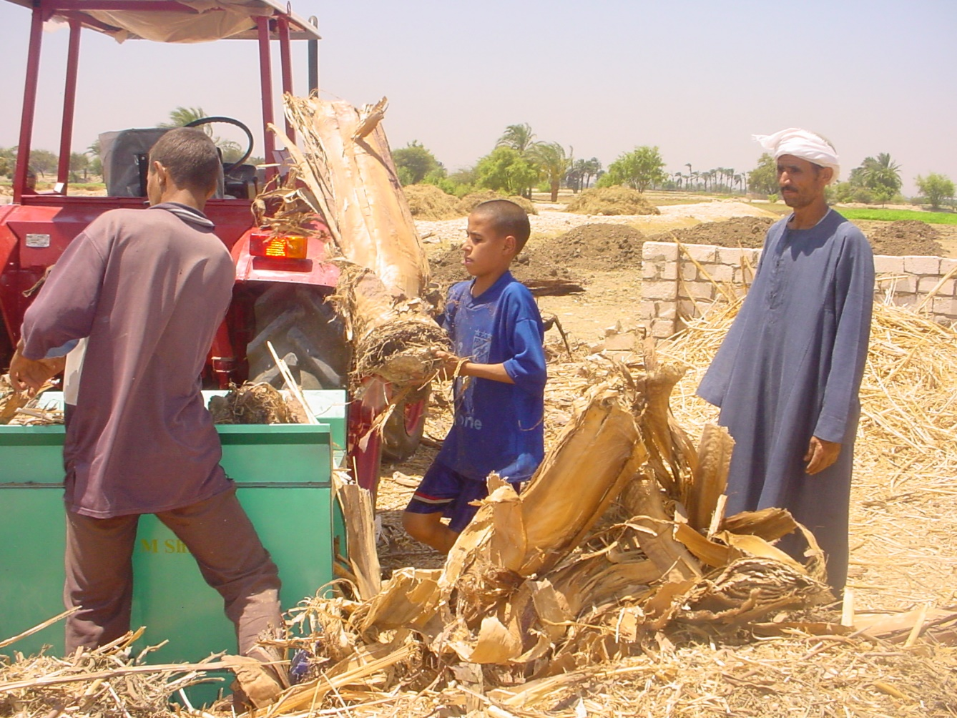
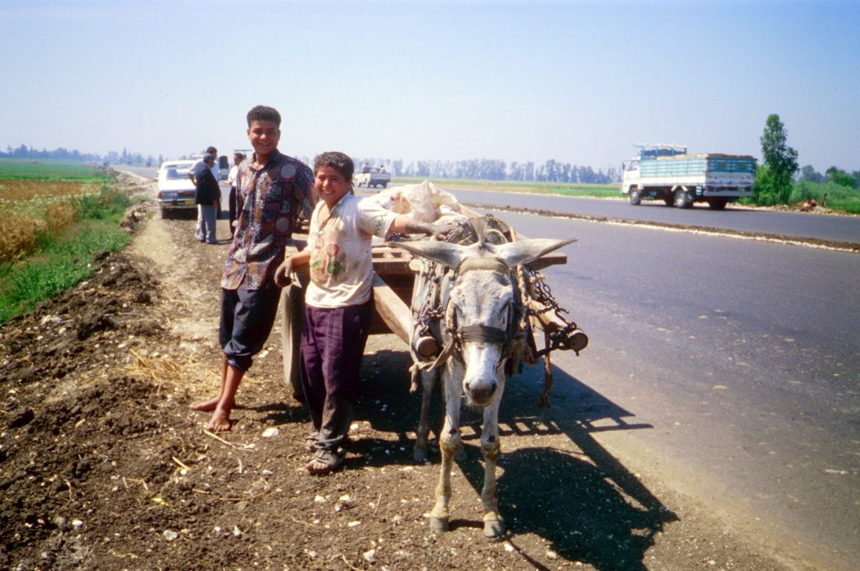

Slide 13
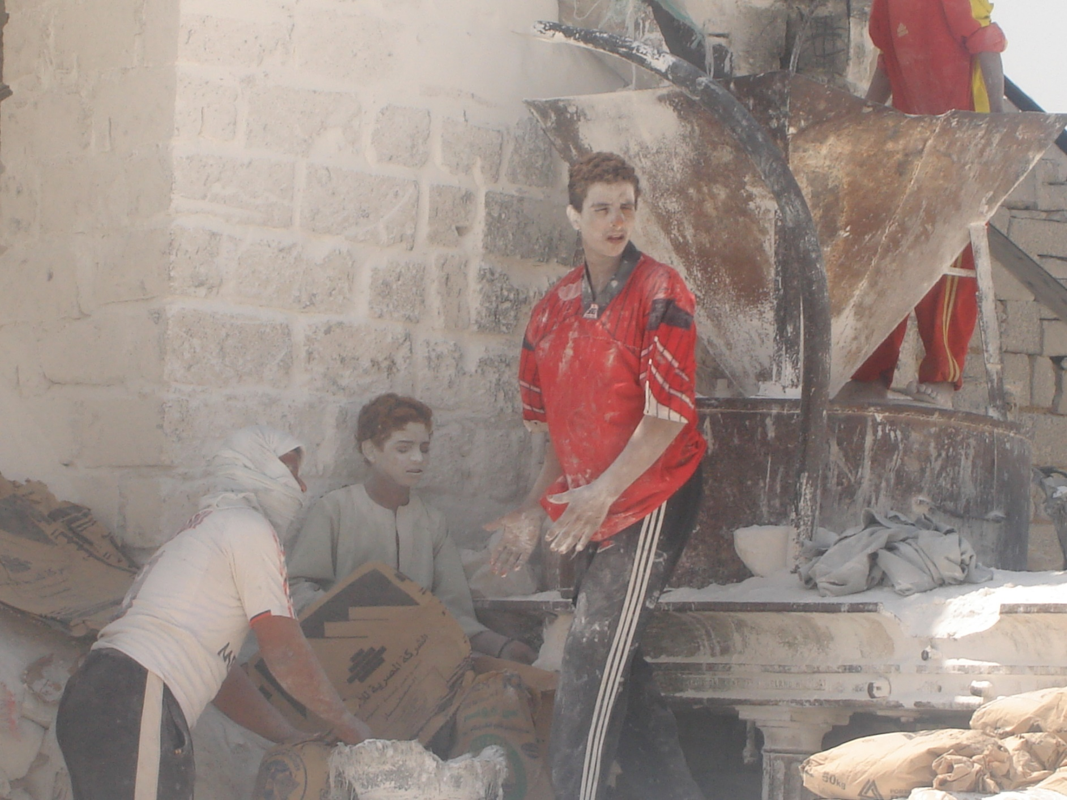

Slide 14
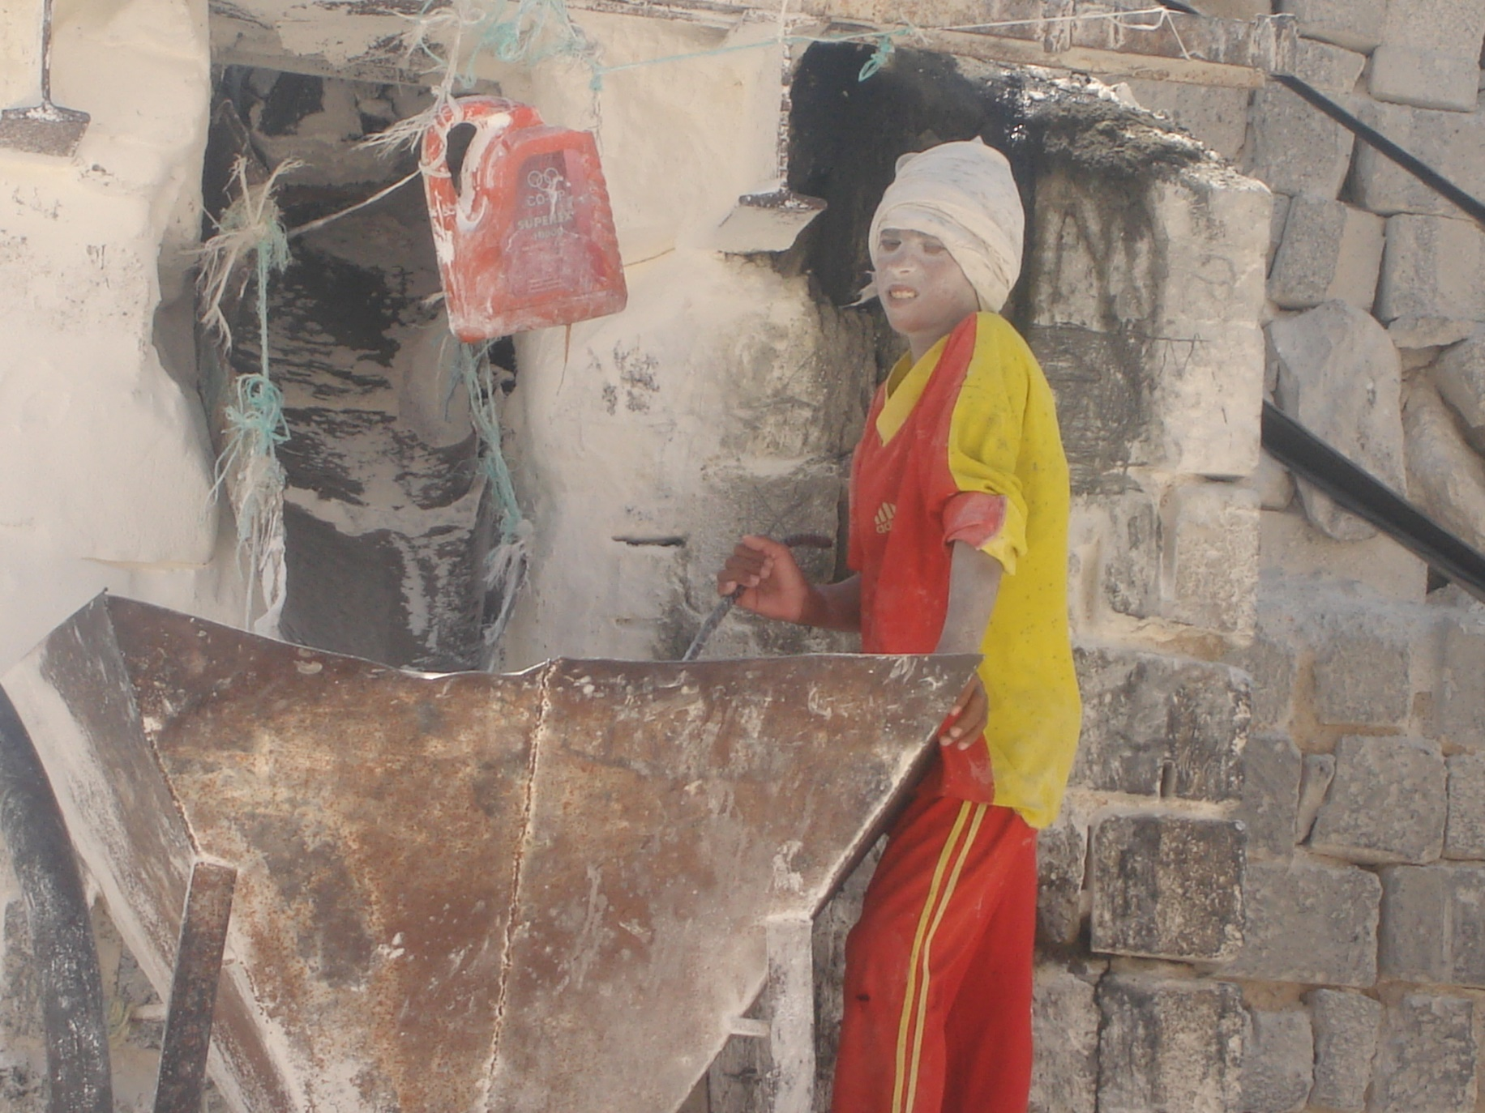

Slide 15
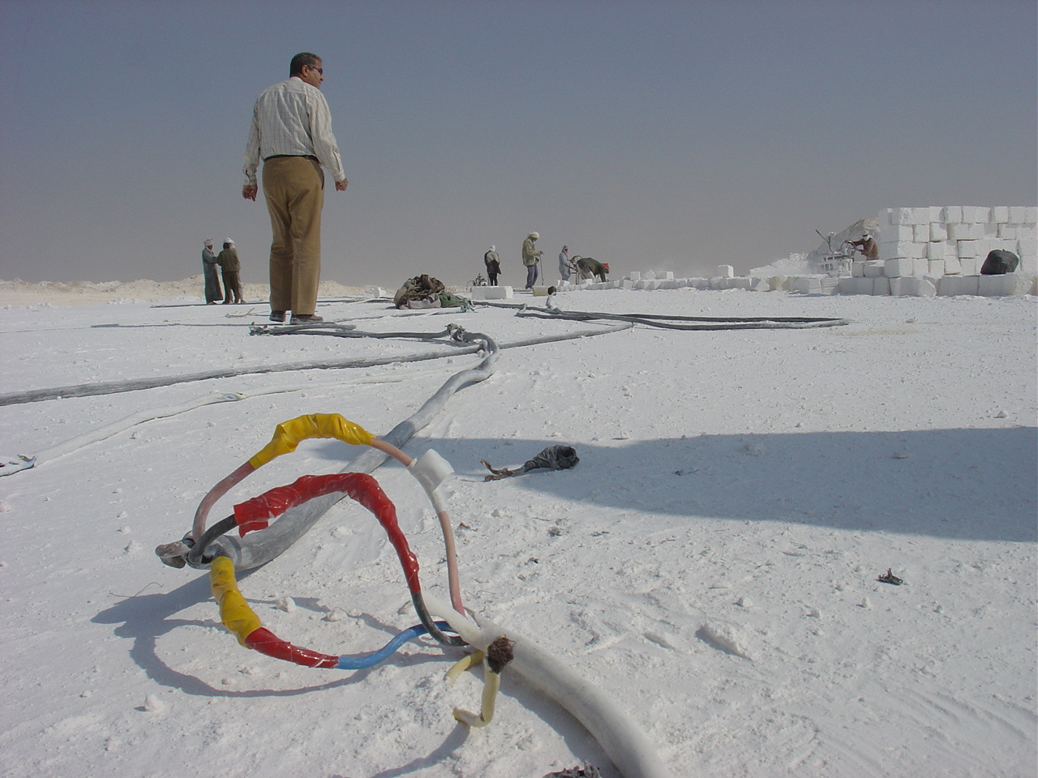

Slide 16
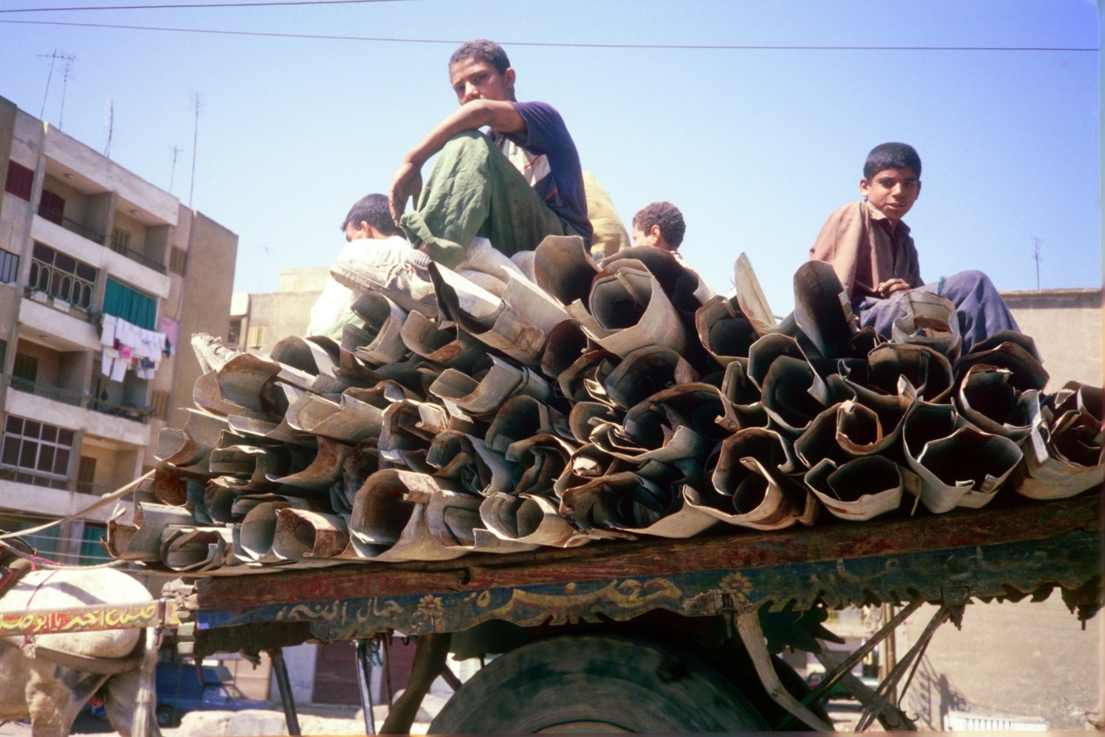
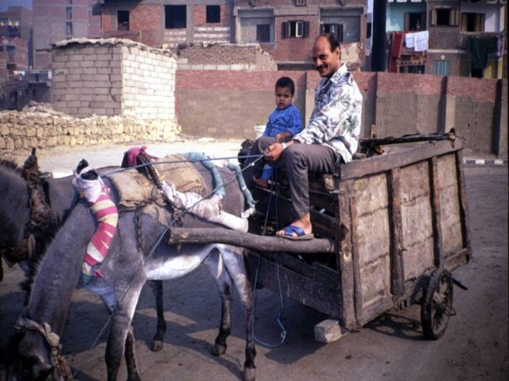

Slide 17
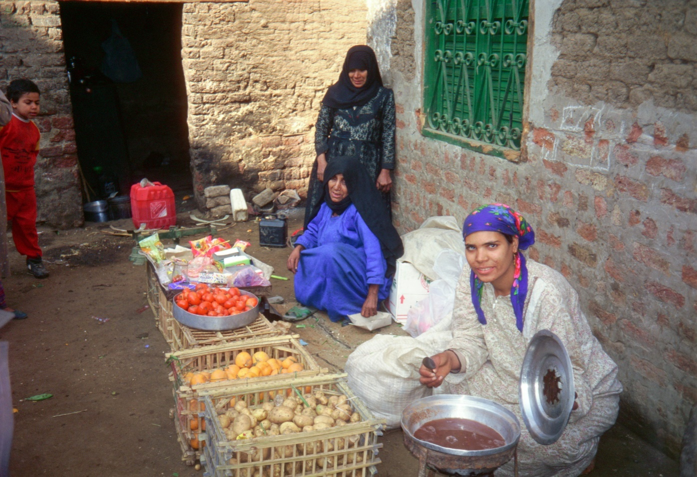
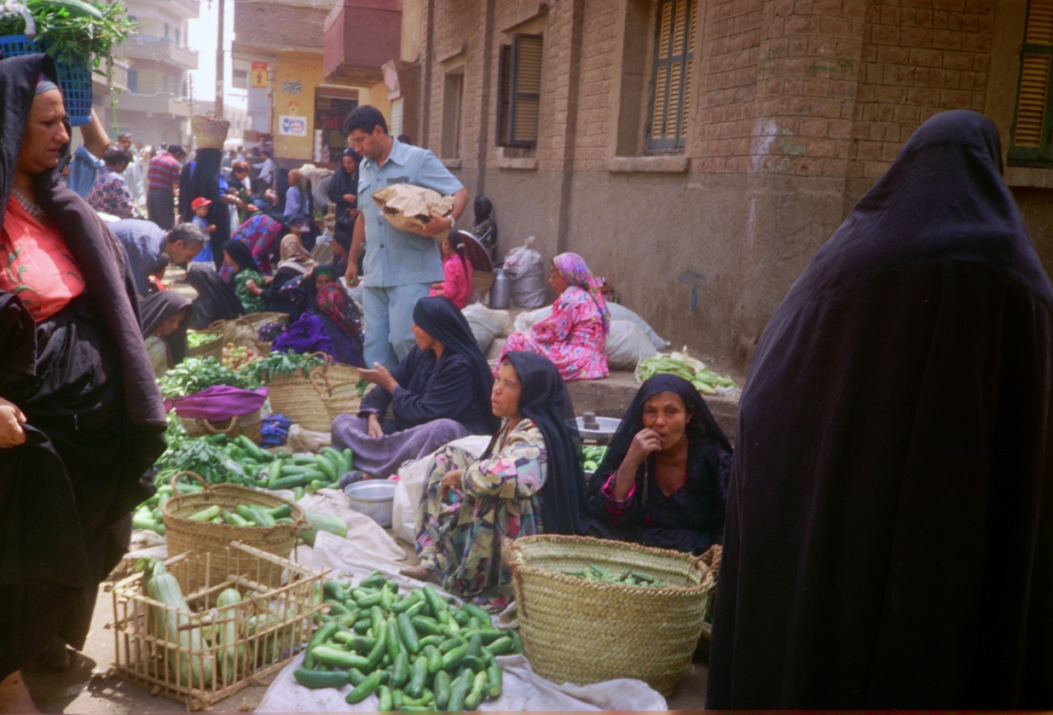
Home Based Rural focus

Slide 18
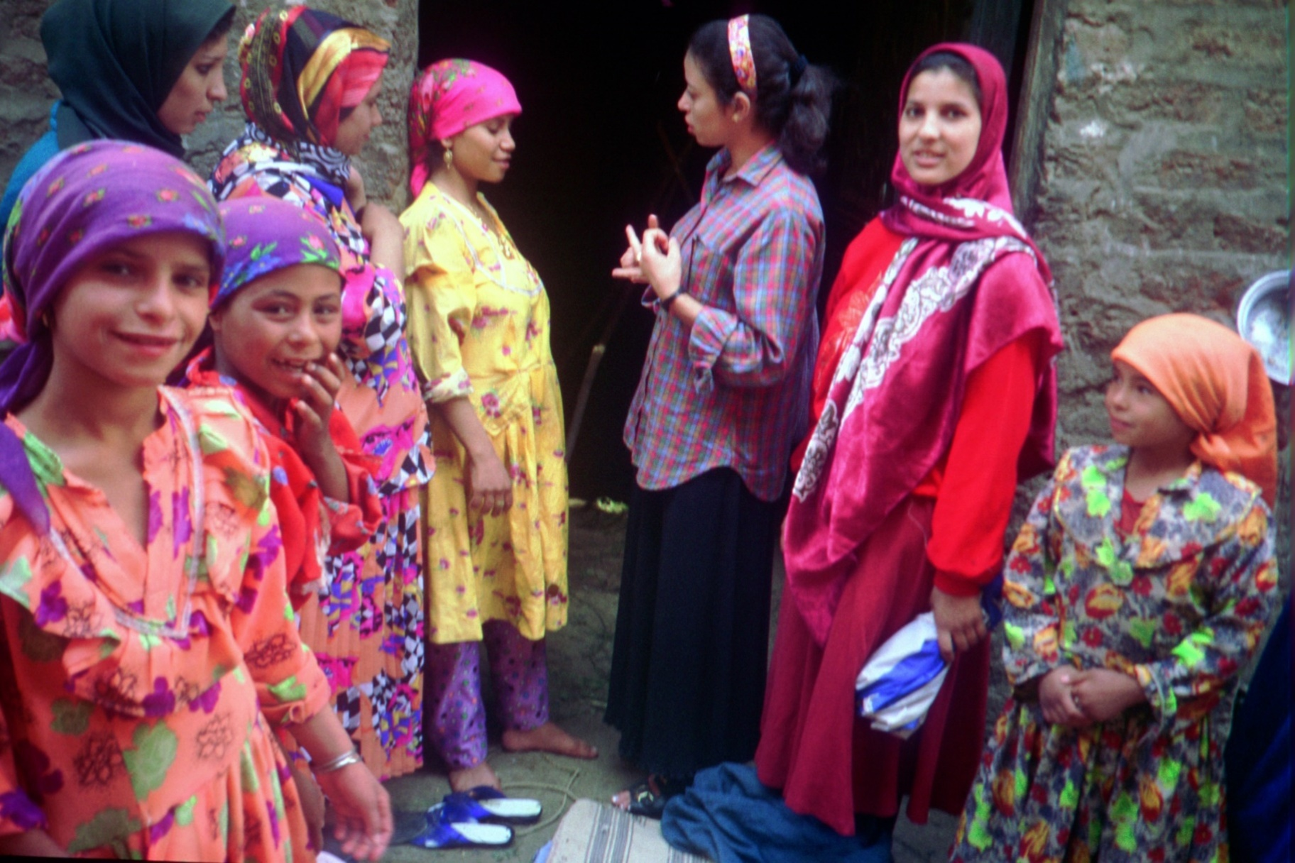
Who Finances these?

Slide 19
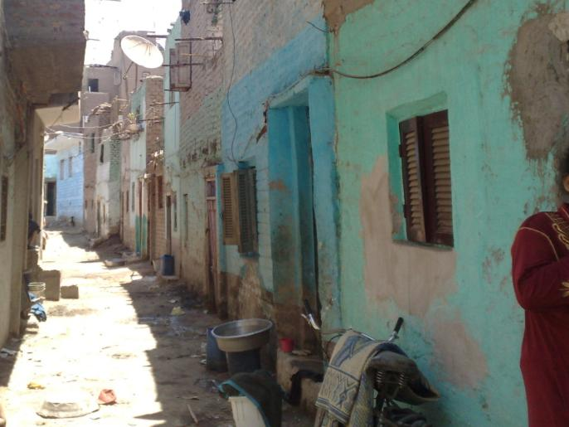
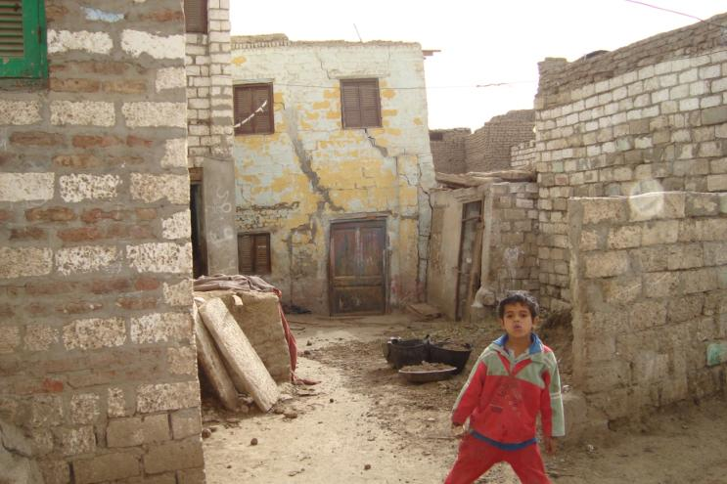
Health Related Housing Improvements
منطقة الاشراف - المنيا
منطقة الجنيدي - المنيا

Slide 20
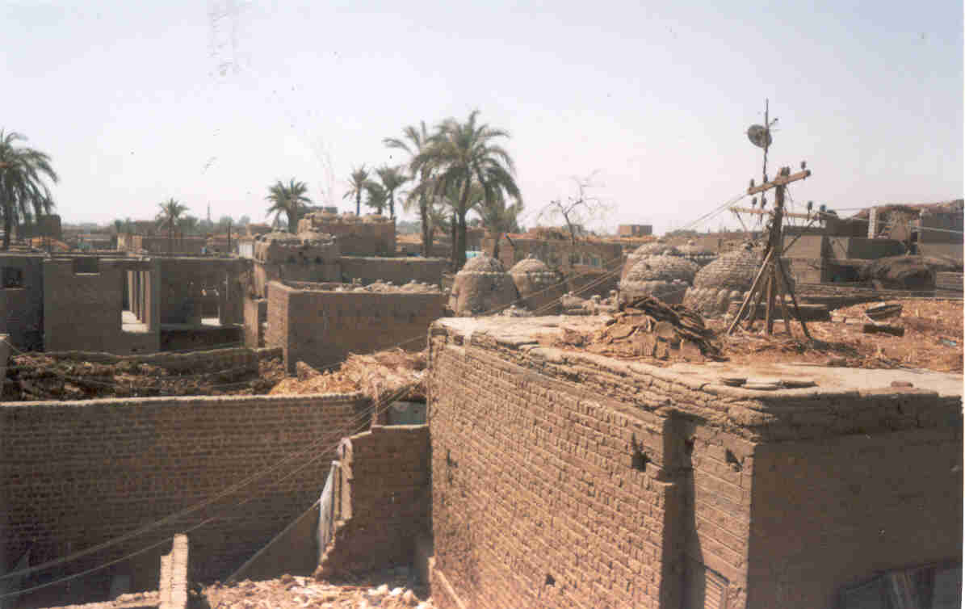
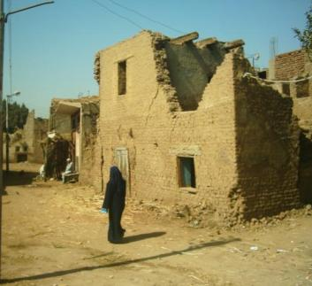

Slide 21
HOME BASED CARE
Care with Love (CWL) was established to fill a gap in providing home based health care. CWL started the first program for training and employing home health care providers to provide needed health care in communities through a system ensuring affordable and accountable health care for those who need and desire it. CWL started in 1996 as a program under an NGO, and then became an independent entity in 2003. It started with expatriate health trainers, and then started selecting and training graduates of the program to be CWL trainers.
Care with love transferred its experience to other NGOs in partnership and not in competition

Slide 22
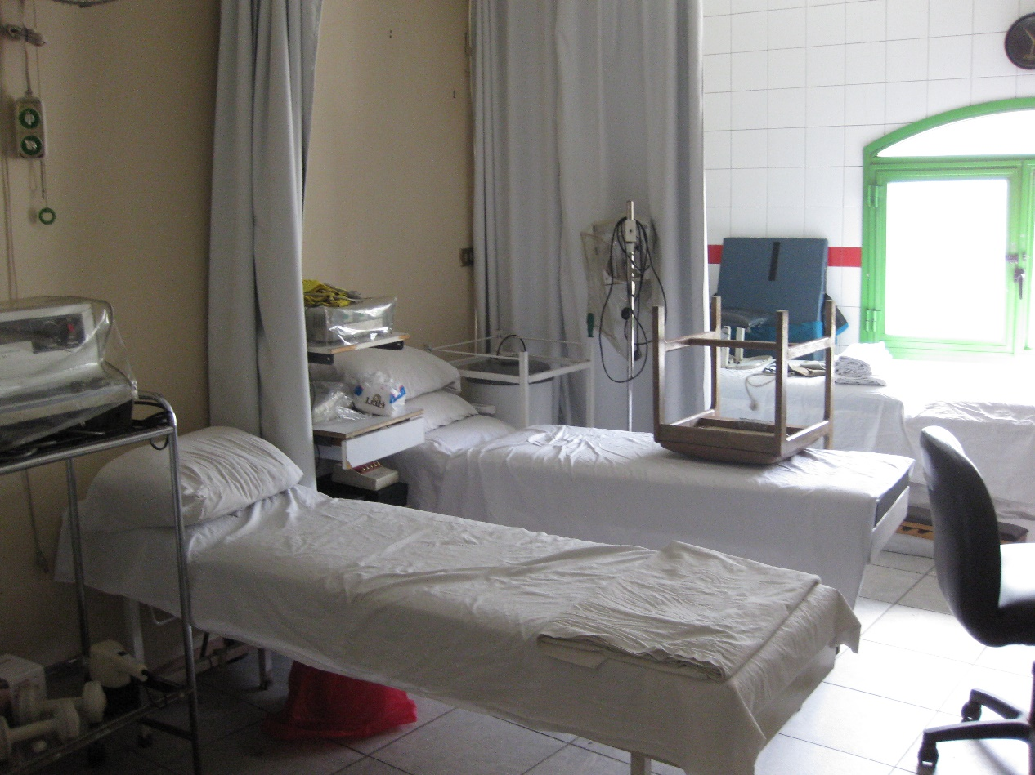
Various levels of Community Based Tertiary Care

Slide 23
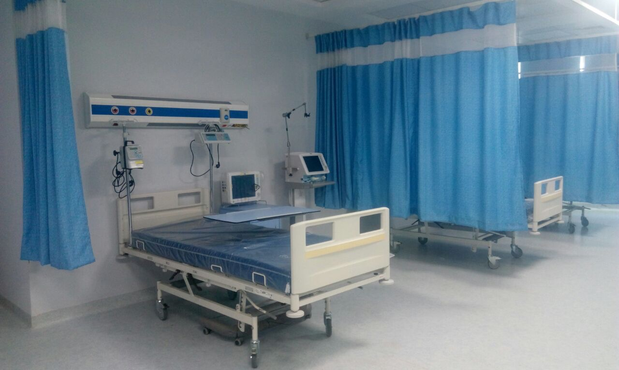
State of the Art Tertiary Care
Raei Misr Hospital in Beni Mazar,

Slide 24
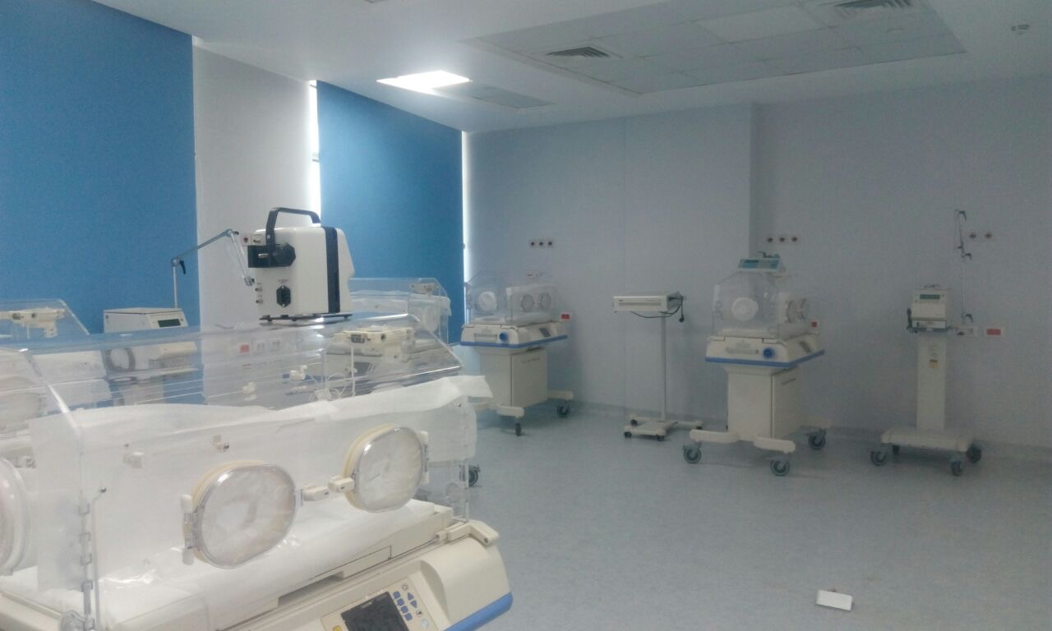

Slide 25
Prospects for PPP with Non Profits
Expand the space available for NGOs to operate: remove barriers to funding, link to medical regulatory authorities, monitor but allow them to maintain some autonomy, recognize their contributions
Recognize the non medical needs which contribute to improved health
Design PPPs for Social Justice and then for universal coverage - the unreached and the unserved constitute a major segment of the population particularly in rural and slum areas

