Slide 1
Private Health Sector:
Challenges and Opportunities
Salman Rawaf MD PhD FRCP FFPH
Professor of Public Health
Director of WHO Collaborating Centre
Department of Primary Care & Public Health
Public-Private Partnership for Universal Health Coverage
MENA HPF, Cairo 12-13 November 2017
s.rawaf@imperial.ac.uk

Slide 2
Overview …..
The main aim of Health System
Three Challenges
P/P General Principles
Partnership vs Collaborations (models)
Good, Bad & Ugly
The solutions
Conclusion Remarks

Slide 3
Public Health / Medicine/ Health systems
Longevity
Life Free of Disease or
Disability
Quality of Life
© Imperial College London WHO CC 20167

Slide 4
Three Changes: Major Influence on Health
Population Growth
Ageing Population
Technological Advances
© Imperial College London WHO CC 20167

Slide 5
General Principles
Private Health Sector is important component of HS
What is PHS?
© Imperial College London WHO CC 20167

Slide 6
‘Private Health Sector Map
Regulators?
Quality Improvements
H Service Providers
Pharma
MedTech
Support
Workforce Supply
Insurance/Commissioners
Consultancy Firms
© Imperial College London WHO CC 20167

Slide 7
‘Private Health Sector Map
Regulators?
Quality Improvements
H Service Providers
(40-50%)
Pharma
(15-35%)
MedTech
(10%+ Rev)
Mainly Capital
Support
(20%+)
Workforce Supply
Insurance/Commissioners
Consultancy Firms
© Imperial College London WHO CC 20167

Slide 8
‘Private Health Sector Map
Therspist
Physioy
Optial
Disability Aids
Wellness Providers
Pharmacy
Dentists
Health Media
H Service Providers
Community Service
Primary Care
Dual Practice
Health Care
Providers
Ambulatory Service
Ambulance Service
Doctor Offices
Hospital Service
Diagnostic Centers
Nursing Home
© Imperial College London WHO CC 20167

Slide 9
General Principles
Private Health Sector is important component of HS
What is PHS?
Partnership Vs Collaboration
© Imperial College London WHO CC 20167

Slide 10
Partnership vs Collaboration
Partnership:
A type of business organization in which two or more individuals pool money, skills, and other resources, and share profit and loss in accordance with terms of the partnership agreement.
Converge Cultures / Governance
http://www.businessdictionary.com/definition/partnership.htmlPartnership
© Imperial College London WHO CC 20167

Slide 11
Partnership vs Collaboration
Collaboration:
A working practice whereby individuals or companies work together to a common purpose to achieve business benefit.
Keep different Cultures / Governance
http://www.businessdictionary.com/definition/partnership.htmlPartnership
Or
© Imperial College London WHO CC 20167

Slide 12
Market Share, Cooperation, Partnership
Public
Private
Sharing the Market Collaborating for Health Partnership for Health
* http://www.bbc.co.uk/news/health-35008921

Slide 13
Market Share, Cooperation, Partnership
Public
Private
Sharing the Market Collaborating for Health Partnership for Health
Operational Agreement Contractual Agreement Joint Investment
Competition Restricted Competition No Competition
No Risk Sharing Limited Risk Sharing Full Risk Sharing
No Social Responsibility Limited Soc Responsibility Full Soc Responsibility
No Tariff Some Tariff (some service) Common Tariff
No Public Good No Public Good Public Good
* http://www.bbc.co.uk/news/health-35008921

Slide 14
Partnership vs Collaboration: Examples in Hospital Service
Capital Development
Management
Service Design & Delivery
Variety of Franchising Rapid Treatment
Models Organisation Centre
© Imperial College London WHO CC 20167

Slide 15
Models in Public Private Partnership in Hospital Provision

Slide 16
General Principles
Private Health Sector is important component of HS
What is PHS?
Partnership Vs Collaboration
Waste of Resources
© Imperial College London WHO CC 20167

Slide 17
The Good, the bad and the ugly
© Imperial College London WHO CC 20167

Slide 18
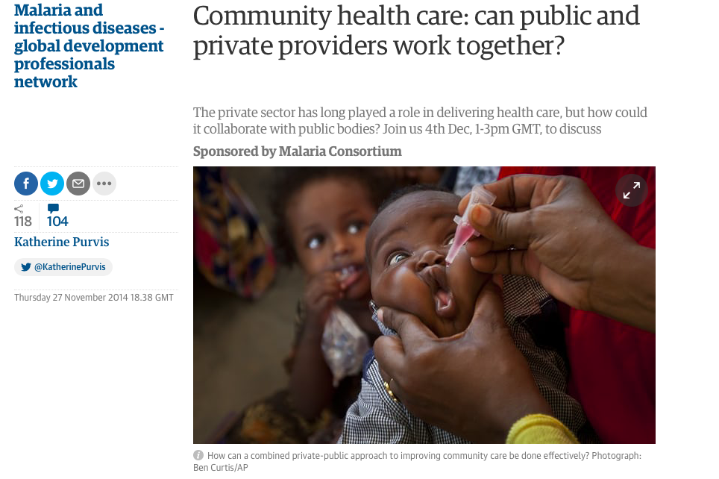
The Good, the bad and the ugly
© Imperial College London WHO CC 20167

Slide 19
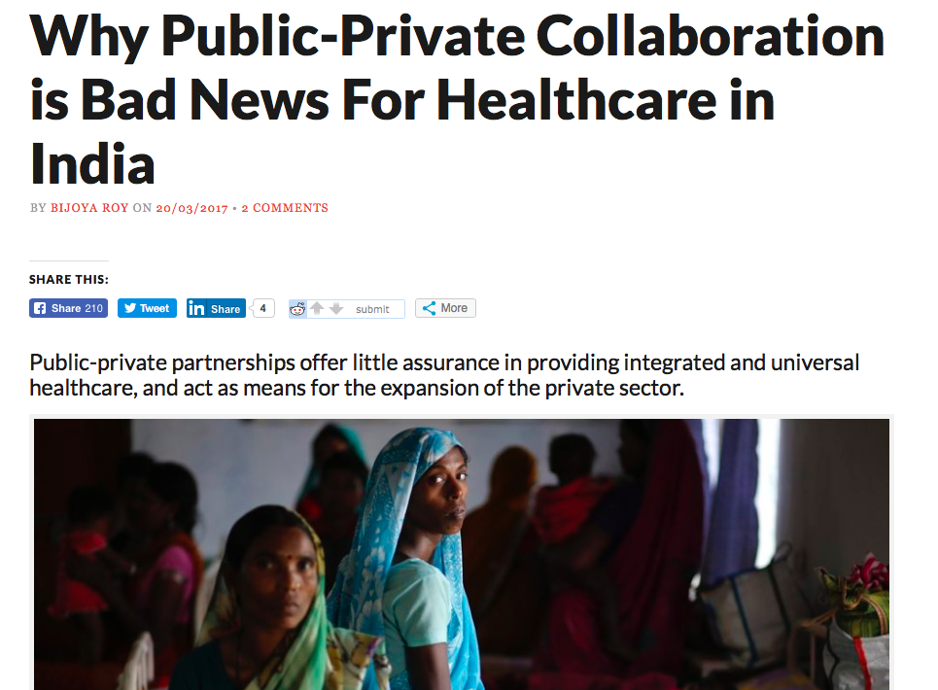
General Principles
© Imperial College London WHO CC 20167

Slide 20
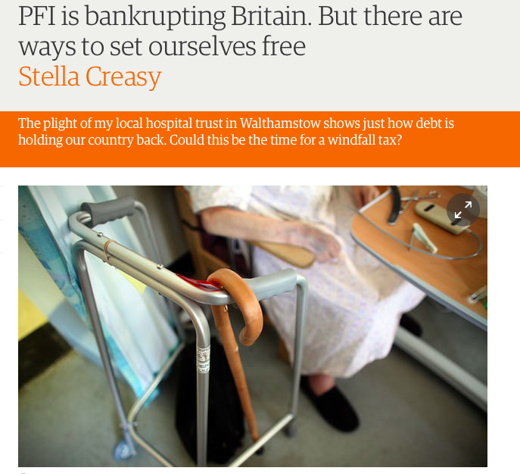

The Good, the bad and the ugly
© Imperial College London WHO CC 20167

Slide 21

© Imperial College London WHO CC 20167

Slide 22
General Principles
Private Health Sector is important component of HS
What is PHS?
Partnership Vs Collaboration
Waste of Resources
© Imperial College London WHO CC 20167

Slide 23
‘The Health Market
2016 2030 20140
7.6 Trillion 8.5 Trillion 9.5 Trillion
© Imperial College London WHO CC 20167

Slide 24
‘The Health Market
2016 2030 20140
7.6 Trillion 8.5 Trillion 9.5 Trillion
7% Public Health/Prevention/Personalised Medicine
30-50% “wasted”
© Imperial College London WHO CC 20167 Global Economic Forum 2017

Slide 25
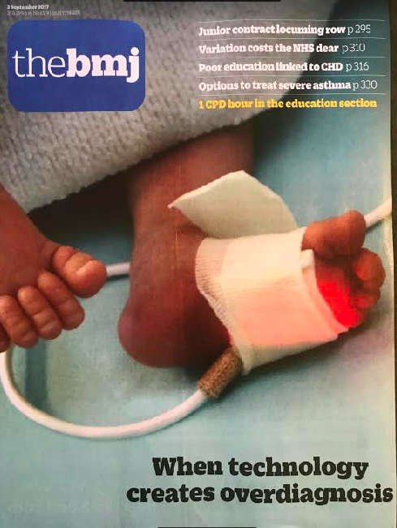

Slide 26
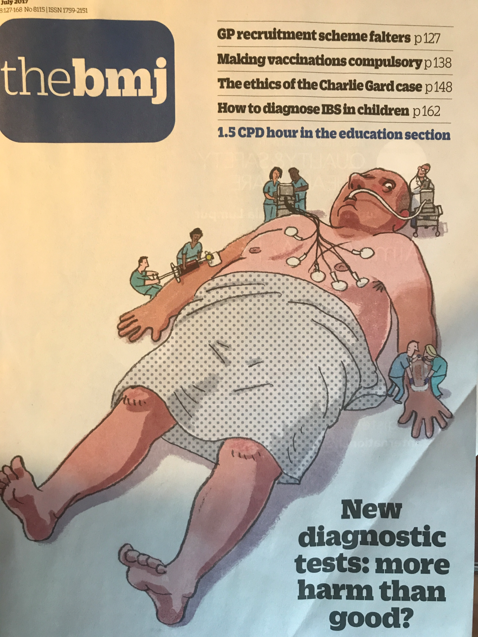
© Imperial College London WHO CC 2017

Slide 27
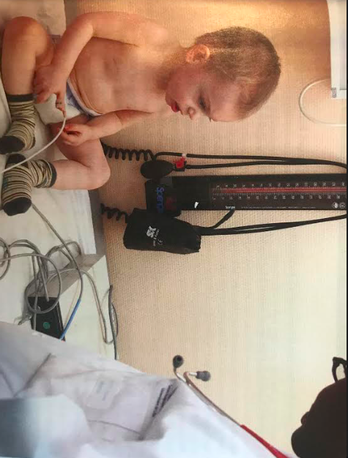
© Imperial College London WHO CC 20167

Slide 28
General Principles
Private Health Sector is important component of HS
What is PHS?
Partnership Vs Collaboration
Waste of Resources
Service needs: Ageing / Technology
Cherry picking
© Imperial College London WHO CC 20167

Slide 29
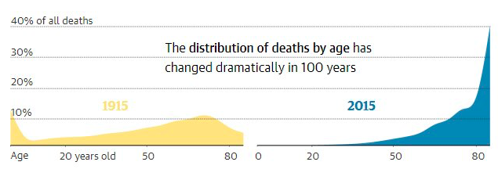
Deaths by age: 1915
? Resources
© Imperial College London WHO CC 2017

Slide 30
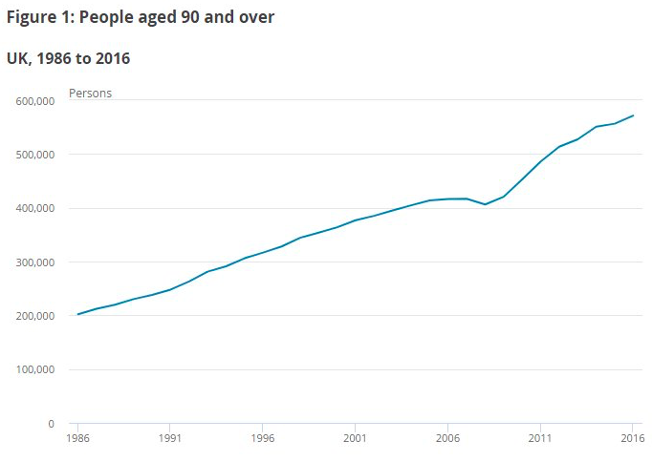
4 Progressive Health Systems
© Imperial College London WHO CC 2016 for MENA HPF Meeting Cairo 12-13 November 2016

Slide 31
Distribution of Health Expenditure US 2013
1%
5%
50%
10%
22%
65%
49%
97%
Source: Commonwealth Fund, Sept 2016

Slide 32
High Needs, High Costs Patients (top 5% consume 50%)
© Imperial College London WHO CC 20167

Slide 33
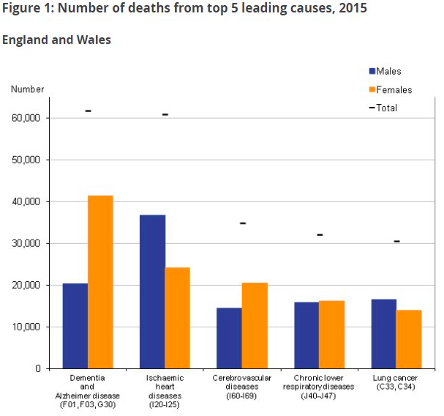
Death from Dementia in the top 5 leading causes, 2015
© Imperial College London WHO CC 2017

Slide 34
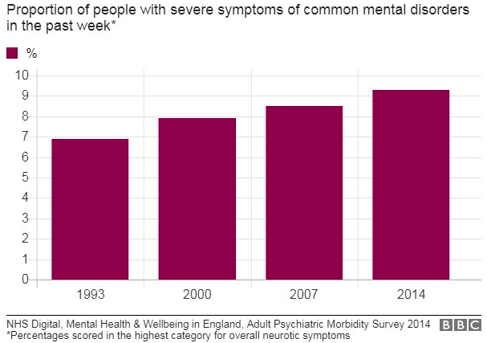
Severe Mental Illness on the rise since 1990: England
© Imperial College London WHO CC 2017

Slide 35
Global Changes in Deaths from 2005-2016 IHME

Slide 36
Global Burden of Disease More NCDs + Emerging Disease
© Imperial College London WHO CC 2017 Sources: IHME 2017

Slide 37
Risks to Health

Slide 38
The Solutions

Slide 39
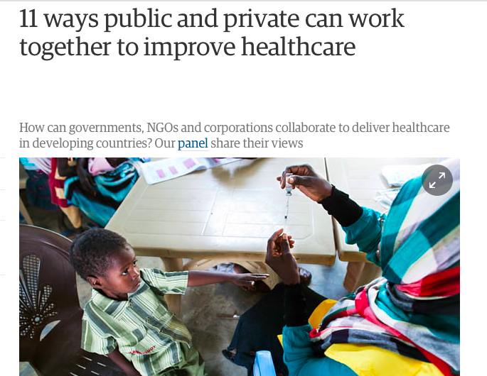
© Imperial College London WHO CC 20167

Slide 40
Policy & Decision Makers
- Sophisticated Commissioners/HAs?/MoH
Tools: ROI, P4R, Risk Sharing, Projections, etc
- Better Costing
- Better Data/ Better Analysis (RWD-RWE)
- Better analysis of generated evidence
- Business Awareness /Business Cases

Slide 41
Pillars for successful P/P ‘Joint Woking” (1)
- National Standards/ Service Framework
- Strict National Regulation (both Public & Private)
- National Priorities for P/P joint working
- Pricing: National Tariff
- National Workforce Standards
Supply, quality, safety (appraisal, revalidation)
- Public / Private Balance (HTP – Turkey)
- Restrict /stop Dual Practice (Turkey/UK)

Slide 42
Resource Allocation: Public & Private Balance
NO “LAISSEZ - FAIRE”
Service volume
Public
care
facilities
84%
Private care facilities
16%
Consider country resources for citizens’ needs
  Keep public-private health care balance
  Don’t allow for dual practice
Ensure regulatory effectiveness
Low &
middle income
High income
Middle income
“ Without adequate public funding
and government stewardship,
health insurance mechanisms pose a threat rather than an opportunity
to the objectives of equity
and universal access to health care.”
Health Insurance
in low-income countries,
Joint NGO Briefing Paper,
May 2008

Slide 43
Resource Allocation: Public & Private Balance
NO “LAISSEZ - FAIRE”
Service volume
Public
care
facilities
84%
Private care facilities
16%
Consider country resources for citizens’ needs
  Keep public-private health care balance
  Don’t allow for dual practice
Ensure regulatory effectiveness
Low &
middle income
High income
Middle income
“ Without adequate public funding
and government stewardship,
health insurance mechanisms pose a threat rather than an opportunity
to the objectives of equity
and universal access to health care.”
Health Insurance
in low-income countries,
Joint NGO Briefing Paper,
May 2008

Slide 44
Citizen Satisfaction
Citizen satisfaction with healthcare
has almost doubled
Share of population satisfied with the healthcare system
2003
2016
39.5%
75.4%
1.9x
Source: TSI Life Satisfaction Survey 2015

Slide 45

Financial Protection
Financial Protection
2002
2015
  Free of charge services for emergency transport and PHC
  No extra charges for services by public hospitals
  No extra charges for emergency, intensive care and some high-cost services, but limited extra charges for other services by private hospitals.
  Minimized co-payments for drugs, orthesis and prosthesis
Share of "out-of-pocket" health spending
Percent
19.8%
17.8%
Catastrophic health expenditure
Numbers of household in ten thousand
81
31
Universal health coverage
Share of population under coverage
65%
99%
Source: Ministry of Health, WHO

Slide 46
Pillars for successful P/P ‘Joint Woking”
- National Standards/ Service Framework
- National Priorities for P/P joint working
- Pricing: National Tariff
- National Workforce Standards
Supply, quality, safety (appraisal, revalidation)
- Restrict/Stop Dual Practice
- Choice vs Necessity

Slide 47
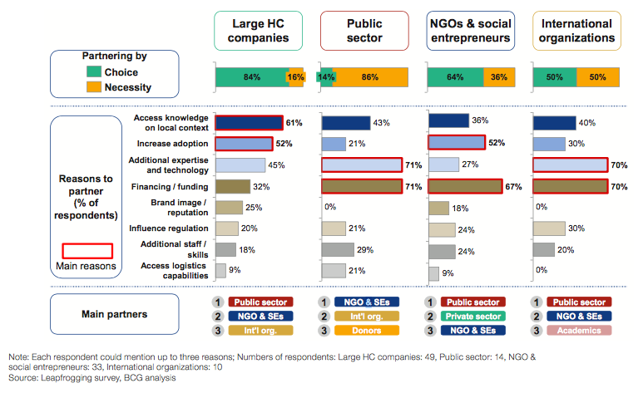
Reasons for Public / Private Engagements

Slide 48
Pillars for successful P/P ‘Joint Woking”
- National Standards/ Service Framework
- National Priorities for P/P joint working
- Pricing: National Tariff
- National Workforce Standards
Supply, quality, safety (appraisal, revalidation)
- Restrict/Stop Dual Practice
- Choice vs Necessity
- Increase Public Funding (Intervention costs)

Slide 49
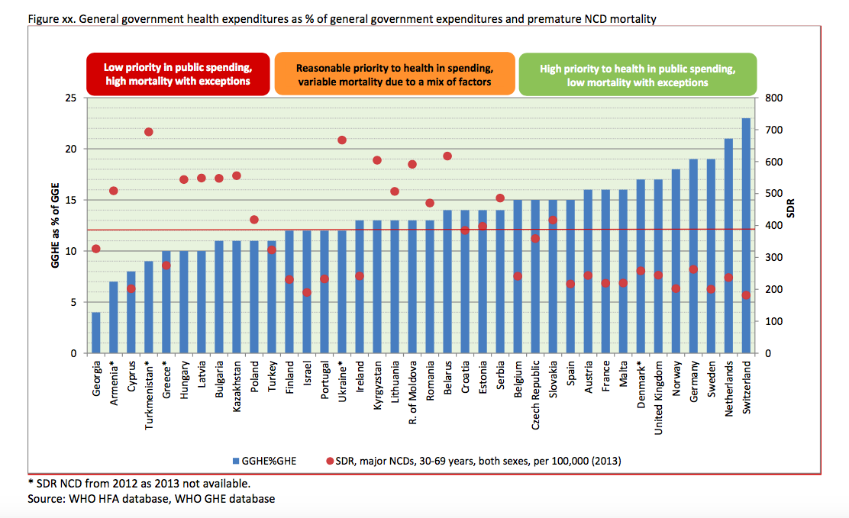
General Government Health Expenditure

Slide 50
Pillars for successful P/P ‘Joint Woking”
- National Standards/ Service Framework
- National Priorities for P/P joint working
- Pricing: National Tariff
- National Workforce Standards
Supply, quality, safety (appraisal, revalidation)
- Restrict/Stop Dual Practice
- Choice vs Necessity
- Increase Public Funding (Intervention costs)
- Leapfrogging system through collaboration (Tech/Expertise/Finance/Management)

Slide 51
In Conclusion
Government takes full responsibility for health (Constitutional / Human rights/ Social Justice/ National Emergencies)
Private Health Sector important contribution
Strong Regulations / Enforcement
Collaboration, No Competition
Culture of Health before Profit
Collaboration to Advance Health system & Maximise Population Benefit (Leapfrogging)

Slide 52

Thank You
Notes:
Olympic London 2012 celebrating the NHS

Slide 53

Brazil: Modern Infrastructure

Slide 54
Brazil: PC Improvement

Slide 55
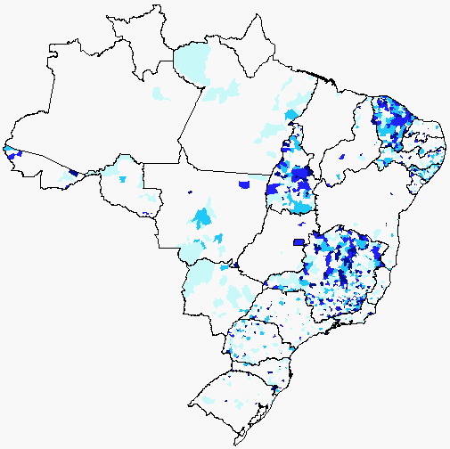
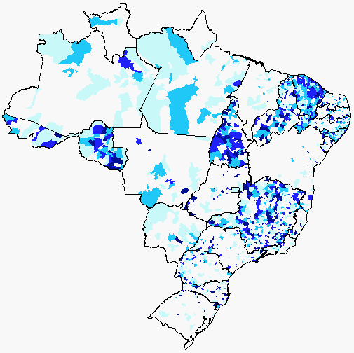
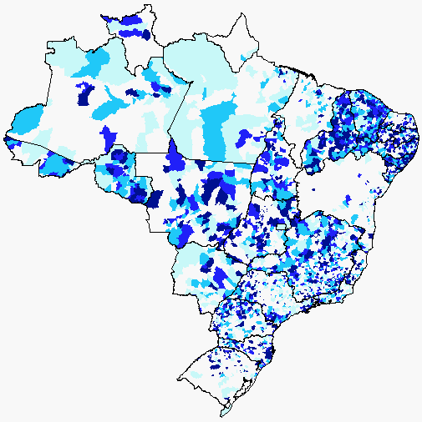
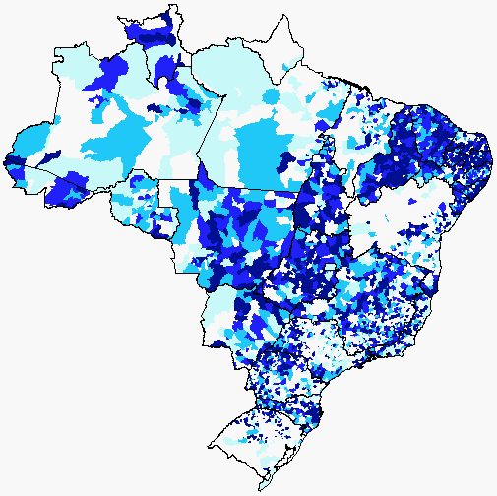
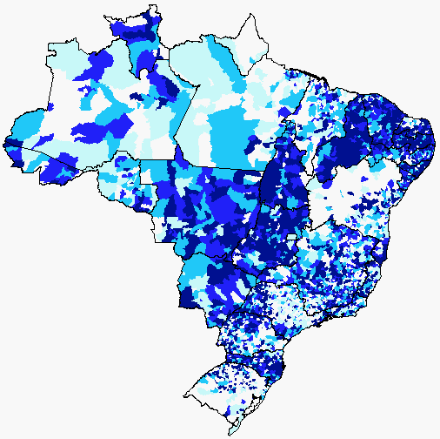
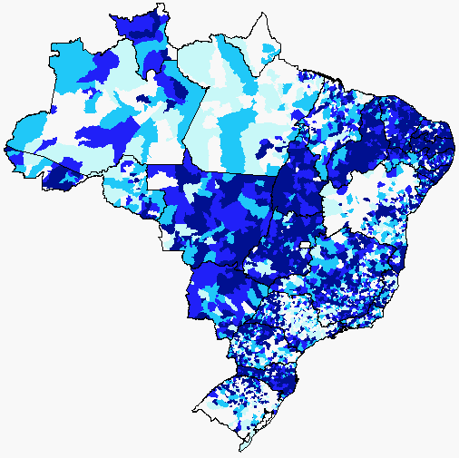
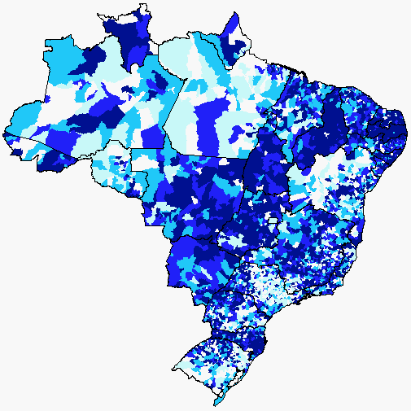
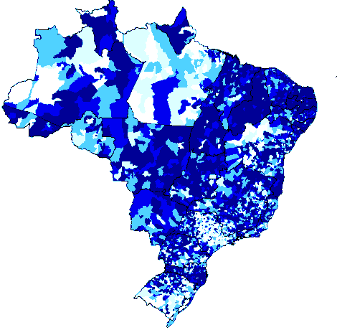
Primary Care in Brazil
1998
1999
2000
2001
2002
0%
0 a 25%
25 a 50%
50 a 75%
75 a 100%

