Slide 1
Private health sector regulations IN Low AND Middle income countries of THE EASTERN MEDITERRANEAN
Public – Private Partnership for Universal Health Coverage
November 12-13, 2017
Sherine Shawky, MD, DrPH
Social Research Center
The American University in Cairo

Slide 2
PRESENTATION OUTLINE
Background
Private health sector regulatory system
Perception of overall regulatory effectiveness
Key Messages

Slide 3
BACKGROUND
Expansion of the private health sector in EMR countries, with decreasing government relative share in total health expenditure and increasing public demand on private healthcare providers
Regulation is one major pillar for governments to harness the private health sector
Knowledge gap in private health sector regulations and regulatory system

Slide 4
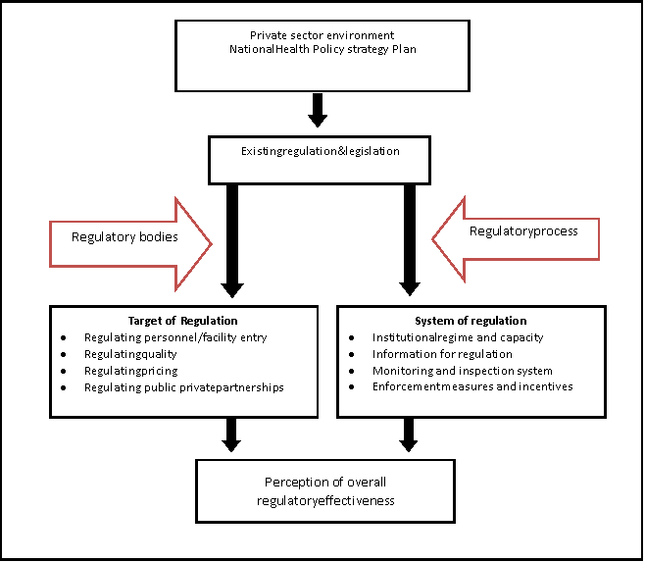
THREE COUNTRY SURVEY: EGYPT, LEBANON AND YEMEN
Does the existing regulatory system provide a promoting environment for Public Private Partnerships?
Goal
  Assist in engaging the private health sector in moving towards universal health coverage in EMR countries
Objectives
  Understand the private health sector complexity
  Recognize the private health sector regulations and regulatory system
  Assess the effectiveness of the private health sector regulatory system as perceived by the various stakeholders
Method
  Desk review
  Key informants in-depth interviews (policy makers, regulators, healthcare managers/professionals)
  Focus group discussions (service beneficiaries)

Slide 5
PRIVATE HEALTH SECTOR
Economic
  For-profit: sole owners, partnerships, companies, private academia
  Not for-profit: mosques, churches, NGOs, civil society
Therapeutic
  Formal
    Individuals, institutions
  Semi-formal:
    Medical doctors providing alternative/modern medicine: Chinese acupuncture, Oxygen therapy, Ozone therapy
    Other healthcare professionals: pharmacists, nurses, technician
  Informal sector
    Informal traditional healers: dayas, barbers, as well as herbal, Quran, spiritual and hegama therapists

Slide 6
REGULATORY BODIES FOR THE PRIVATE HEALTH SECTOR
The President
Prime Minister
The Parliament
Advisor Council
Ministry of Finance
Ministries of Planning
Ministry of Higher Education
Ministry of Agriculture
Ministry of
Justice
Ministry of
Foreign Affairs
Ministries of Labour
Ministry of Environment
Ministry of
Interior
Ministry of Trade
Ministry of Investment
For-profit Profit Health Sector
Professional Synd.
Independent Medical Council
Other civil society entities
Ministry
of Health
Ministries of Administration
Ministry of Social Affairs
Not-for-profit Health Sector
Semi-formal Health Sector
Informal Health Sector

Slide 7
EXISTING LEGISLATIONS/REGULATIONS GOVERNING THE PRIVATE HEALTH SECTOR
Constitution
  Values health
Laws
  Mostly recent horizontal laws: market entry and administration arrangements for private sector employees/institutions
  Mixture of old and recent vertical laws: healthcare professionals, private healthcare facilities, professional syndicates, services, pharmaceuticals
Mixture of huge package of old and recent resolutions
MOH resolutions to enact vertical laws, organize and manage health sector
Other Ministries resolutions to enact horizontal laws, organize and manage private sector
National health policy
Universal health coverage, private sector expansion, public-private partnership, commercialized care

Slide 8
TARGET OF THE PRIVATE HEALTH SECTOR REGULATIONS
Healthcare professionals
    Physicians, dentists, nurses
    Biochemistry, bacteriology and pathology specialist
    Physiotherapists and medical massage
    Midwives, assistant midwives, psychologists, dental makers, opticians
    Pharmacists, assistant pharmacists, medicine brokers
  Professional acts ( FGC, …..)
Healthcare facilities
  Clinics: Private medical clinic, specialized clinic,
  Specialized Medical Center (laboratories, X-ray centers, ….
  Private hospital: inpatient, outpatient
  Specialized units (renal dialysis, cardiac cauterization, operation theater)
  Pharmacies
  Convalescence homes, health clubs, optician shops,
Pharmaceuticals and other products (beyond the scope of the study)
  Drugs, cosmetics
  Medical equipment and supplies
  Food, food products and milk formula
  Drug factories, drug stores, advertisement agencies, brokers office, importing/exporting agency

Slide 9
REGULTORY FRAMEWORK FOR THE PRIVATE HEALTH SECTOR
 | Facilities | Healthcare Practitioners
Market entry | Registration, licensing Relicensing (one country) | Registration, licensing Relicensing, work permit (one country)
Quality/safety | Non-mandatory accreditation | Code of ethics Certification
Quantity/distribution | None | None
Pricing | Approval of facility proposed fee schedule Reference non-obligatory fee schedule | Non-mandatory fee schedule No salary scale
Public-private partnership | Contracting | Contracting
Private-private partnership | None | None

Slide 10
PRIVATE HEALTH SECTOR REGULATORY ENFORCEMENT
Method:
  Control-based
Target:
  Target the formal providers
Tools
  MOH inspection on technical aspects and structural measures
  Ministry of administration for administrative aspects
  Other Ministries for horizontal measures
  Formal/informal beneficiaries complaints
Actions
  Penalties

Slide 11
PERCEPTION TOWARDS THE REGULATORY EFFECTIVENESS
Policy Makers and Regulators
Promoting environment, organized market entry and better quality than public sector
Weak organization, limited resources and insufficient incentives, conflicting laws and fragmented resolutions and uncontrolled semi-formal and informal providers
Inspection is challenged by insecurity and disrespect
Monitoring is challenged by absent or incomplete information/databases
Outdated non-standard and non-realistic fee schedule
Public-private partnership opens door for manifold practice and patient drain to private sector

Slide 12
PERCEPTION TOWARDS THE REGULATORY EFFECTIVENESS
Healthcare Mangers and Practitioners
Bureaucratic environment with informal influences
Irrelevant conflicting regulations
Work overload and patient violence
Irregular ineffective inspection with informal payment
Outdated non-standard fee schedule, no salary scale
Low salaries, irregular payments with public employer and no contracting arrangements with private employer

Slide 13
PERCEPTION TOWARDS THE REGULATORY EFFECTIVENESS
Healthcare Beneficiaries
Money making business
No regulations and if exists are not enforced
No inspection, weak complaint system
Loose for unqualified individuals and poor quality institutions
Manifold practice, crowdedness and long waiting time, lack of services
Expensive and unaffordable
Public sector lacks resources and private sector has informal arrangement for money making

Slide 14
KEY MESSAGES
The private health sector is very complex, multifaceted and intermixed and regulating it to allow for PPPs is not an easy mission
The private health sector is mainly governed by the Ministry of Health, yet other ministries are still involved in the regulatory system and they need to be considered in PPPs
The regulations suffer from conflict between old and recent laws and mixture of huge fragmented old and recent ministerial resolutions while public private contracting requires a set of harmonized regulations to the define the relation between the public and private health sectors as well as the relation within the private health sector
The regulatory instruments focus on market entry and the regulatory framework is full of gaps and pitfalls that hinders progress on PPPs
The irrelevant enforcement system and the lack of information on the private sector performance and impact are true obstacles to ensure effectiveness, efficiency and sustainability
The voice of all sectors of the population provides a comprehensive picture for the regulatory reform

Slide 15
THANK YOU

